Slide 1
Biotechnology

Slide 2
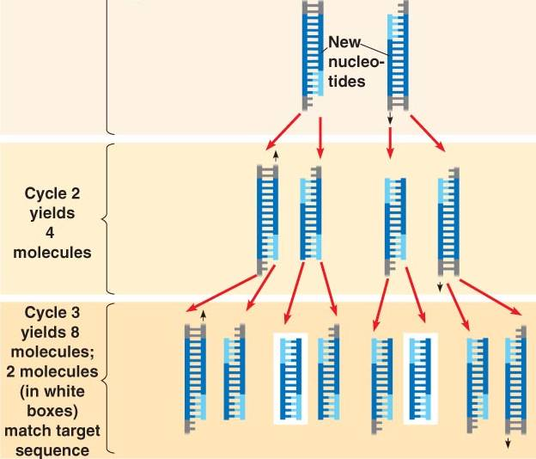
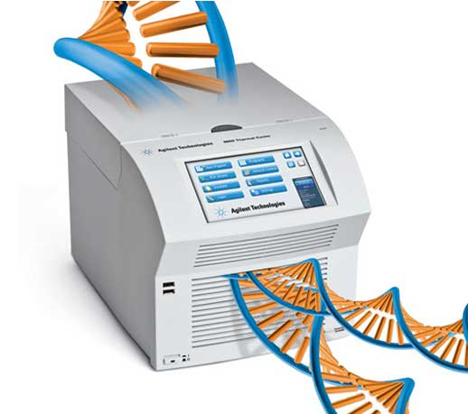
Polymerase Chain Reaction PCR
Why is it important to make more than one copy of a DNA sample?
Needed: Thermal cycler, primers, free DNA nucleotides and DNA polymerase
Heating → denature
Primers added
DNA Polymerase
Repeat
Notes:
genomics.agilent.comgenomics.agilent.com, bio1151.nicerweb.com

Slide 3
DNA Profiling
Comparing sections of DNA between individuals in order to determine relationships
How are DNA profiles (or fingerprints) made?
PCR is used for all samples
Restriction endonucleases (enzymes) added
Fluorescent marker added
Samples added to chamber
Electric current passed through chamber
Fragments sorted by size

Slide 10
Gene Transfer
DNA Isolated
Donor
Host
Restriction enzymes
Insertion
Ligase
DNA incorporated into host
Host produces protein

Slide 11
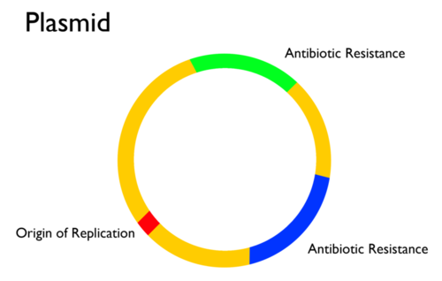
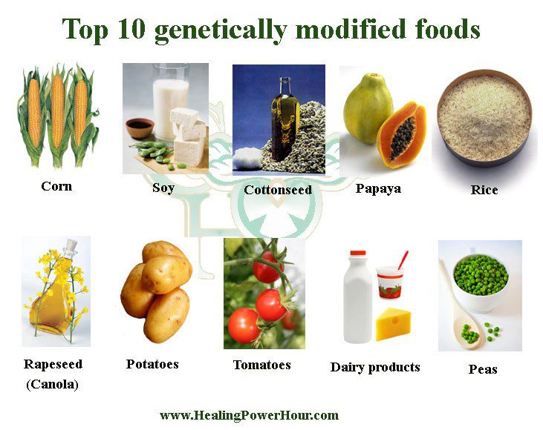
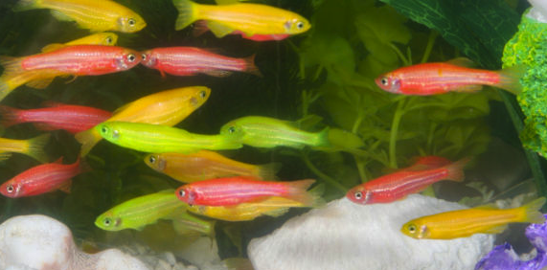
Gene Transfer
Transgenic organism
GMO
Recombinant DNA

Slide 12
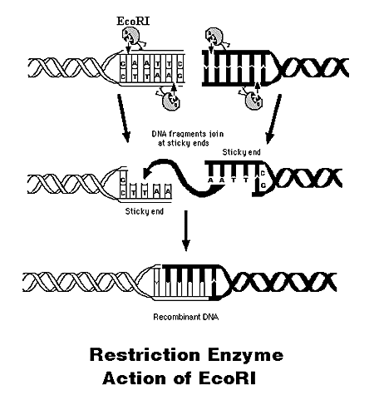
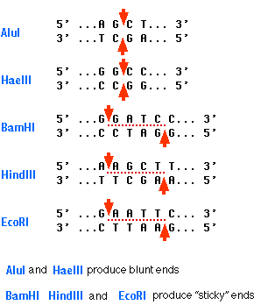
Restriction enzymes

Slide 13
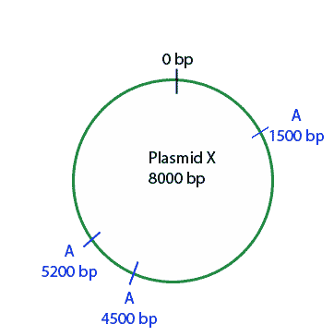
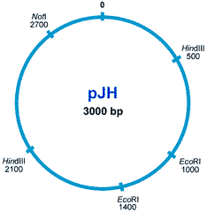
Restriction Enzymes

Slide 14
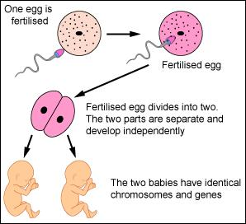
Cloning
Some organisms produce clones naturally
Self pollinating plants
Bacteria
Organisms that produce asexually

Slide 15
Cloning
Two types of artificial cloning:
Reproductive cloning
Therapeutic cloning

Slide 16
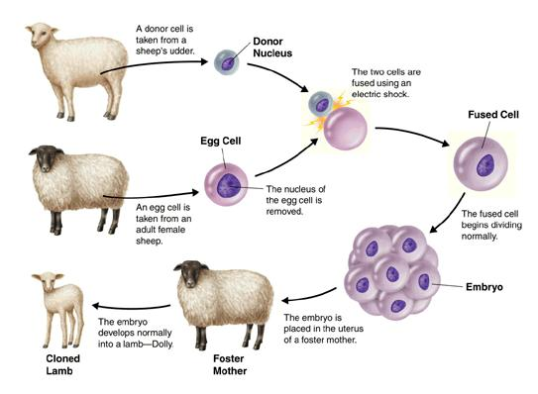
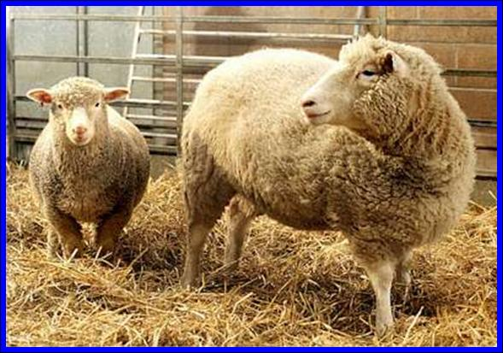
Reproductive cloning
Use of SCNT (somatic cell nuclear transfer)
Allows a whole organism to be reproduced

Slide 17
Therapeutic cloning
A cloned embryo is used just for stem cells
Still uses SCNT
The egg cell undifferentiates the adult nucleus resulting in an embryonic type cell
Patients can receive their own tissues as transplants to solve the problem is rejection
Treatment of diseases (diabetes, heart disease, Parkinson’s)

