Slide 1
Option C
Advanced Ecology

Slide 2
Species and communities
C.1

Slide 3
Limiting Factors
A limiting factor is the factor that is most scarce in relation to an organisms needs
Plant examples: soil salinity, water availability, pH, light intensity
Animal examples: Breeding sites, water availability, food supply and territory
The distribution of species is affected by limiting factors

Slide 4
Limiting Factors

Slide 5
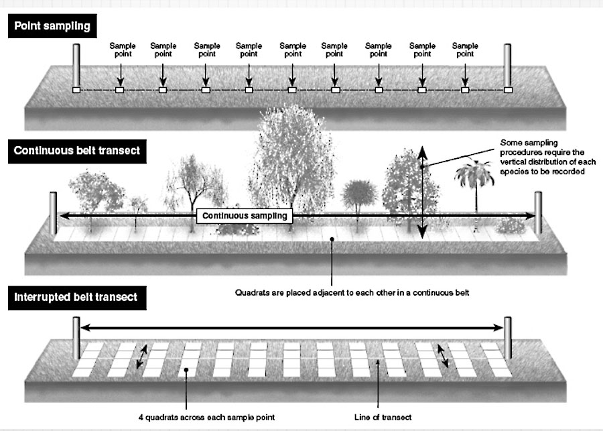
Transects
Correlates distribution of plant and animal species with an abiotic variable

Slide 6
Niche
The role a species plays
Spatial habitat and interactions with other species
Examples?
Different from habitat alone

Slide 7
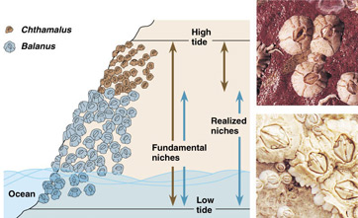
Niche
Fundamental vs realized

Slide 8
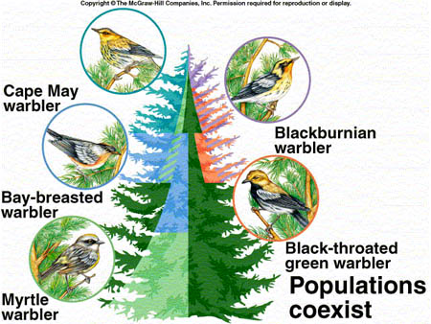
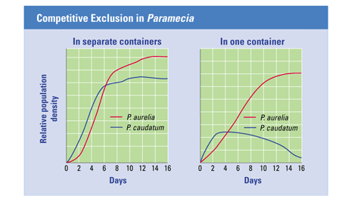
Competitive Exclusion
Two species cannot survive indefinitely in the same habitat if their niches are identical

Slide 9
Interspecific Interactions
Competition
Herbivory
Predation
Parasitism
Mutualism
Commensalism

Slide 10
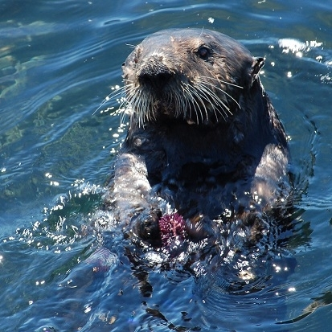
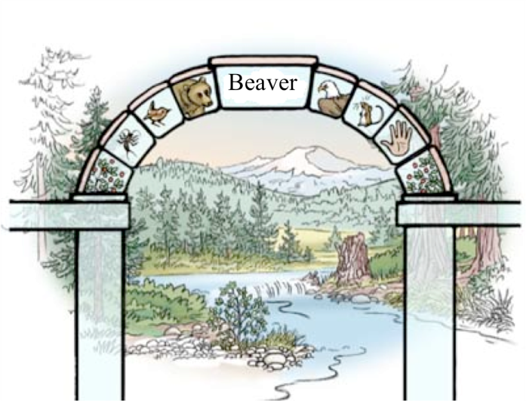
Keystone Species
A Keystone species has a disproportionate effect on the structure of an ecological community.
Many consequences result from the removal of a keystone species

Slide 11
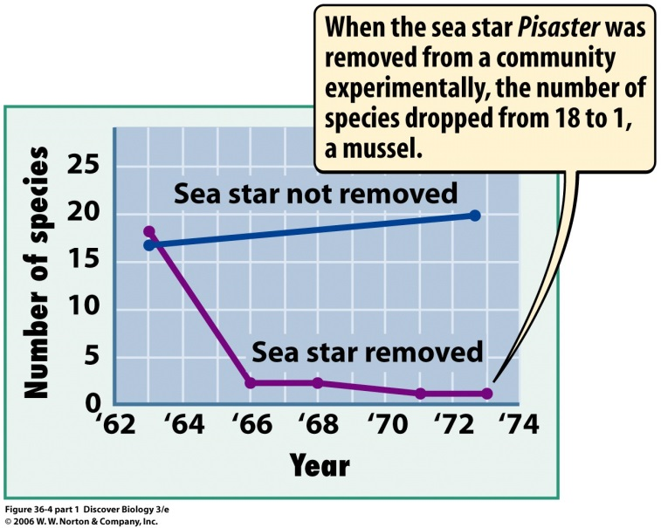
Keystone Species
Sea Star
Competition for new resources and space
Predator that keeps pray species in check
A barnacle species became dominant that wiped out the algae population
Species emigrated due to lack of food
Reduction in biodiversity

