Slide 1
Advanced Ecology
Option C

Slide 2
Conservation of Biodiversity
C.4

Slide 3
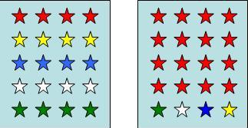
Biodiversity
The variety of living things in an area
Composed of richness and evenness
Richness = amount of different species
Evenness = How close in numbers each species is

Slide 4
Simpson’s Diversity Index
Measurement of biodiversity
Takes into account richness and evenness
Simpson’s reciprocal index:

Slide 5
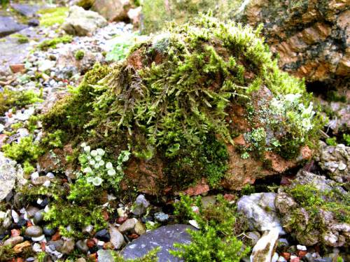
Indicator Species
Indicator species only occur when specific environmental conditions are present
Can indicate whether and ecosystem is healthy or not
Sensitive to sulfur dioxide

Slide 6
Biotic Index
Compares the frequency of an indicator species
# of organism x pollution tolerance
Add them together and divide by total organisms

Slide 7
Types of Conservation
In situ – keep the endangered species in natural habitat
Ex situ – remove endangered species from habitat

Slide 8
In situ conservation
Nature reserve with active management
Controlled grazing
Removal of vegetation
Limiting predators
Feeding animals

Slide 9
Ex situ
Botanic gardens
Captive breeding
Sometimes released later

Slide 10
Geography and Diversity
Location and size of nature reserves can impact their success
Large vs small reserves
Connected nature vs isolated reserves
Edge effect

