Slide 1
Advanced Ecology
Option C

Slide 2
The nitrogen and phosphorus cycles
C.6

Slide 3
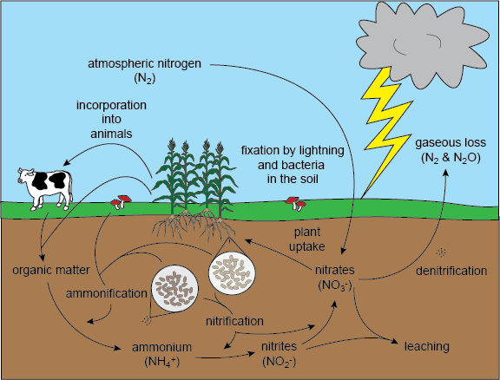
The nitrogen cycle

Slide 4
Nitrogen Fixation
78% of atmosphere is N2
Plants are unable to take this up
Nitrogen fixing bacteria convert N2 to ammonia (NH3)
Some bacteria can convert ammonia into nitrates

Slide 5
Nitrogen Fixation
A specific genus of bacteria, Rhizobium, lives symbiotically (mutualism) with the roots of plants
Capable of nitrogen fixation for the plants
Bacteria get nutrients in return

Slide 6
Dentrification
The bacteria Nitrosomonas converts ammonia into nitrite (NO2)
Chemoautotrophs – conversion produces energy which is used to fix CO2 into carbon moleciles
Nitrites → nitrates by Nitrobacter
Chemoautotrophs
Usable form of nitrogen

Slide 7
Denitrification
Reduction of nitrate to N2
Denitrifying bacteria can use oxygen as an electron acceptor but use nitrate when oxygen is not available
This releases N2
Reduction in bioavailability of nitrogen

Slide 8
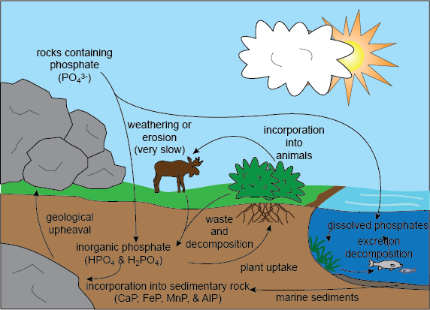
Phosphorus Cycle

Slide 9
The Phosphorus Cycle
Important for many molecules (ATP, DNA) and cell membranes
Weathering and erosion of Phosphorite (sedimentary rock) releases phosphorus into the soil
Phosphorus is taken up by plants
Large stocks in marine sediment and mineral deposits

Slide 10
The phosphorus cycle
The turnover rate is much slower than the nitrogen cycle
Amount of phosphorus released from one stock to another per unit time

Slide 11
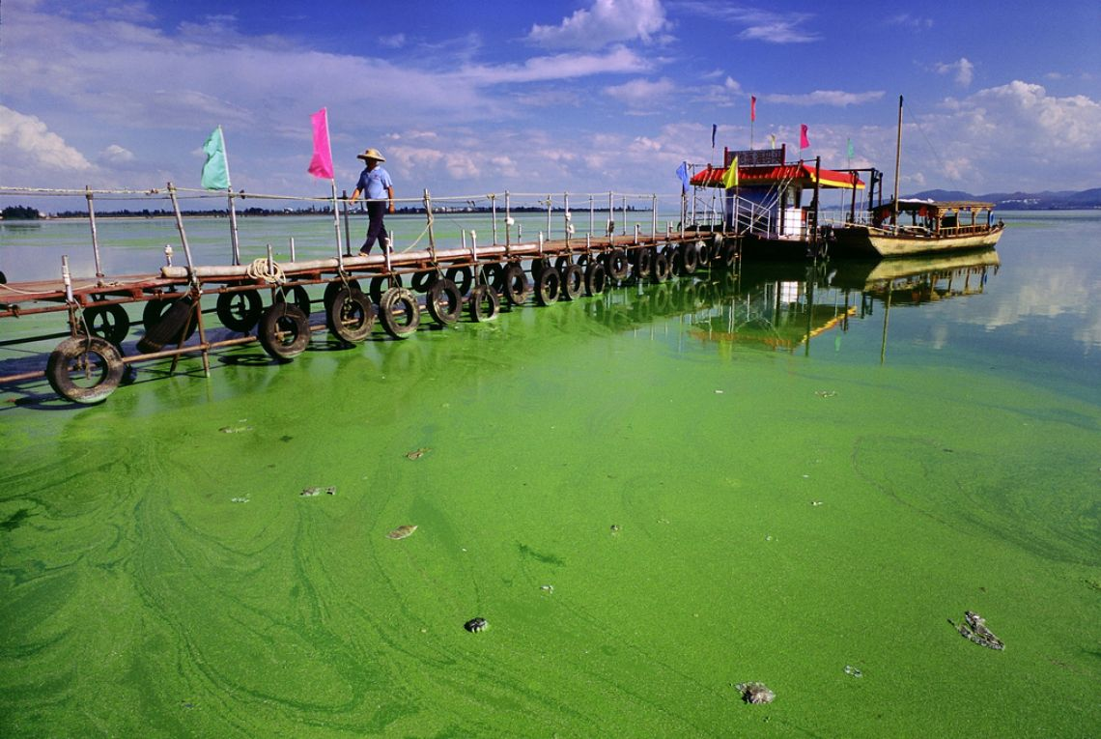
Agriculture
Phosphate is mined for conversion to phosphate-based fertilizer
Use of phosphate-based fertilizers can lead to runoff
eutrophication

Slide 12
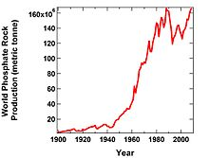
Peak Phosphorus
There is a limited supply of phosphorus to mine
Peak phosphorus – when maximum global phosphate production rate is reached and then begins to fall because of depletion of reserves
Could result in famine
No alternative sources

Slide 13
Eutrophication
Nutrient enrichment of water
Algal blooms
Lack of light
Lack of oxygen
Algae and plants die
Limiting to organisms such as fish

