Slide 1
Cell Division

Slide 2
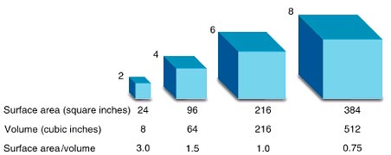
Cell Division
Do our cells grow?
Why do our cells not grow forever?
What happens when our cells get too big?
Surface area vs. volume

Slide 3
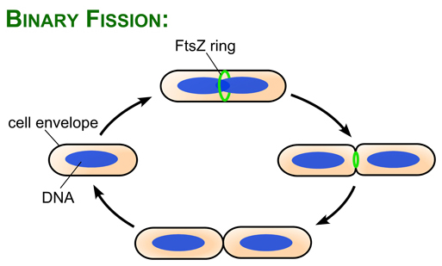
Binary Fission
Bacteria cell
Growth and division

Slide 4
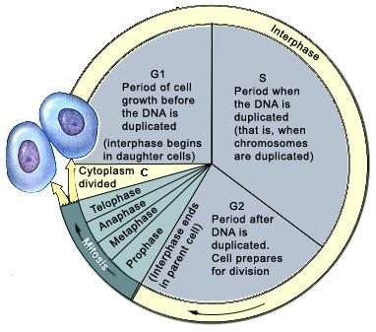
Cell Division
Cell cycle

Slide 5
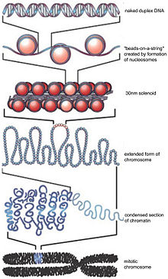
Cell Division
Remember how DNA is supercoiled into chromosomes

Slide 6
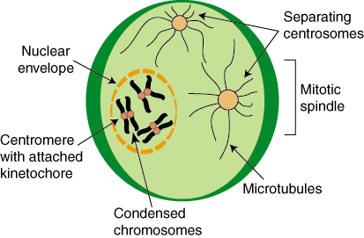
Cell Division
Prophase

Slide 7
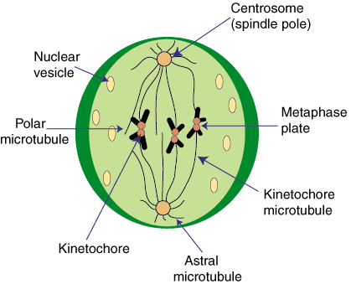
Cell Division
Metaphase

Slide 8
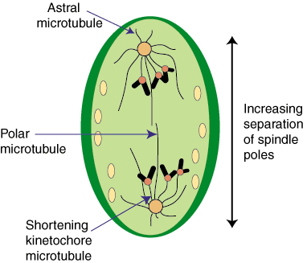
Cell Division
Anaphase

Slide 9
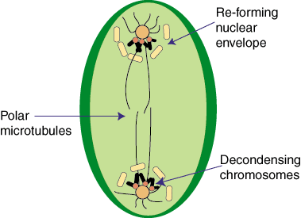
Cell Division
Telophase

Slide 10
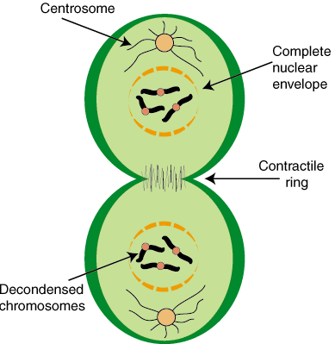
Cell Division
Cytokinesis

Slide 11
Cell Division
Result = two identical cells
Purpose = growth, tissue repair, asexual reproduction

