Slide 1
CeLL membrane and transport

Slide 2
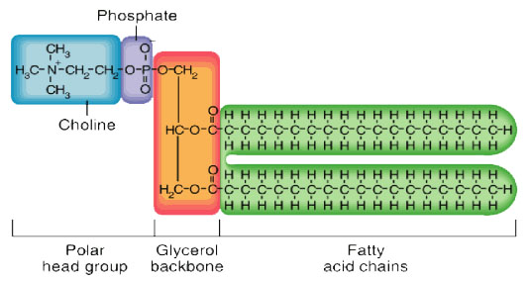
Cell Membrane
Phospholipid bilayer
Why lipids?

Slide 3
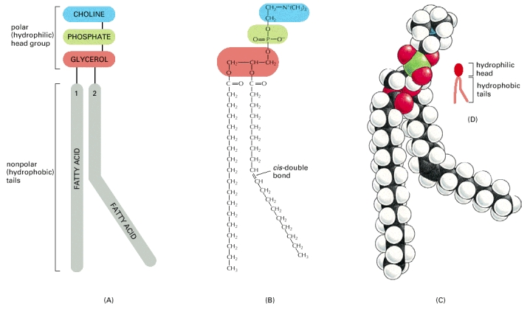
Cell Membrane
Amphipathic

Slide 4
Cell Membrane

Slide 5
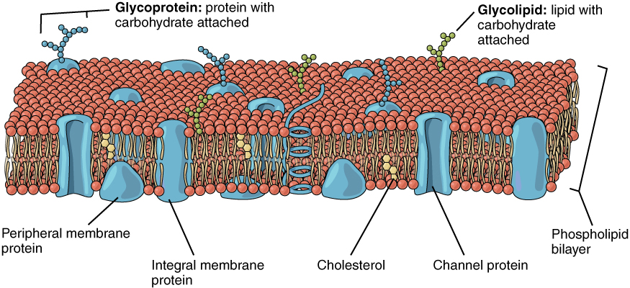
Cell Membrane
The membrane has other components

Slide 6
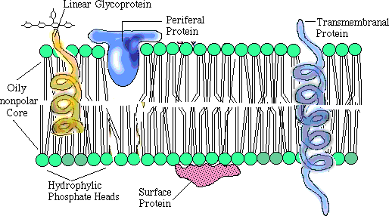
Cell Membrane
Fluid mosaic model
Mosaic = all of the components
Fluid = components can move

Slide 7
Cell Membrane
In order for things to enter or leave the cell they must pass through the plasma membrane
Diffusion
Osmosis
Active transport

Slide 8
Diffusion
With the concentration gradient
No energy
High concentration = source
Low concentration = sink

Slide 9
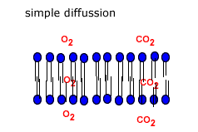
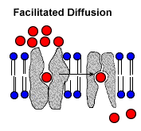
Diffusion
Simple diffusion
Facilitated diffusion

Slide 10
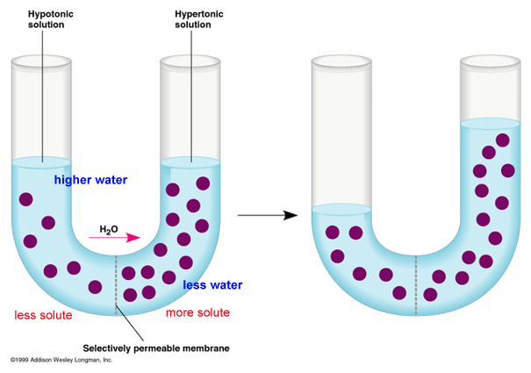
Osmosis
Semi-permeable membrane
With the concentration gradient

Slide 11
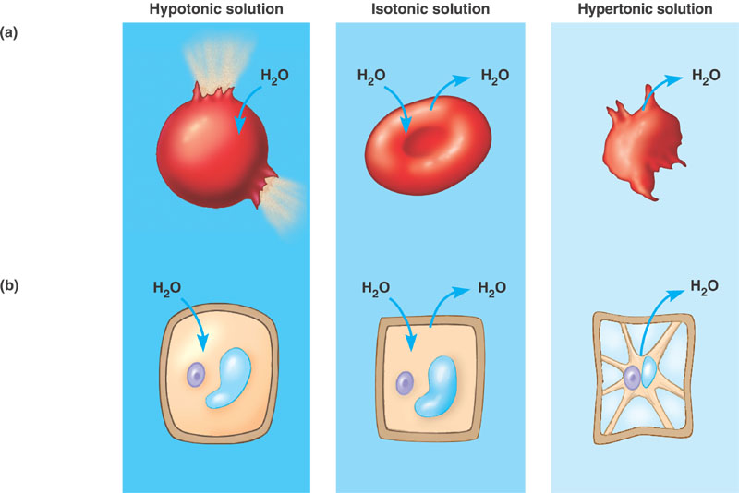
Osmosis
Tonicity of water
Cytolysis and plasmolysis

Slide 12
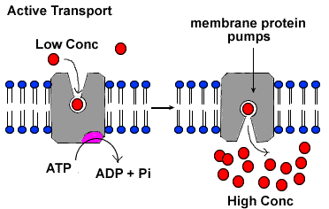
Active Transport
Against concentration gradient
Energy (ATP)

Slide 13
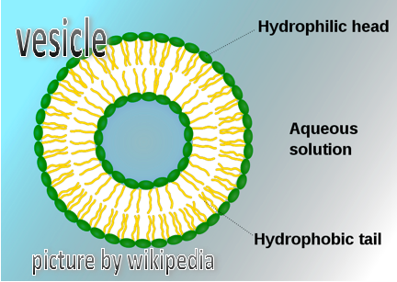
Active Transport
Endocytosis or exocytosis
Membrane fluidity
Continuity of the plasma membrane

Slide 14
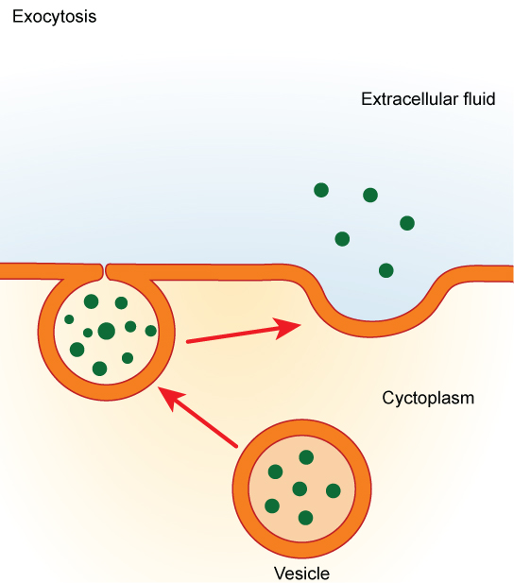
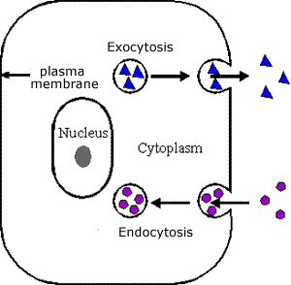
Watch the animation

Slide 15
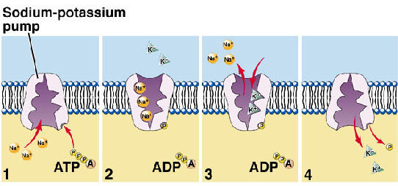
Active Transport
Example = sodium potassium pump
Nervous system

