Slide 1
Topic 2
Cells

Slide 2
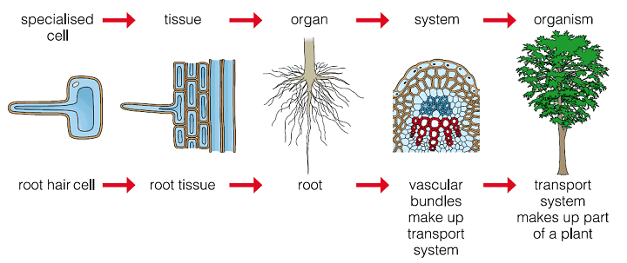
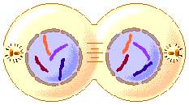
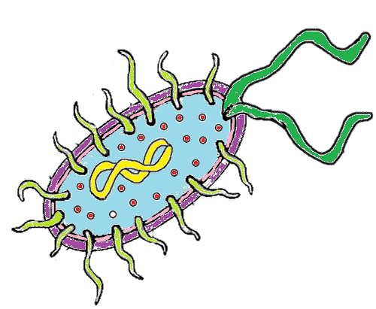
2.1 Cell Theory

Slide 3
2.1 Cell Theory
If cells only come from pre-existing cells how did the first cell form?

Slide 4
Cell Theory

Slide 5
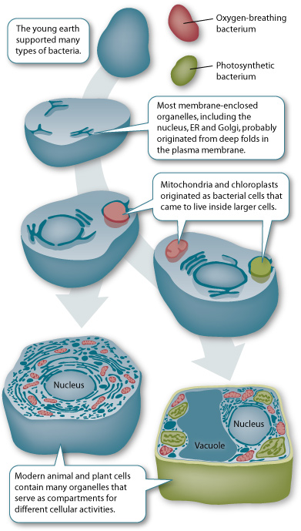
Cell Theory
Endosymbiotic Theory

Slide 6
2.1 Cell Theory
Cells come in different shapes and sizes
These are in order from biggest to smallest
Organelles
Bacteria
Viruses
Membranes
Molecules

Slide 7
Cell Theory
All cells have these things in common:

Slide 8
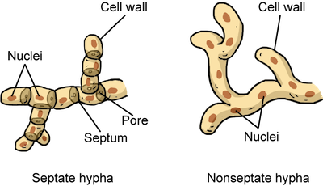
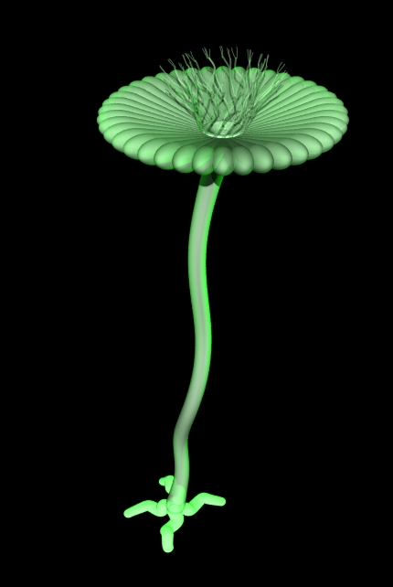
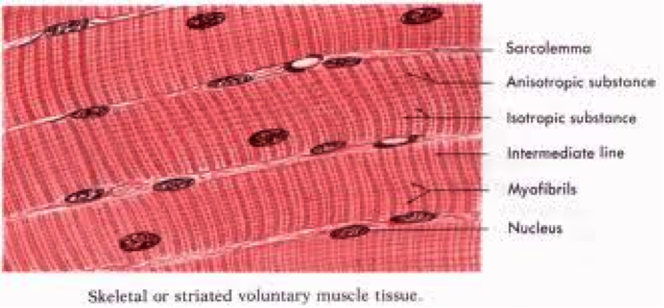
Cell Theory
Exceptions to cell theory
Striated muscle fibers
Fungal hyphae
Algae

Slide 9
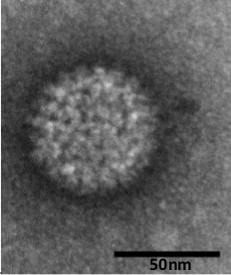
2.1 Cell Theory
How to measure the actual size of a cells
Magnification = size of image/size of specimen

Slide 10
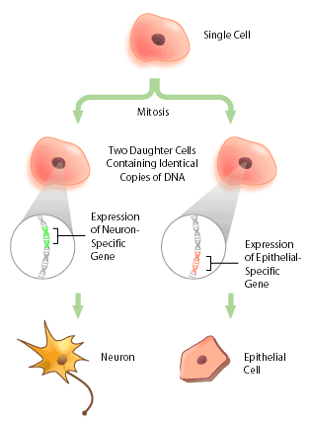
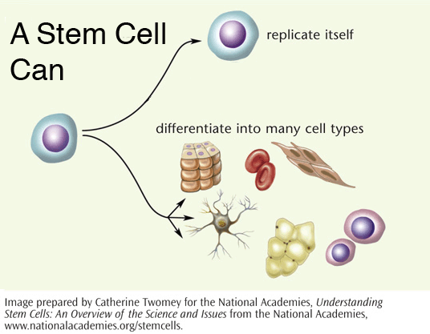
2.1 Cell Theory
Stem Cells
Differentiation

Slide 11
Stem Cells
Sources
Bone marrow
Umbilical cord
Embryos
Plasticity
Multipotent
Pluripotent
Totipotent

Slide 12
Types of Cells and Cell Structure

Slide 13
Complete the assignment on organelles found in prokaryotes and eukaryotes

Slide 14
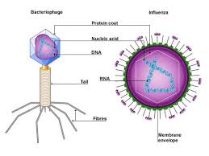
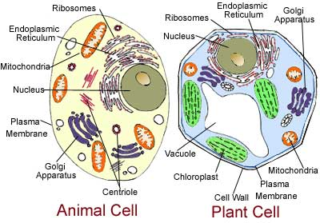
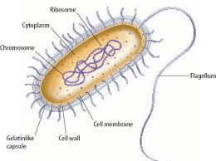
What do all cells have in common?
4 things

Slide 15
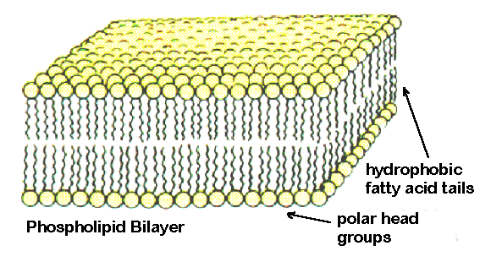
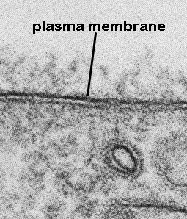
Organelles
Cell Membrane
Phospholipid
Bilayer
Semipermeable

Slide 16
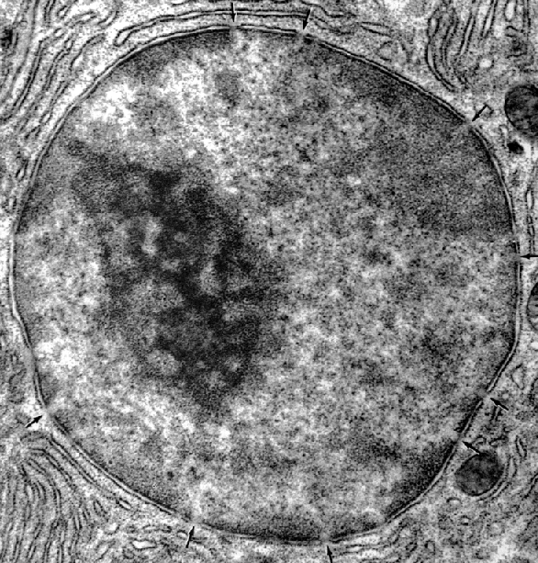
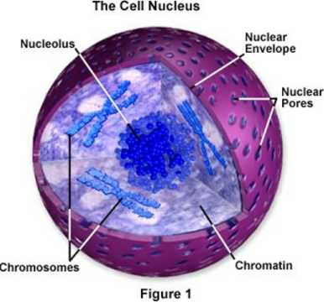
Organelles
Nucleus
Nuclear envelope
Nucleolus

Slide 17
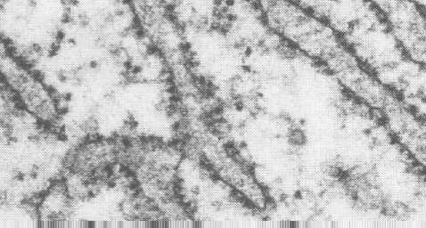
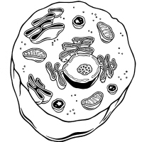
Organelles
Ribosome

Slide 18
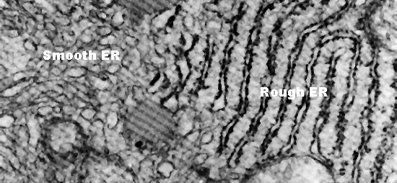
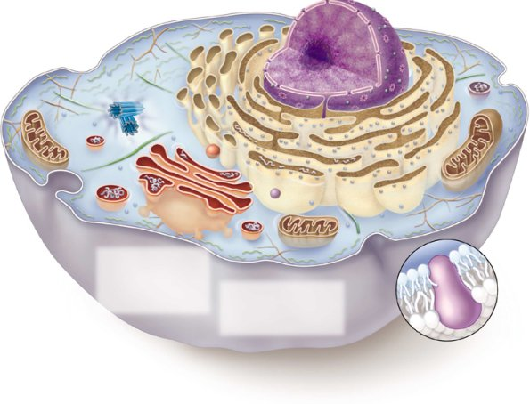
Organelles
ER
Smooth
Rough
Vesicles

Slide 19
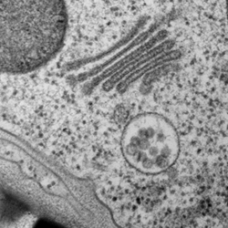
Organelles
Golgi

Slide 20
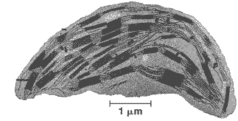
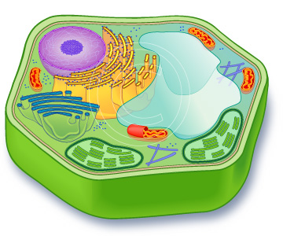
Organelles
Chloroplast

Slide 21
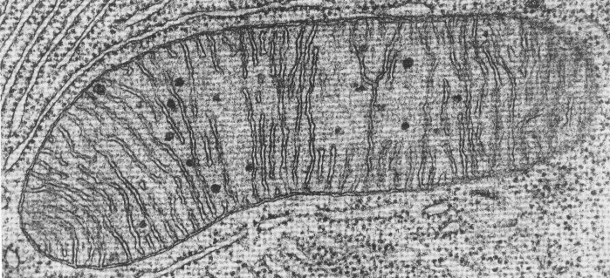
Organelles
Mitochondria

Slide 22
Organelles
Lysosome
Vacuole
Cytoplasm

Slide 24
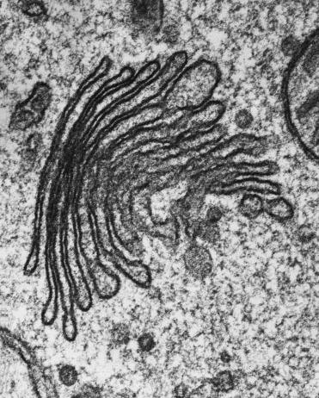
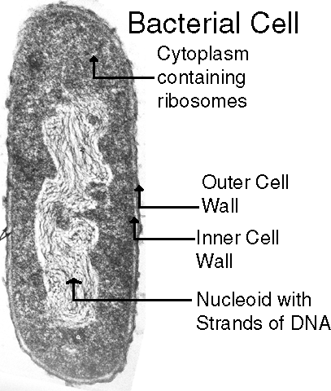

Slide 25
Fill out charts to compare prokaryotes and eukaryotes

