Slide 1
Classification
Topic 5.3 and 5.4

Slide 2
Binomial Nomenclature
The binomial system of nomenclature is the formal system by which all living species are classified (taxonomy)
It was initially developed by a Swedish botanist named Carolus Linnaeus in 1735
It is periodically assessed and updated at a series of international congresses which occur every 4 years

Slide 3
Binomial Nomenclature
The binomial system of nomenclature provides value because:
It allows for the identification and comparison of organisms based on recognized characteristics
It allows all organisms to be named according to a globally recognized scheme
It can show how closely related organisms are, allowing for the prediction of evolutionary links
It makes it easier to collect, sort and group information about organisms

Slide 4
Binomial Nomenclature
According to the binomial system of nomenclature, every organism is designated a scientific name with two parts:
Genus is written first and is capitalized (e.g. Homo)
Species follows and is written in lower case (e.g. Homo sapiens)
Some species may occasionally have a sub-species designation (e.g. Homo sapiens sapiens –modern man)
How to write a scientific name:
Typed = italics
Handwritten = underline

Slide 5
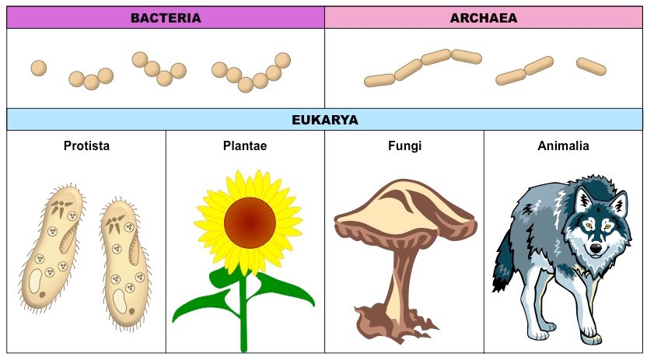
Domains
Eukarya – eukaryotic organisms that contain a membrane-bound nucleus (includes protist, plants, fungi and animals)
Archaea – prokaryotic cells lacking a nucleus and consist of the extremophiles (e.g. methanogens, thermophiles, etc.)
Eubacteria – prokaryotic cells lacking a nucleus and consist of the common pathogenic forms (e.g. E. coli, S. aureus, etc.)

Slide 6
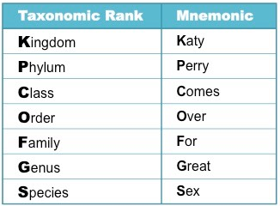
Taxonomy
Taxonomy is the science involved with classifying groups of organisms on the basis of shared characteristics
Organisms are grouped according to a series of hierarchical taxa – the more taxa organisms share, the more similar they are
The taxa used are kingdom, phylum, class, order, family, genus and species (genus + species = scientific name)
Spaghetti

Slide 7
Types of Classification
Artificial classification involves selecting unifying characteristics first and then grouping organisms accordingly
Advantage - easy to develop and relatively stable (unlikely to change)
Disadvantage - do not generally show evolutionary relationships and for this reason are not commonly used
For example, if organisms were classified according to the presence of fins then whales would be grouped with fish
If organisms were classified based on the presence of shells then snails would be grouped with turtles and not with squid

Slide 8
Types of Classification
Natural classification involves grouping organisms based on similarities first and then identifying shared characteristics
All members of a particular group would have shared a common ancestor
This means that natural classification schemes can be used to predict characteristics shared by species within a group
Advantage - identifies traits based on groupings, rather than assigning groups based on traits
Disadvantage - are highly mutable and tend to change as new information is discovered

Slide 10
Types of Classification
Phylogenetic classification – is now being used to differentiate organisms based on genetics
Organisms who share a greater level of homology in their DNA or amino acid sequences are expected to be more closely related

Slide 11
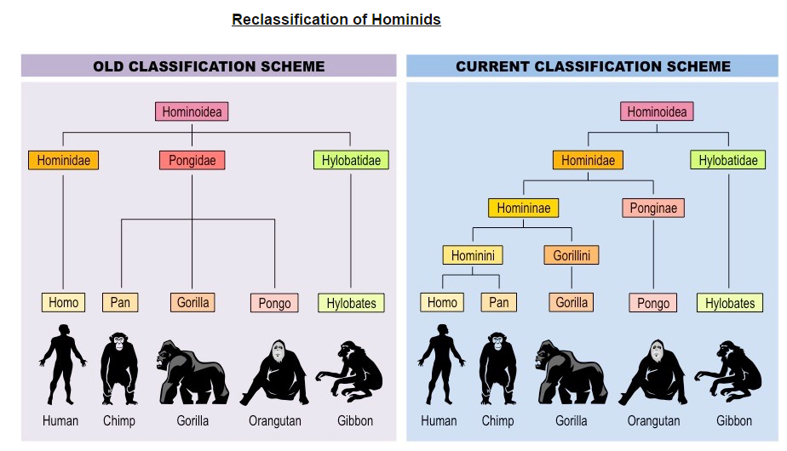
Classification
Natural classification systems can change
Groups of species may be separated into different genera if new evidence suggests they evolved from different ancestral species
Alternatively, different species may be grouped into a shared taxon if new evidence suggests more recent common ancestry

