Slide 1
Topic 4: Ecology
4.1
Species, Communities, and Ecosystems

Slide 2
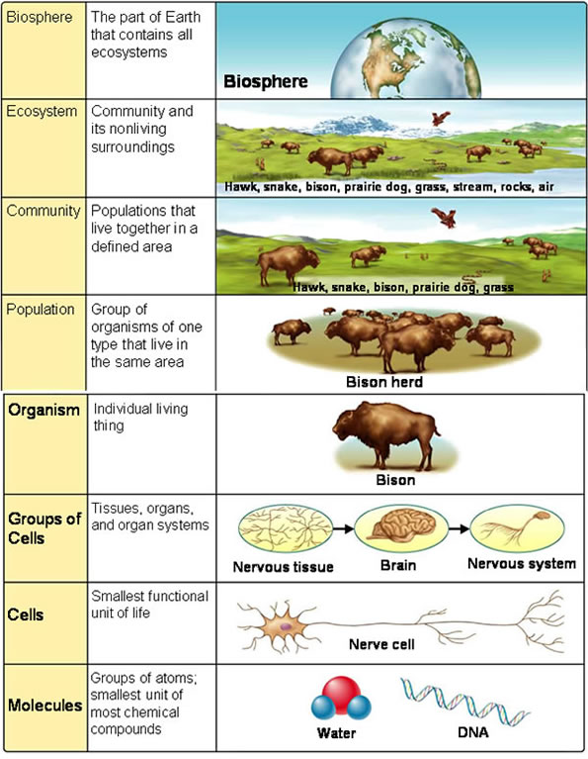
Levels of an Ecosystem
Abiotic vs Biotic

Slide 3
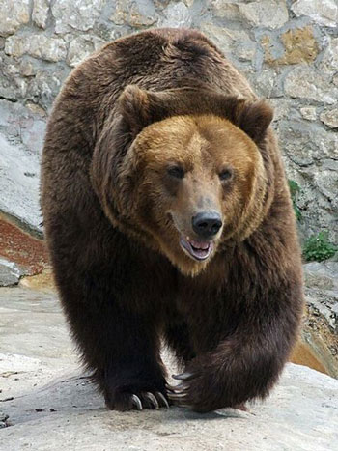
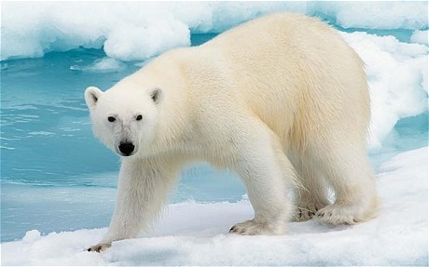
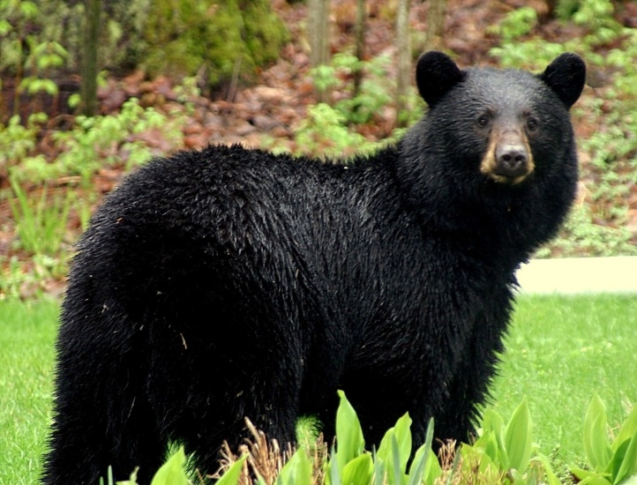
What is a species?
Species - ?

Slide 4
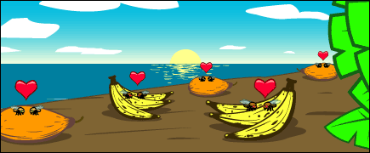
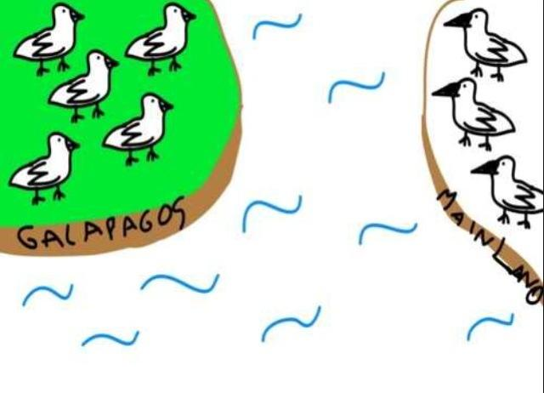
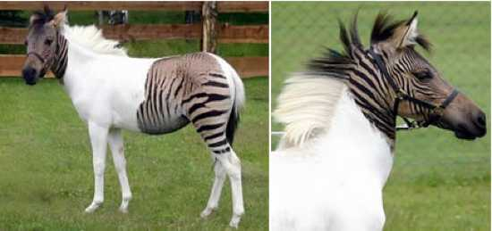
What is a species?
How do species recognize their own species?
Can two different species breed?
Species may be reproductively isolated in separate populations

Slide 5
Types of Species
Autotrophic or heterotrophic
Both?
Consumers
Producers
Detritivores
Saprotrophs
Carnivores
Herbivores
Omnivores

Slide 6
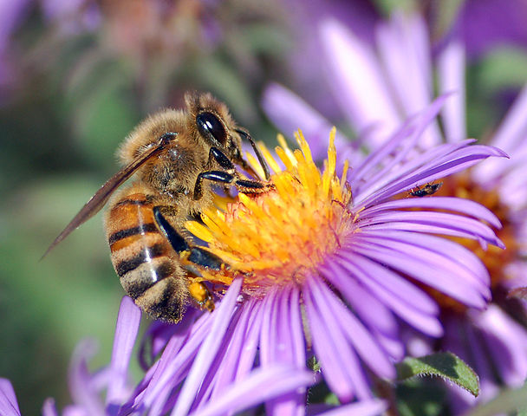
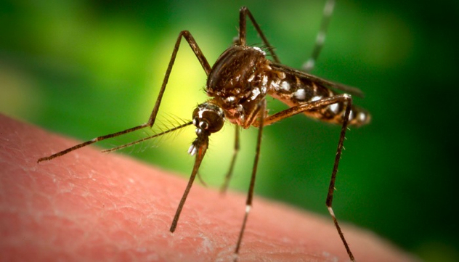
What is a community?
A community is formed by different populations of different species living together and interacting with each other
Can be formed by interactions with abiotic factors
Mutualism
Commensalism
Parasitism

Slide 7
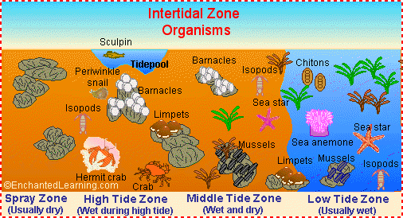
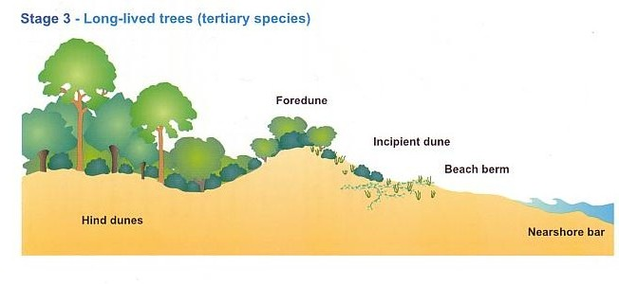
Ecosystems
Abiotic and biotic
Abiotic can influence biotic
Biotic can influence abiotic

Slide 8
Nutrient Cycling
Inorganic nutrients are maintained by nutrient cycling
Why are inorganic nutrients important? (C, H, O, N, P)
How do autotrophs obtain inorganic nutrients?
How do heterotrophs obtain inorganic nutrients?

