Slide 1
Topic 4 Ecology
4.2 Energy Flow

Slide 2
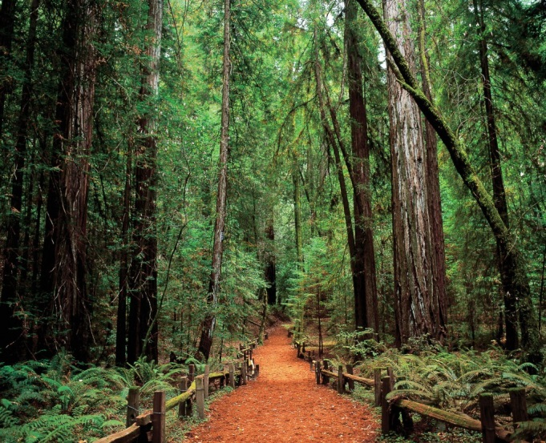
Energy Flow
Where does the energy come from for most ecosystems?
How is it turned into chemical energy?
How are heterotrophs dependent on this?
Different ecosystems have different amounts of available energy
Availability vs use

Slide 3
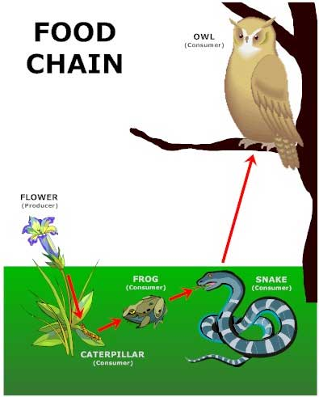
Energy Flow
Chemical energy in carbon compounds flows through food chains by means of feeding

Slide 4
Energy Flow
Energy released by respiration is used in living organisms and converted to heat
Why do cells need energy?
Are energy transformations 100% efficient?
What happens to heat?

Slide 5
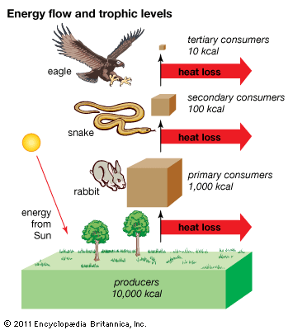
Energy Flow
Trophic Levels

Slide 6
Energy Flow
Why is so much energy lost?
Released as heat
Not all of the organism is consumed
Not all that is consumed is digested or absorbed

Slide 7
Energy Flow
Biomass – total mass of a group of organisms
Biomass is lost
Since carbon compounds contain energy, biomass contains energy
CO2 and water loss from respiration
Uneaten or undigested parts

Slide 8
Energy Flow
The loss of energy restricts the length of food chains and biomass at higher trophic levels

