Slide 1
Genetic Modification
3.5

Slide 2
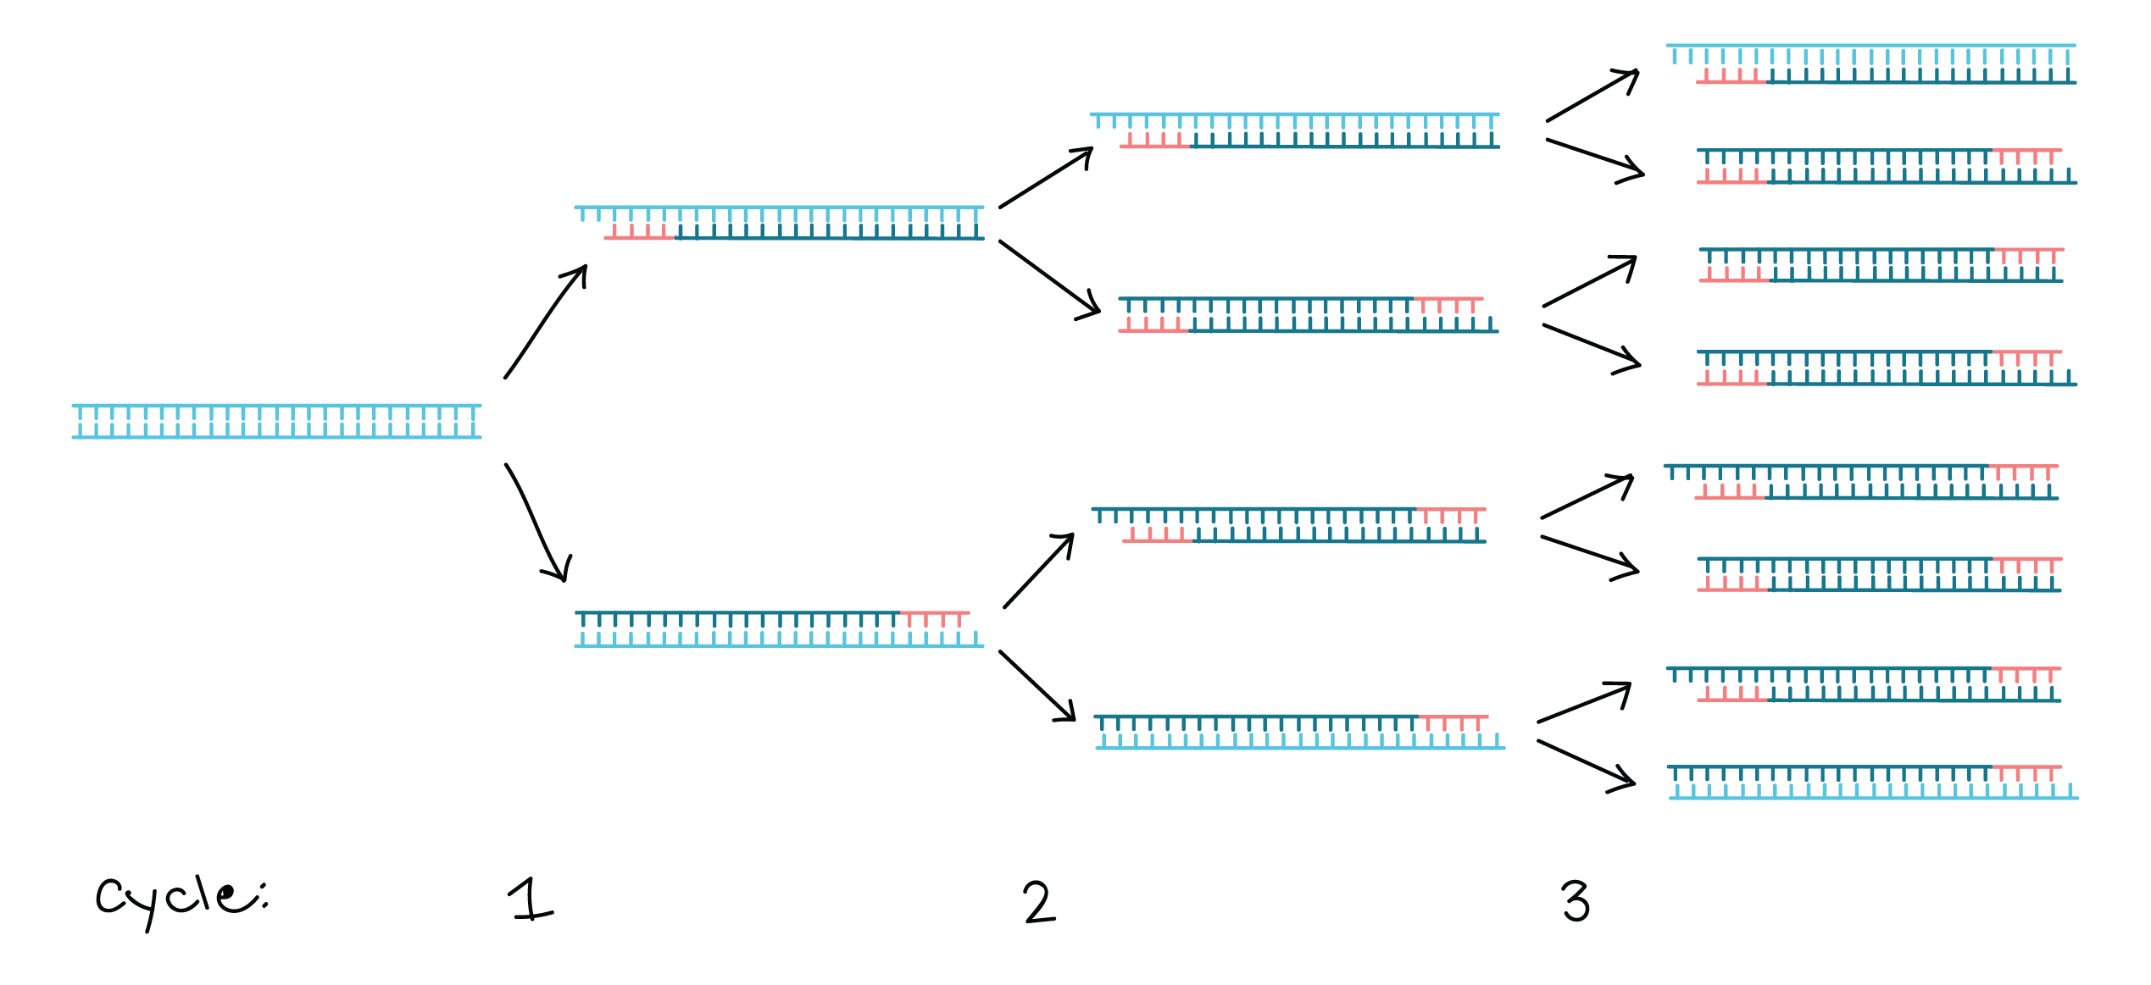
PCR
Polymerase chain reaction (PCR) is an artificial method of replicating DNA
Used to amplify large quantities of a specific sequence of DNA from a small sample
Why would you want to do this?
Each reaction cycle doubles the amount of DNA

Slide 3
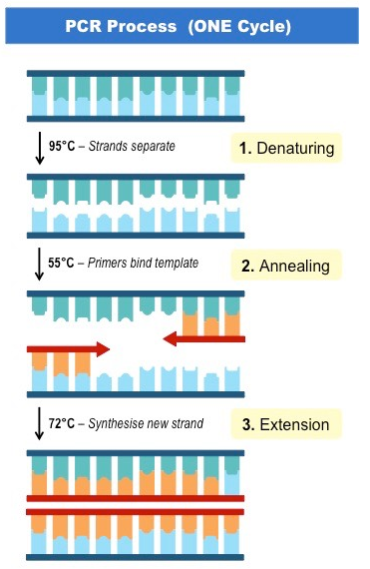
PCR
A thermal cycler is used to complete the PCR process
Denaturation
Annealing
Elongation

Slide 4
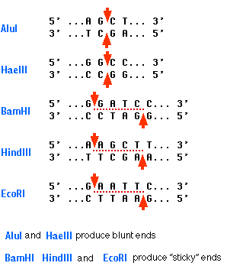
Restriction Endonucleases
Aka restriction enzymes
Cut DNA at specific locations known as restriction sites
Each enzyme cuts at a different site
Can produce blunt ends or sticky ends

Slide 5
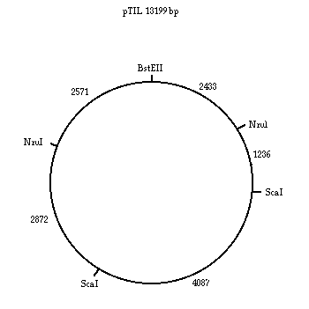
Restriction Mapping
How many pieces would you have if you were to cut the plasmid with ScaI?
What would their sizes be?
What about NzuI?

Slide 6
Genetic Modification
Gene modification is carried out by gene transfer between species
The genetic code is universal so an organism can potentially express a new trait if the appropriate gene is introduced into its genome
The transfer of genes between species is called gene modification, and the new organism created is called a transgenic

Slide 7
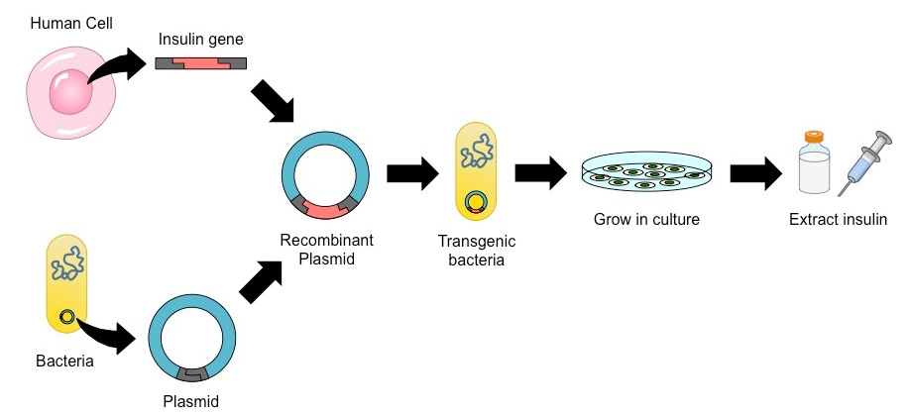
Genetic Modification
Four main steps:
Isolation of gene and vector (by PCR)
Digestion of gene and vector (by restriction endonuclease)
Ligation of gene and vector (by DNA ligase)
Selection and expression of transgenic construct

Slide 8
Isolation of gene and vector
Isolate DNA
Use PCR to amplify
A vector is chosen

Slide 9
Digestion with restriction enzymes
In order to incorporate a gene of interest into a vector, both must be cut with restriction enzymes at specific recognition sites

Slide 10
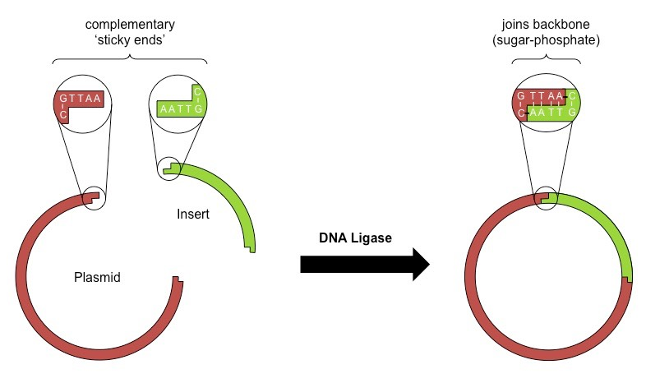
Ligation of vector and insert
The gene and vector are then spliced together by the enzyme DNA ligase to form a recombinant construct

Slide 11
Selection and expression
The recombinant construct is introduced into an appropriate host cell or organism
Antibiotic selection is commonly used in order to identify which cells have successfully incorporated the recombinant construct
Transgenic cells, once isolated and purified, will hopefully begin expressing the desired trait encoded by the gene of interest

Slide 12
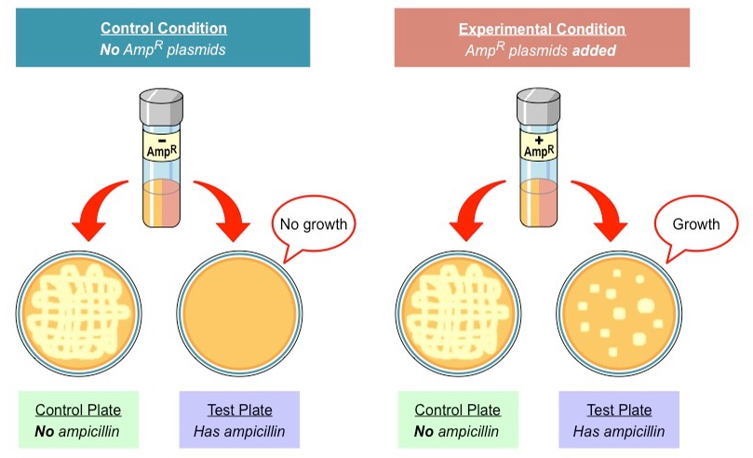

Slide 13
Gel Electrophoresis
Gel electrophoresis is used to separate proteins or fragments of DNA according to size
Create a DNA fingerprint

Slide 14
Gel Electrophoresis
DNA may be cut into fragments using restriction endonuclease
DNA samples are placed into an agarose gel
Electric current is run through the gel causing the negative DNA to move to the positive end

Slide 15
Gel Electrophoresis

Slide 16
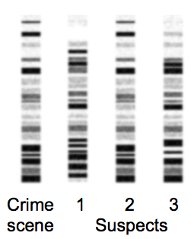
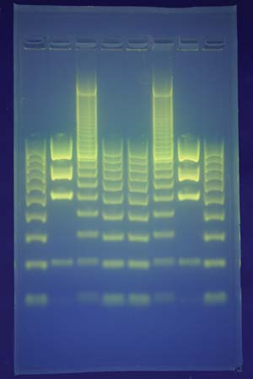
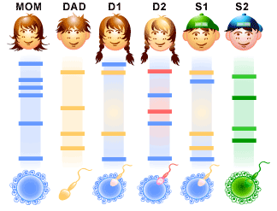
Gel Electrophoresis

Slide 17
Gel Electrophoresis
Proteins may also be used in this process
Proteins may be folded into a variety of shapes (affecting size) and have positive and negative regions (no clear charge)
Protein samples are placed into a polyacrylamide gel
Electric current is run through the gel separating the protein fragments

Slide 18
Cloning
Clones are groups of genetically identical organisms, derived from a single original parent cell

Slide 19
Cloning
Natural Cloning
All bacteria, the majority of fungi and many species of protists reproduce asexually to produce genetic clones
Binary Fission
Budding
Fragmentation

Slide 20
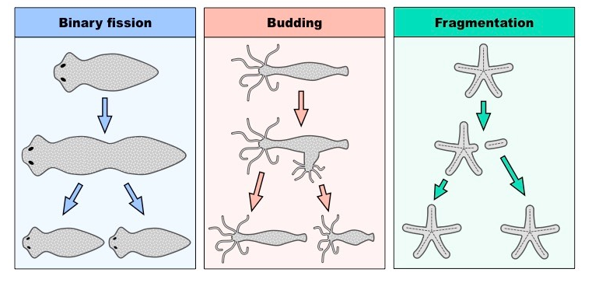
Cloning

Slide 21
Cloning
Plants have the capacity for vegetative propagation, whereby small pieces can be induced to grow independently

Slide 22
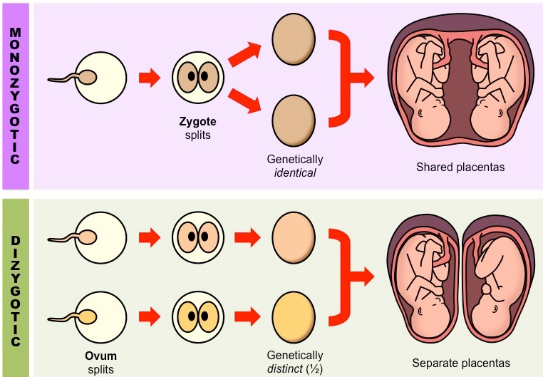
Cloning
Even human beings are capable of creating genetic clones through natural means

Slide 23
Cloning
Artificial cloning
At a very early stage, embryonic cells retain pluripotency
Separated artificially and then implanted into a surrogate
This method of cloning is limited by the fact that the embryo used is still formed randomly via sexual reproduction and so the specific genetic features of the resulting clones have yet to be determined

Slide 24
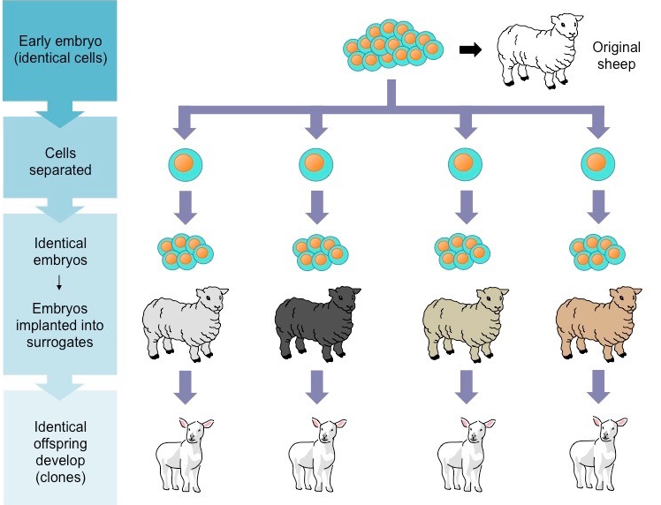

Slide 25
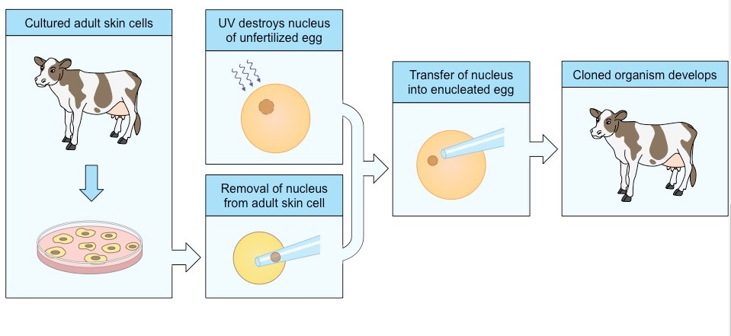
Cloning
Second method of artificial cloning is SCNT
Stem cells can be artificially generated from adult tissue using a process called somatic cell nuclear transfer (SCNT)
Steps in virtual lab

Slide 26
Cloning
Two different types of cloning with different purposes
Reproductive cloning:
Therapeutic cloning:

Slide 27
GMOs
Genetically modified organisms (GMOs) are used in agriculture to improve crop yields and reduce farming costs
However the use of GM crops is a contentious issue, as economic benefits must be weighed against environmental risks

Slide 28
GMOs
Human health
Can incorporate genes for certain proteins, vitamins, or vaccines
Can be made to lack common natural allergens or toxins
Could trigger unexpected adverse health reactions in some individuals
Currently, not all foods with GM components are labelled, making informed decisions of use difficult for consumers

Slide 29
GMOs
Economics
Grow in a wider range of environments (e.g. drought / frost / salinity resistance)
Produce greater yields (crops can potentially grow larger and faster)
Slow the rate of spoiling, leading to longer shelf lives for GM foods
Resistance to certain viruses or produce toxins to pests Herbicide resistant crops can be used to allow for the easier killing of weeds (which compete with crops for soil nutrients)
Improved yield, reduction in farming costs and ability to farm more land will provide an economic benefit to farmers
Patent protection allows biotech companies to restrict the use of seeds and force farmers to pay high prices for use

Slide 30
GMOs
Environment
The ability to farm a wider range of environments with GM crops will potentially reduce the need for associated deforestation
Generation of pest-resistant crops means that less chemical insecticides will be released into the environment
GM crops could potentially reduce biodiversity in a region by competing with indigenous plant life
Furthermore, proteins or toxins produced by GM crops could negatively affect certain organisms within the ecosystem
Cross-pollination by GM crops could also result in the formation of herbicide-resistant weeds and grasses
GM crops with pest toxins could also accelerate the evolution of resistant pest species

Slide 31
GMOs
Analysis of data on risks to monarch butterflies of Bt crops
On edmodo

