Slide 1
IB Chemistry
Option B – Human Biochemistry

Slide 2
Energy
Calculate the energy value of a food item from enthalpy of combustion data
E = mcΔT
E – energy
M – mass of water (convert grams to percent 4g = .04)
C – specific heat capacity of water (4.18)
ΔT – change in temperature

Slide 3
Energy
1.13g of rice raises the temperature of 525 g of water by 3.31°C.
E = .525 x 4.18 x 3.13 = 7.26 kJ
So the energy content of rice is 7.26kJ
7.26 x 100/1.13 = 642 kJ per 100g

Slide 4
Proteins
Proteins are important molecules
Biological catalysts (enzymes)
Transport (hemoglobin)
Structural (collagen and keratin)
Hormones (FSH and insulin)
Immune (antibodies)

Slide 5
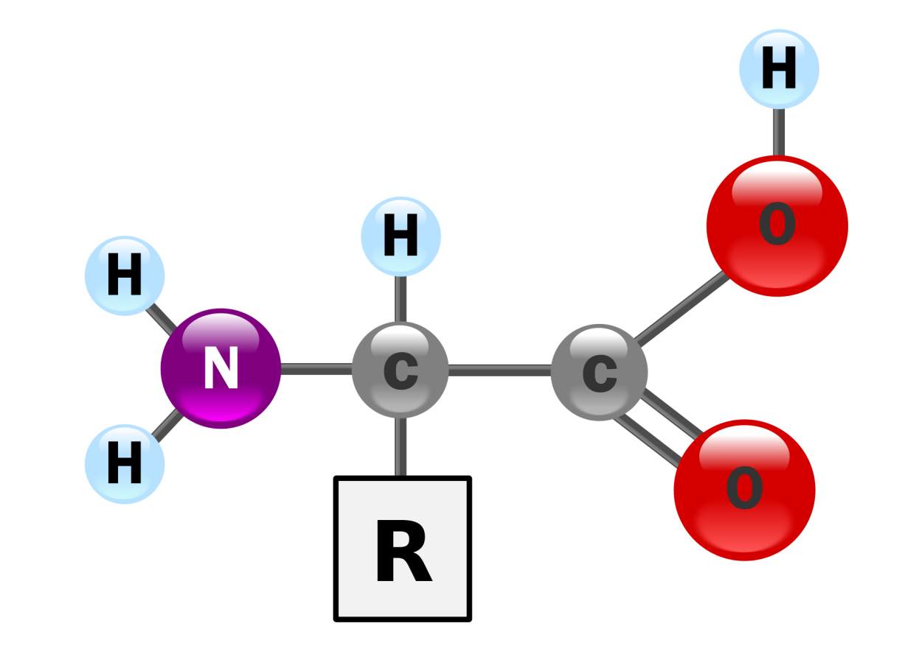
Proteins
Made up of the elements C, H, O, N, S
Monomers of proteins are amino acids
The general formula for an amino acid is N2HCHRCOOH

Slide 6
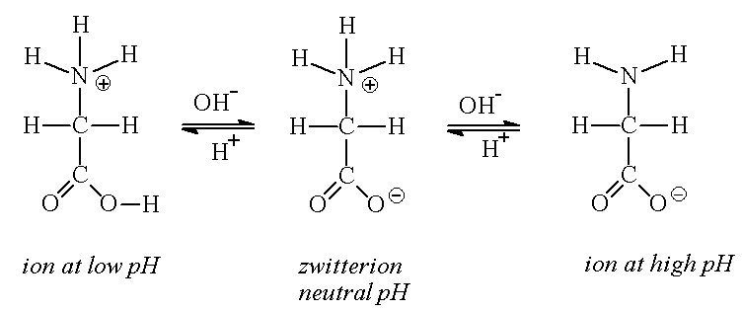
Proteins
Amino acid properties
At a low pH the amine group is a proton donator (acid)
At a high pH the caboxyl group is a proton acceptor (base)
At a certain pH (isoelectric point) the amino acid is a zwitterion

Slide 7
Proteins
Amino acids join together through a condensation reaction to form a dipeptide
Condensation reaction involves the loss of water
Peptide bond

Slide 8
Proteins
The process of joining many monomers together is called polymerization
Polymerization of amino acids creates a polypeptide

Slide 9
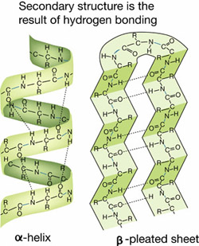
Proteins
Levels of protein structure
1° - the sequence of amino acids
2° - Intramolecular
hydrogen bonding forms
α helices and β pleated
sheets

Slide 10
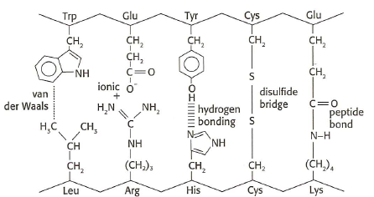
Proteins
3° - folding of the chains to create interactions between R groups and a 3D structure

Slide 11
Proteins
4° - interactions between multiple tertiary structures

Slide 12
Carbohydrates
Provide short term energy
Soluble
Easy to digest
Produced by photosynthesis
Cell walls

Slide 13
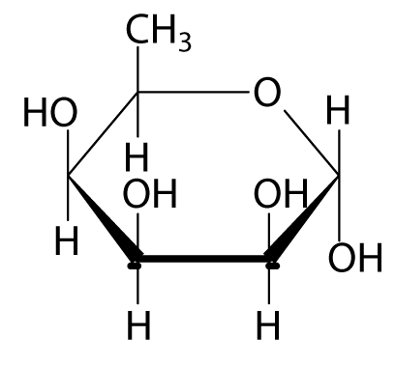
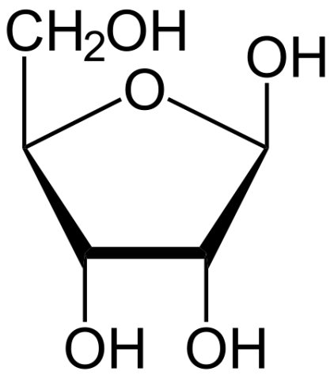
Carbohydrates
Made of up the elements C, H, O
1:2:1
Monomers are monosaccharides
Glucose, fructose, galactose
Contain a carbonyl group
Contain at least 2 hydroxyl groups

Slide 14
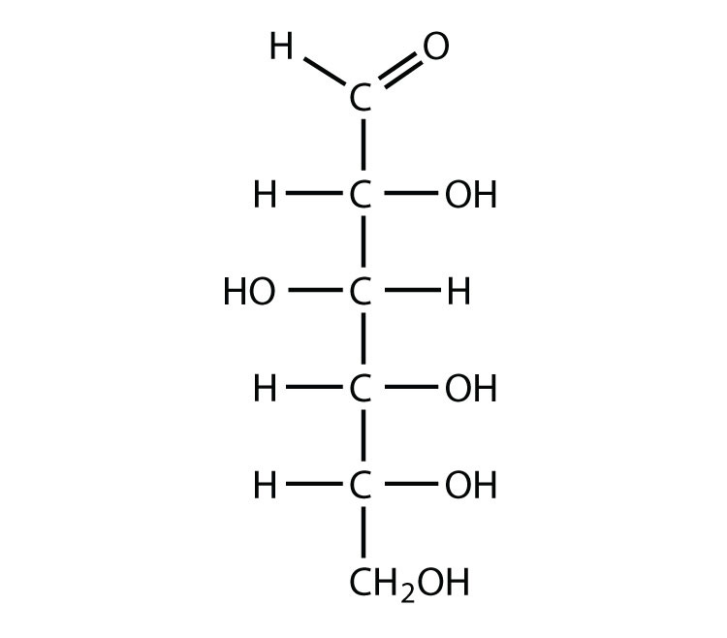
Carbohydrates

Slide 15
Carbohydrates
Disaccahrides
Two monosaccharides
Lactose, sucrose, maltose

Slide 16
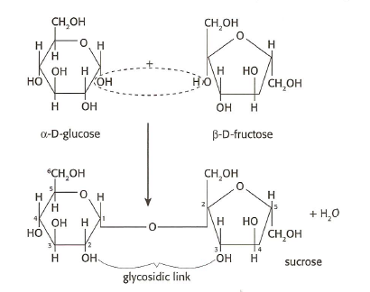
Carbohydrates

Slide 17
Carbohydrates
Polysaccharides
Many monomers
Cellulose
Starch
Glycogen

Slide 18
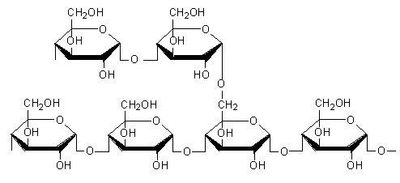
Carbohydrates
Starch
Energy storage for plants
Exists as two forms
Amylose
Water soluble
Straight chain polymer of glucose
Amylopectin
Not water soluble
Branched polymer of glucose

Slide 19
Lipids
Store more energy than carbs
Not soluble in water
Insulation
Buoyancy
Cell membranes
Hormones

Slide 20
Lipids
Contains the elements C, H, O
Hydrocarbon chains

Slide 21
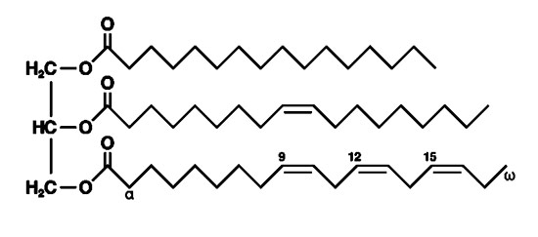
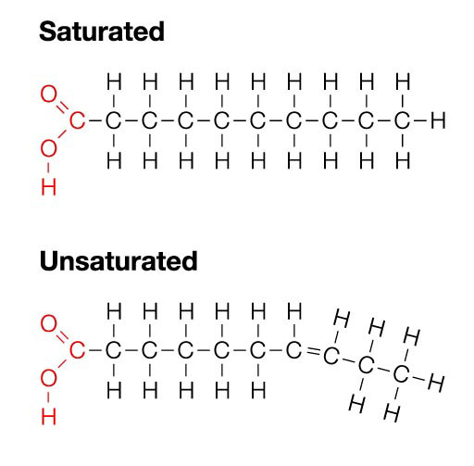
Lipids
Fats and oils
Triglycerides
Fatty acids
Saturated
Unsaturated
Poly and mono
glycerol

Slide 22
Lipids
Triglycerides are hydrolyzed by lipases
Glycerol and fatty acids are further broken down by redox reactions into carbon dioxide, water and energy

Slide 23
Lipids
Omega fatty acids
ω- 3 linoleic acid
ω - 6 linoleic acid
Essential for the body to synthesize longer and more unsaturated fatty acids

Slide 24
Lipids
Trans fatty acids
Made synthetically by hydrogenating other polyunsaturated fatty acids
Present in fried foods
Increase LDL cholesterol
Increase risk of heart disease

Slide 25
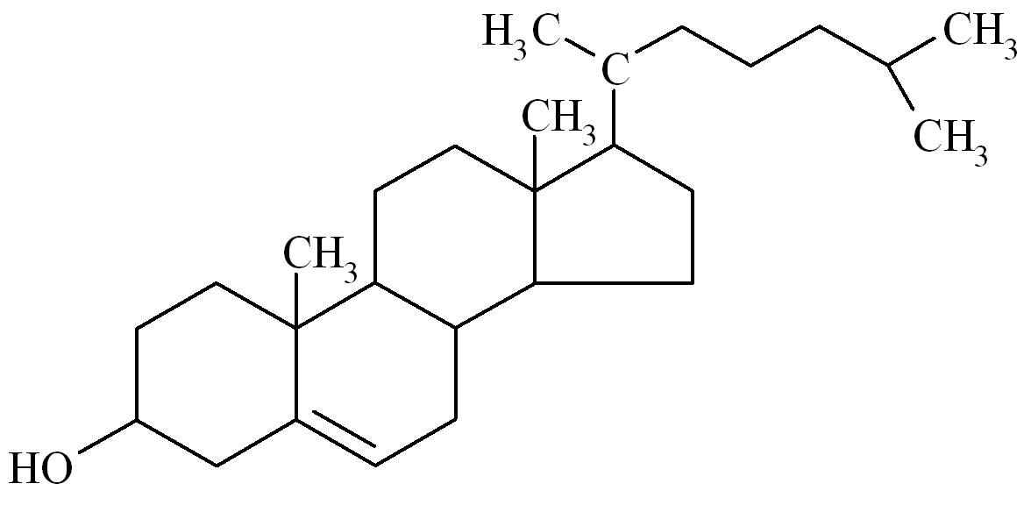
Lipids
Cholesterol
Steroid
4 ring structure
LDL transport cholesterol to the arteries
HDL can transport cholesterol back to the liver

Slide 26
Micro and Macro Nutrients
Macro nutrients
Carbs, lipids, proteins
Some minerals
Micro nutrients
Needed in trace amounts
Vitamins and minerals

Slide 27
Hormones
Hypothalamus
Pituitary gland
Endocrine glands

Slide 28
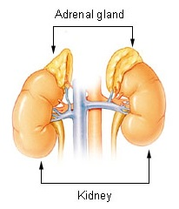
Hormones
Epinephrine
Adrenal glands
Amphetamine
Fight or flight
Excitement
Pupil dilation
Heart rate
glucose

Slide 29
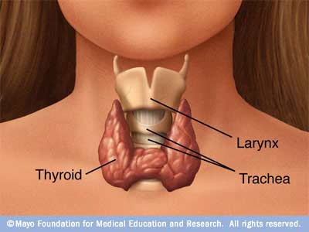
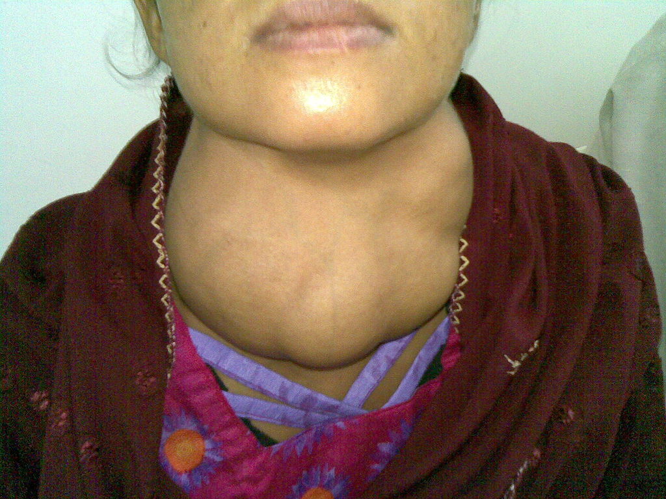
Hormones
Thyroxin
Thyroid
Metabolism
Hypothyroidism
Hyperthyroidism

Slide 30
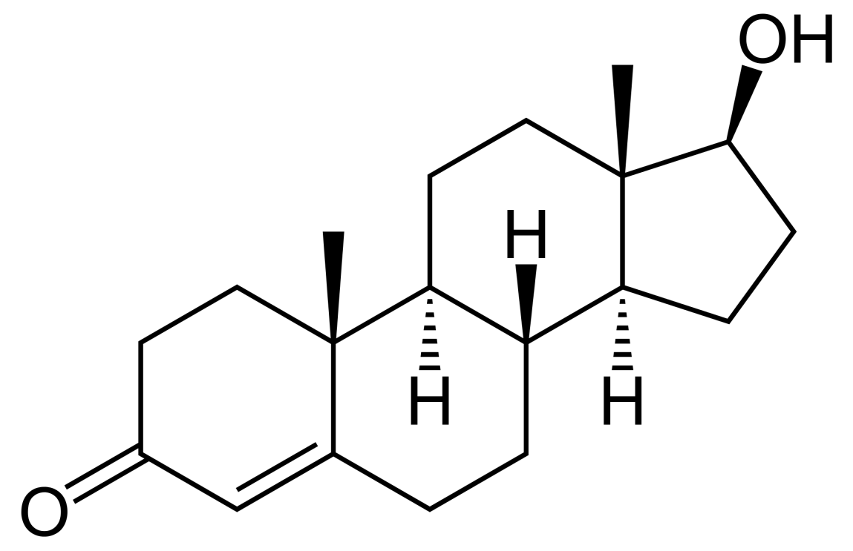
Hormones
Sex hormones
Testosterone and androsterone
Progesterone and estrogen (estradiol)

Slide 31
Hormones
Oral contraceptive
Menstrual cycle review
Pill contains estrogen and progesterone
Mimics pregnancy

