Slide 1
Immune System
Defense against infectious diseases

Slide 2
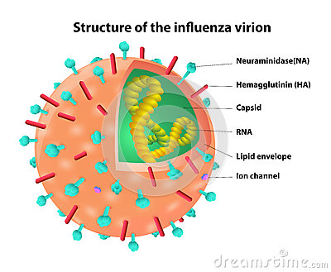
Antigens
Any molecule that can cause an immune response is an antigen
Antigens are molecules found on the surface of cells

Slide 3
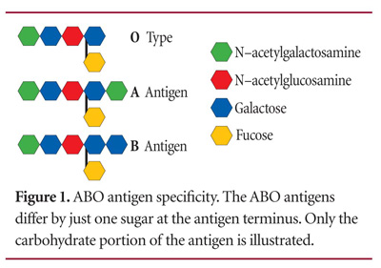
Antigens
Blood types have different antigens
What is this important for blood transfusions?

Slide 4
Primary Defense
The first line of defense against infections is the skin and mucus membranes
Sebaceous glands
Mucus membranes

Slide 5
What happens when the skin is broken?
Platelets release clotting factors
Clotting factors → enzyme named thrombin
Thrombin causes the conversion of fibrinogen into fibrin
Traps platelets
Scab

Slide 6
Coronary Heart Disease
Coronary arteries carry blood to the wall of heart
Coronary thrombosis is when blood clots form in the coronary arteries
Why is this bad?

Slide 7
Coronary Heart Disease
Risk factors correlated with increased risk of coronary thrombosis

Slide 8
Secondary Defense
Non-specific defense mechanisms
White blood cells
Phagocytes

Slide 9
Secondary Defense
Phagocytic leucocytes (macrophages)
They concentrate at sites of infection
Pathogens are engulfed
Pathogen digested
Phagocytosis = 'cell-eating'
Some of the pathogens antigenic fragments may be presented on the surface of the macrophage, in order to help stimulate antibody production

Slide 10
Tertiary Defense
Specific immunity
Challenge and response
Recognize and respond specifically to different types of micro-organism and have memory
White blood cells
lymphocytes, macrophages, and helper T cells

Slide 11
Antibodies
Destroy pathogens
Opsonization
Neutralization of viruses and bacteria
Neutralization of toxins
Activation of a complement
Agglutination

Slide 12
Tertiary Defense
Macrophages present antigens on their membrane
Helper T cells bind to the specific antigen and are activated
Helper T cells bind to specific B lymphocytes (B cells) and activate them

Slide 13
Tertiary Defense
Antigens on the pathogen cause the needed antibody to be produced
A small portion of B cell clones develop into memory cells, which may survive for years providing long-term immunity

Slide 14
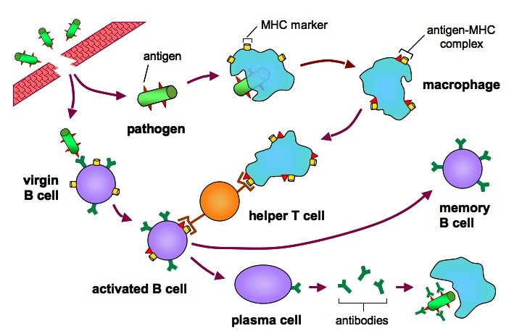
Immune Response

Slide 15
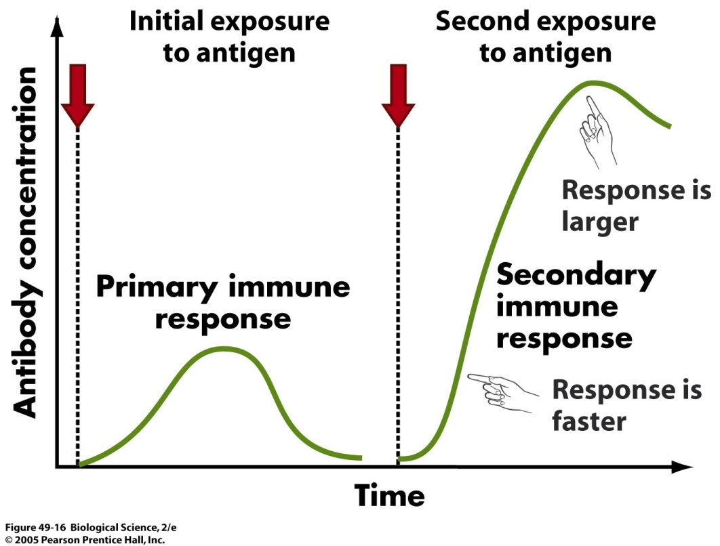
Immunity
Results from presence of antibodies that recognize the antigen or memory cells
Developed when body responds and develops memory cells

Slide 16
Vaccines
Trigger immunity without causing disease
Live weakened
Derivative with antigens
Primary immune response is triggered
Secondary immune response is possible upon infection

Slide 17
Vaccines
Edward Jenner tested smallpox in a way that is unethical today
Tested the claim that if an individual had cowpox they could not get smallpox
Infected an 8 year old with cow pox and then after he recovered infected him with smallpox
Boy did not get smallpox
What issues would this cause today?

Slide 18
Vaccines
Smallpox was eradicated by vaccines
Last case was in 1977
Success due to:
Limited to humans
Symptoms appear quickly so the amount of people infected is less
Long lasting immunity

Slide 19
Antibiotics
How do they work?
Bacterial DNA replication
Bacterial ribosome function
Cell wall function
Can antibiotics be used on viral infections? Why?

Slide 20
Resistance
Bacteria develop resistance via natural selection
Some strains develop multiple resistance such a MRSA
How to avoid antibiotic resistance
Doctors limiting prescriptions for serious bacterial infections
Completing the course of antibiotics
Hospital hygiene
Eliminating the use of antibiotics by farmers in animal feed
New antibiotics

Slide 21
HIV and the Immune System
When the body detects the virus it will produce antibodies (HIV +)
HIV destroys helper T cells
Retrovirus
Has RNA but can make DNA once it enters the host
When a collection of conditions is present the person has AIDS

Slide 22
Zoonosis
Most pathogens are species specific
Zoonosis is when the pathogen can cross the species barrier
Lyme disease, bird flue, West Nile
Increased contact of human race with animals increases the rates of zoonosis

Slide 23
Histamines
Are released in response to infection
Mast cells in connective tissue and basophils in the blood can release histamine
Histamines result in the dilation of the small blood vessels making them leaky
Increases blood flow and allows immune components to respond
Symptoms are itching, fluid build up, sneezing, rashes, and anaphylaxis

Slide 24
Monoclonal Antibodies
Monoclonal antibodies (mAb) are antibodies derived from a single B cell clone
An animal is injected with an antigen and produces specific plasma cells
The plasma cells are removed and fused (hybridized) with tumor cells capable of endless divisions (immortal cell line)
The resulting hybridoma is capable of synthesizing large quantities of specific antigen, for use in diagnosis and treatment

Slide 25
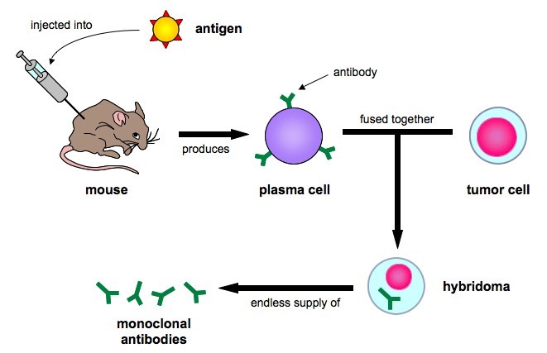
Monoclonal Antibodies

Slide 26
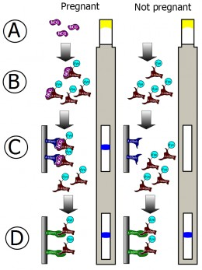
Monoclonal Antibodies
Monoclonal antibodies can be used to test for pregnancy via the presence of human chorionic gonadotrophin (hCG)
An antibody specific to hCG is made and is tagged to an indicator molecule
When hCG is present in the urine it binds to the anti-hCG monoclonal antibody and this complex will move with the fluid until it reaches a second group of fixed antibodies
When the complex binds to the fixed antibodies, they will appear as a blue line (positive result) due to the presence of the indicator molecule

