Slide 1
Muscles and Movement

Slide 2
Parts
Bones: Provide a hard framework for anchorage of muscles and act as levers to facilitate movement
Ligaments: Connect bone to bone
Muscles: Provide the force required for movement
Tendons: Connect muscles to bones
Nerves: Motor neurons provides the stimulus for muscle movement and co-ordinates sets of antagonistic muscles

Slide 3
Joints
Where two bones meet
Synovial joints are the most common joints and meet at a joint capsule with synovial fluid
Cartilage – prevents bones from rubbing together and absorbs shocks
Synovial fluid - Provides food, oxygen and lubrication
Joint capsule – ligament covering that holds fluid and prevents dislocation. Provides passive stability by limiting range of movement.

Slide 4
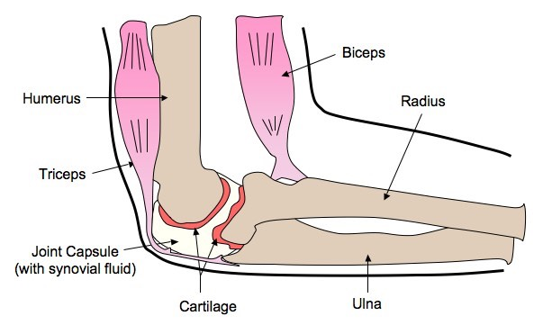
The Elbow
Biceps muscle contracts, the forearm moves up
Triceps muscle contracts, the forearm moves down
What type of muscle movement is this?
Need to be able to annotate a diagram of the elbow

Slide 5
The Elbow
Biceps: Bends the arm
Triceps: Straightens the arm
Humerus: Anchors muscle
Radius / Ulna: Acts as forearm levers - radius for the biceps, ulna for the triceps
Cartilage
Synovial Fluid
Joint Capsule

Slide 6
Both synovial joints but they allow for different ranges of motion

Slide 7
Types of Muscle
Striated
Move the body
Attached to bones
Smooth
Involuntary
Cardiac
Make up the heart

Slide 8
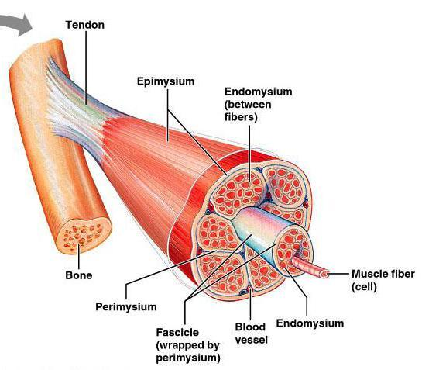
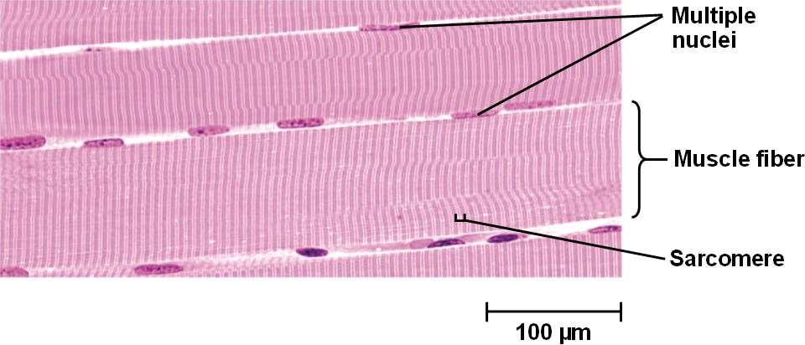
Skeletal Muscle
Striated muscle
Can see stripes
Bundles of muscle fibers
Sarcolemma surrounds each fiber
Many nuclei
Very long

Slide 9
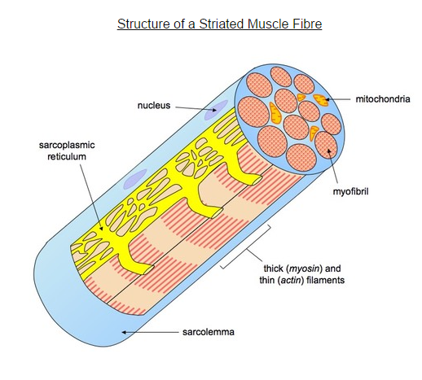
Skeletal Muscle
Within the muscle fibers there are many parallel, elongated myofibrils
Sarcoplasmic reticulum is a modified version of the endoplasmic reticulum
Extends throughout the muscle fiber
Many mitochondria

Slide 10
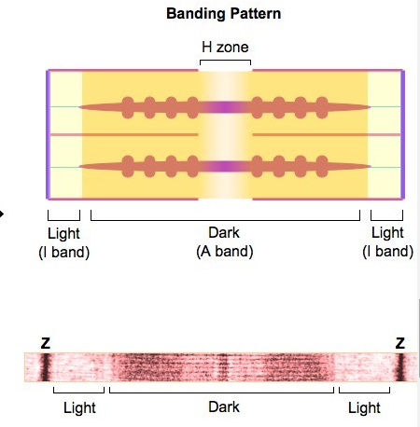
Skeletal Muscle
Myofibrils have light and dark bands
Z-line is in the center of each light band
One z-line to the next is a sarcomere
Sarcomeres are the functional unit of myofibrils

Slide 11
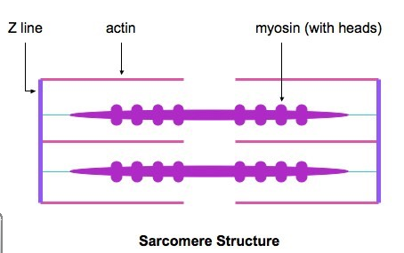
Skeletal Muscle
Banding pattern is due to actin and myosin (two types of protein filaments)
Actin = thin
Myosin = thick
Actin is attached to z-line
Myosin is within the actin

Slide 12
Skeletal Muscle
The H zone is the area only occupied by the thick filaments (myosin)
The I bands (light) are the regions occupied by only thin filaments (actin)
The A bands (dark) are the regions occupied by both filaments (overlap)
The Z lines represent the extremities of a single sarcomere

Slide 13
Muscle Contraction
Contraction occurs by the sliding of actin and myosin
Myosin causes sliding
Has heads that bind to specific sites on actin (cross bridge)
When the head moves it causes sliding

Slide 14
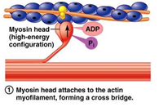
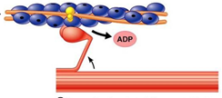
Muscle Contraction
When a muscle is relaxed two proteins, tropomyosin and troponin, block the binding sites between actin and myosin
When a neuron sends a signal to contract Ca+ are released from the sarcoplasmic reticulum
Ca+ causes proteins to move
Myosin binds to actin and causes the head to swivel to the center of the sarcomere

Slide 15
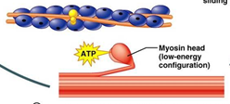
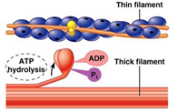
Muscle Contraction
ATP breaks cross bridges
Hydrolysis of ATP provides energy for myosin heads to swivel (away from the center of the sarcomere)

Slide 16
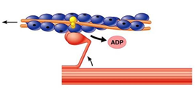
Muscle Contraction
New cross bridge formed at the adjacent site
Energy stored in the myosin causes it to swivel in towards the center of the sarcomere which moves actin

Slide 18
Application
Antagonistic pairs of muscles in an insect leg
Will be added later

Slide 19
Skill
Annotation of a diagram of the human elbow.

Slide 20
Skill
• Skill: Drawing labelled diagrams of the structure of a sarcomere.

Slide 21
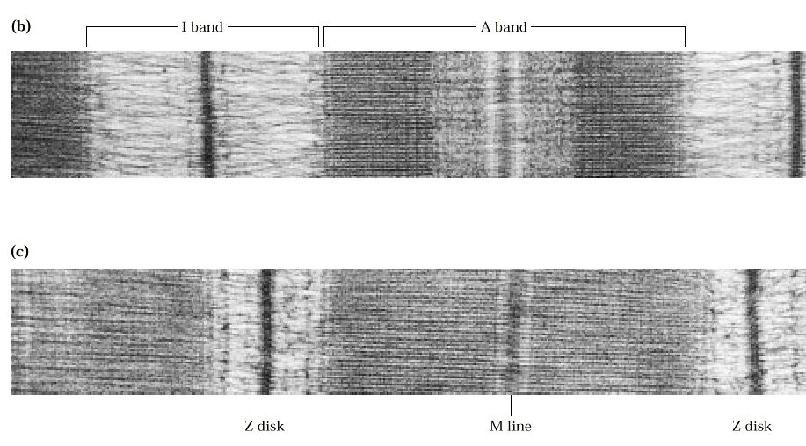
Skill
Analysis of electron micrographs to find the state of contraction of muscle fibers.

