Slide 1
Other Patterns of Inheritance

Slide 2
Incomplete Dominance
Neither allele is completely dominant
Heterozygous phenotype is a mix
Example:
Red = RR
White = WW
Pink = RW
Why are we using two different capital letters?

Slide 3
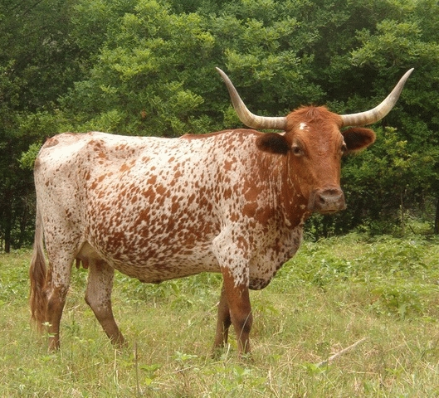
Codominance
Both alleles are equally dominant
Heterozygous phenotype is both
Example
Red = RR
White = WW
Roan = RW
Roan is white with red spots

Slide 4
Multiple Alleles
More than two alleles
So far we have only had 2
Example
R = red
B = blue
Y = yellow
O = orange

Slide 5
Multiple Alleles
Blood types are an example of multiple alleles
The alleles are:
A or I^{A}
B or I^{B}
O or i
A and B are co dominant
O is recessive to A and B
Why is the “i” lowercase for the O allele?

Slide 6
Multiple Alleles
Possible genotypes and phenotypes
Genotype | Phenotype
AA, AO | Type A
BB, BO | Type B
AB | Type AB
OO | Type O

Slide 7
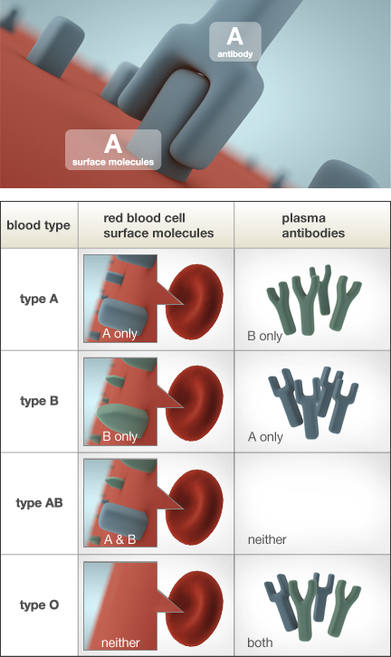
Multiple Alleles
Antibodies fight off foreign molecules
If antigens don’t recognize a molecule it is foreign

Slide 8
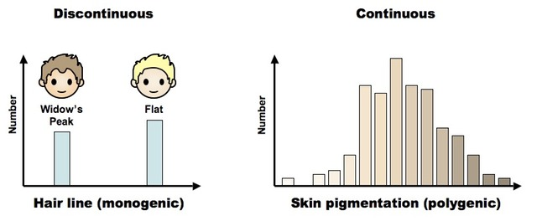
Polygenic Traits
Traits that are controlled by many genes
Usually have a continuum of phenotypes

Slide 9
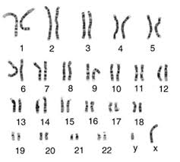
Sex-Linked Traits
Inherited on the sex chromosomes
Women XX
Men XY
Most sex linked traits are on the X chromosome
Hemophilia and colorblindness are examples

Slide 10
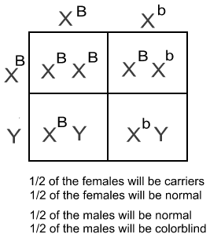
Sex-linked Traits
More men then women show X-linked recessive traits
A woman who is a carrier for colorblindness has children with a man who is not colorblind

