Slide 1
Reproductive System
Continued

Slide 2
Topics
How sperm and egg are made
Fertilization
Pregnancy

Slide 3
Spermatogenesis
The testes are made of seminiferous tubules which produce sperm
Between the tubules are interstitial cells which produce testosterone
Each tubule has a lining of germline epithelium cells
The germline epithelium will divide by mitosis to make spermatogonia
Spermatogonia divide by meiosis to make spermatozoa (sperm)
Sertoli cells nourish the sperm cells

Slide 4
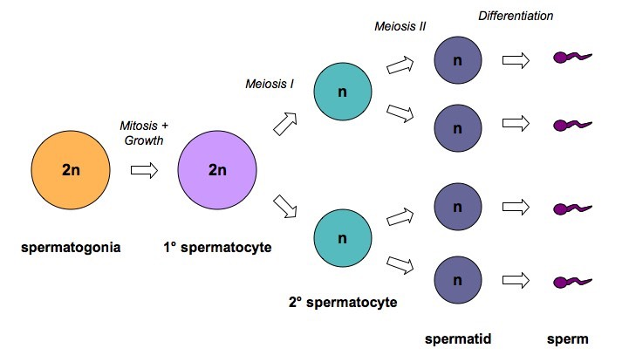
Spermatogenesis

Slide 6
Oogenesis
Oogenesis starts in the ovaries of a female fetus
Germline epithelium divided by mitosis
At 4-5 months these cells start to divide by mitosis
At 7 months they are still in the fist division and follicle has formed around them
Cells are arrested in prophase I until puberty

Slide 7
Oogenesis
At birth there are around 400,000 primary follicles
At each menstrual cycle a small group are stimulated to develop
Which hormone does this?
Only one becomes a mature follicle with a secondary oocyte

Slide 8
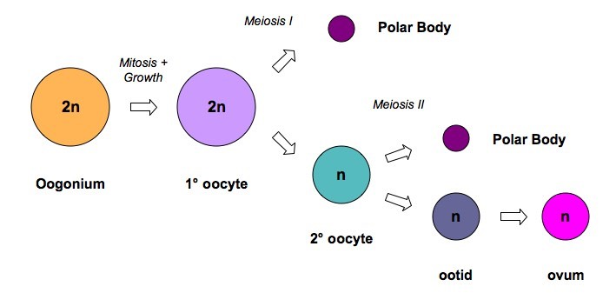
Oogenesis

Slide 10
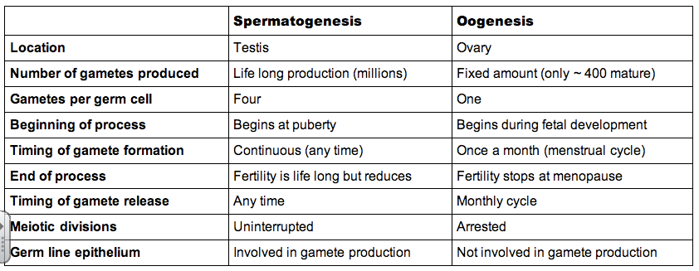
Sperm and Egg

Slide 11
Sperm and Egg
Contains nutrient and mitochondria for cell division
Composed of glycoproteins
proteins fibers for strength (red line)

Slide 12
Fertilization
What is fertilization?
Internal
Festination happens outside the body
Gametes released outside the body
Must be in the same general location
Cons: predation, environment
Typically aquatic
External
Fertilization happens inside the body
Typically terrestrial or marine mammals

Slide 13
Fertilization
Polyspermy is when more than one sperm enters the egg
Measures are taken to prevent this from happening
The egg releases chemicals that can be detected by sperm (chemotaxis)

Slide 14
Fertilization
The acrosome contains enzymes that when bound to the zona pellucida are released to digest the jelly coat
Without the acrosome the membrane on the tip of the sperm can bind to the egg membrane due to proteins on the sperm cell
This sperm has fused with the egg and the nucleus will energy the egg cell resulting in fertilization

Slide 15
Fertilization
The sperm activates the egg
Zona pellucida undergoes the cortical reaction
The cortical granules release enzymes that destroy the sperm-binding proteins on the jelly coat

Slide 16
Implantation
Following fertilization the fertilized ovum divides
After many divisions a hollow ball of cells called a blastocyst is formed
It takes approximately 7 days for the blastocyst to reach the uterus
The blastocyst embeds into the endometrium (implantation)
Now gets nutrients from endometrium using fingerlike projections that have developed

Slide 17
hCG
The endometrium is sustained by the hormone progesterone
If progesterone levels aren't maintained (i.e. the corpus luteum degenerates), then the endometrium will shed
The blastocyst that secretes human chorionic gonadotrophin (hCG)
hCG maintains the corpus luteum post-ovulation
Gradually the placenta develops and produces progesterone (at around 8 - 10 weeks), at which point the corpus luteum is no longer needed

Slide 18
The placenta
Composed of fetal tissue
In contact with material tissue
Placental villus is a finger like projection that exchanges materials with the mother
The spaces between the villi are filled with material blood
Fetal blood flows close to the surface of the villi
The barrier between the maternal blood and fetal blood is called the placental barrier which is selectively permeable

Slide 19
The Placenta
Nutrients, oxygen and antibodies will be taken up by the fetus, while carbon dioxide and waste products will be removed
Around the 9th – 12th week the placenta secretes estrogen and progesterone
The corpus luteum can break down

Slide 20
Birth
The process of childbirth = parturition
When the fetus is fully grown and takes up all available space in the uterus the walls of the uterus will stretch
A signal is sent to the brain releasing oxytocin from the pituitary
Oxytocin inhibits progesterone, which was inhibiting uterine contractions
Oxytocin also directly stimulates the smooth muscle of the uterine wall to contract, initiating the birthing process
The contraction of the uterine wall causes further stretching, which triggers more oxytocin to be released which causes more muscle contractions (positive feedback)

Slide 21
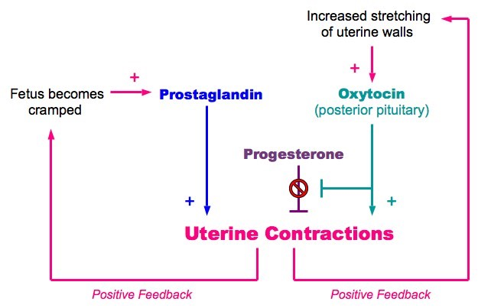
Birth
The fetus releases prostaglandins in response to the cramped conditions which cause further contractions
Contractions will stop when labor is complete and the baby is birthed (no more stretching of the uterine wall)

Slide 22
Types of species
Altricial = give birth to helpless offspring
Immobile
Eyes closed
Unable to get food
Precocial
Mobile
Open eyes
Usually mammals with large body size due to longer gestation

