Slide 1
The Kidney

Slide 2
Types of Organisms
Osmoconformers match their body osmolality to their environment actively or passively
Majority of marine invertebrates
Osmoregulators tightly regulate their body osmolality, which always stays constant
Blue crab, humans

Slide 3
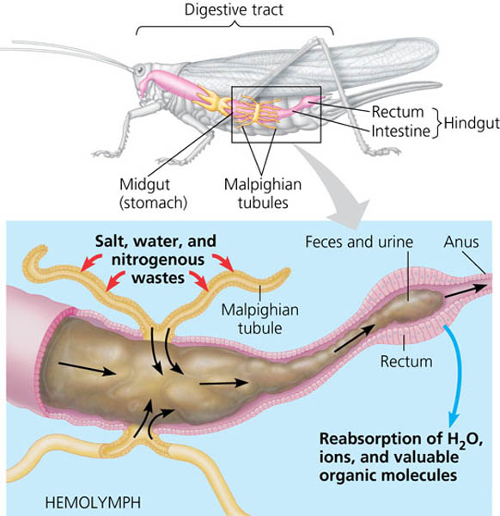
Osmoregulation
How do insects remove waste?
The Malpighian tubule system in insects
Hemolymph - Circulating fluid in insects similar to blood
Open to digestive tract

Slide 4
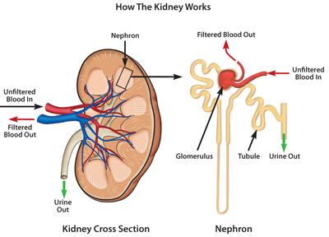
Osmoregulation
In humans the kidney is responsible for osmoregulation

Slide 5
The Kidney
Excretory products are produced by cells and removed from the blood by the kidney
Four groups of substances removed from the blood
Toxins that are not fully metabolized
Water
Salt
Nitrogenous waste (urea)
Which of the four are not excretory products?
Salt and water removal are part of osmoregulation

Slide 6
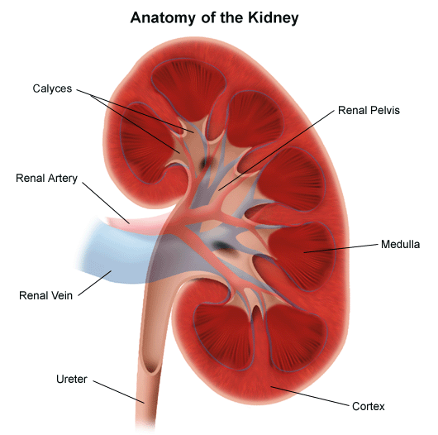
The Kidney
Kidneys = filter
Filtered material = filtrate
Reabsorption of materials
Excretion of waste in the form of urine

Slide 7
The Kidney
Renal Artery – branches off of the aorta bringing waste-filled blood into the kidney.
Renal Vein – removes the filtered blood from the kidneys to the inferior vena cava

Slide 8
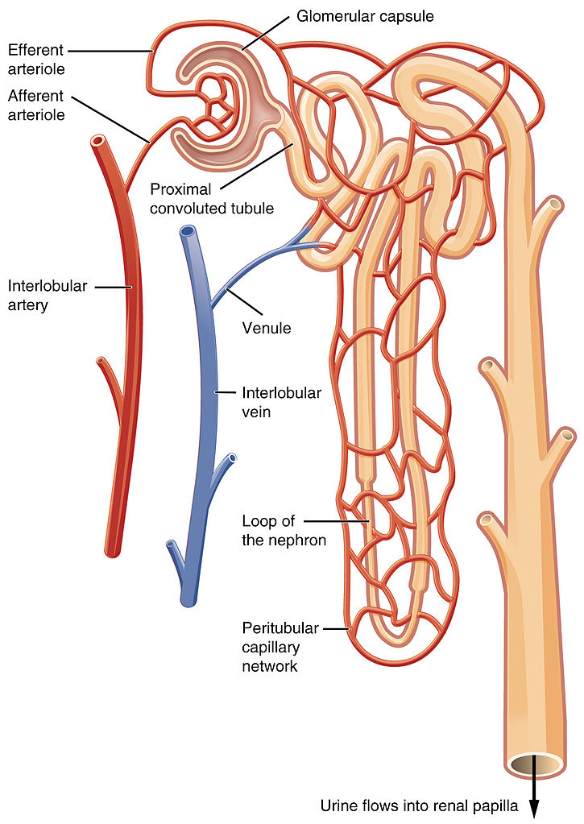
The Kidney
Basic functional unit of kidney
Filtration unit
Afferent arteriole brings blood from the renal artery
Capillaries in the glomerulus have high pressure which allows fluid to move into the Bowman’s capsule

Slide 9
The Kidney

Slide 10
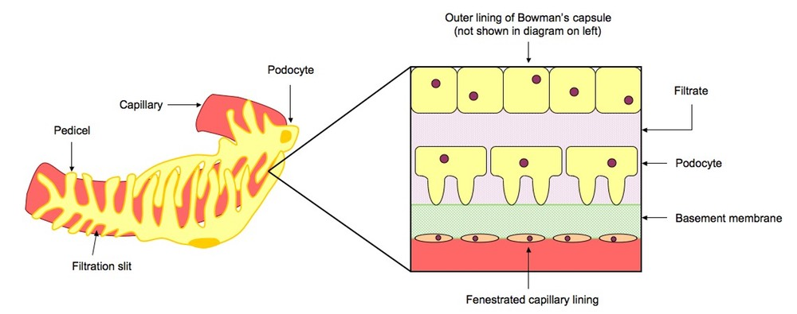
The Nephron
The structure of the glomerulus and Bowman’s capsule aid in ultrafiltration
Pores – between the cells in the walls of capillaries
The basement membrane –
Covers and supports the walls of the capillaries,
Negatively charged glycoproteins
Prevents plasma proteins from being filtered due to positive charge.
Podocytes –
Form the inner wall of the Bowman’s capsule.
Each cell has extensions that wrap around the capillaries
short branches that prevent small molecules from being filtered out.

Slide 11
The Kidney
Proximal convoluted tubule
Selective reabsorption by active transport
All glucose, amino acids, 80% water, sodium, and mineral ions

Slide 12
The Kidney
Active transport into cells of tubule then diffusion into blood
Water follows by osmosis
Structure of proximal convoluted tubule
Microvilli
Mitochondria
Protein pumps and carrier proteins

Slide 13
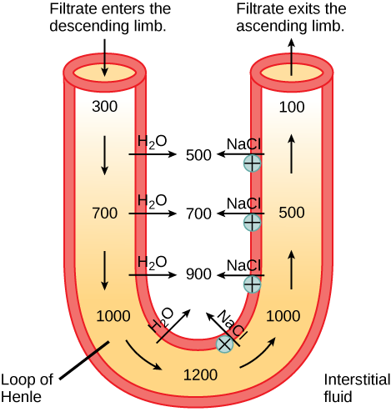
The Kidney
Loop of Henle maintains hypertonic conditions in medulla
Descending limb permeable to water
Matches concentration of medulla
Ascending limb is permeable to salt
Actively pumped out
Generates concentration in medulla

Slide 14
The Kidney
The distal convoluted tubule allows for more reabsorption
Filtrate is hypotonic
Passes to collecting duct which can change its permeability to water
Antidiuretic hormone (ADH)
Makes collecting duct permeable to water

Slide 15
The Kidney

Slide 16
ADH
Secreted by pituitary gland
Targets collecting ducts of kidneys
Collecting ducts extend into hypertonic medulla

Slide 17
*****Alcohol prevents ADH from being released

Slide 18
Loop of Henle and Adaptations
Kangaroo Rats never drink water so how do they survive?
Long loop of Henle
More salt reabsorption
Larger salt concentration in medulla
More water reabsorption
Highly concentrated urine

Slide 19
Types of Waste
Different organisms produce different waste products due to their habitat

Slide 20
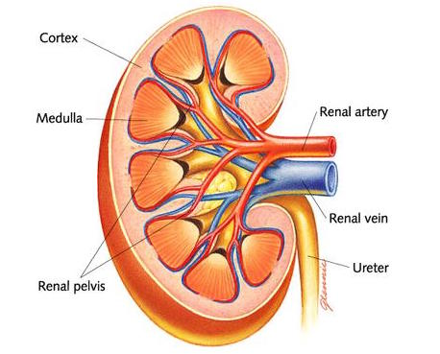
Skills
• Skill: Drawing and labelling a diagram of the human kidney.
• Skill: Annotation of diagrams of the nephron.

Slide 21
Applications
Application: Consequences of dehydration and overhydration.
Dehydration
Symptoms?
Causes?
Rehydrate with water and drinks that contain glucose and salts
Overhydration
Potentially fatal but rare

Slide 22
Applications
Application: Treatment of kidney failure by hemodialysis or kidney transplant.
Kidney failure results in people not being able to remove toxic substances form their blood
Hemodialysis is artificial filtering of the blood using a machine

Slide 23
Applications
• Application: Blood cells, glucose, proteins and drugs are detected in urinary tests.
Glucose
diabetes
Proteinuria
Diabetes
High blood pressure

