Slide 1
The Reproductive System
Also some hormones and homeostasis

Slide 2
Maintaining Blood Sugar
Pancreatic cells detect blood glucose levels and respond when they are too high or low
Regions of the pancreatic tissue contain endocrine tissue (Islets of Langerhans)
Secrete hormones into the blood stream
Two cells α and β

Slide 3
Maintaining Blood Sugar
α cells secrete glucagon when blood sugar is to low
Glycogen → glucose
β cells secrete insulin when the blood sugar rises
Uptake of glucose in other tissues
glucose → glycogen

Slide 4
Maintaining Blood Sugar
Type I Diabetes – can’t produce enough insulin
Autoimmune
β cells are destroyed
Treated by injections or implanted devices
Possible use of stem cells to replace β cells
Type II Diabetes - Body does not respond to insulin
Deficiency of insulin receptors or glucose transporters
Often caused by diet and lifestyle
Treated by modifying diet and lifestyle

Slide 5
Maintaining Body Temperature
Thyroid gland → thyroxin
Thyroxin contains iodine
Targets most cells
Regulates the metabolic rate
High MR increases generation of body heat

Slide 6
Maintaining Body Temperature
Consequences of iodine deficiency
Lethargy
Depression
Weight gain (slower metabolism)
Feeling cold
Constipation

Slide 7
Appetite
Controlled by concentration of leptin in blood
Determined by amount of adipose and food intake
Adipose → leptin
Target is hypothalamus
Specifically the part that helps control appetite
Increase in adipose = increase in leptin = long term appetite inhibition and reduction in food intake

Slide 8
Appetite
Experiments on mice
A strain of mice (with two recessive alleles ob/ob) had increased feeding and adipose tissue through weight gain.
Wild type mice had a gene that supported the production of leptin
Ob/ob mice can not produce leptin
Injections of leptin showed a decrease in appitite and body mass

Slide 9
Appetite
The discovery in mice led to the idea that we could treat obesity in humans
A clinical trial was done with 73 obese volunteers
Injected with leptin or placebo
Swelling and skin irritation
Group with leptin had a larger but highly variable decrease in body mass
Ob/ob mice don’t produce leptin but this is not true of obese humans
Other option is that the target cells have become resistant

Slide 10
Circadian Rhythms
In the hypothalamus there are two groups of cells called suprachaismatic nuclei (SCN)
Set daily rhythm
Control pineal gland secretion of melatonin
Melatonin increases in the evening
Drops at dawn

Slide 11
Circadian Rhythms
Melatonin regulates sleep-wake cycle
Causes drowsiness and promotes sleep
Drop in core body temperature
Receptors have been found in the kidney
Control of urine production at night?
Experiments with melatonin
Removal of light cues
SCN and pineal gland maintain rhythm

Slide 12
Circadian Rhythms
Jet lag
SCN and pineal gland maintain original rhythm
Typically only lasts for a few days
Ganglion cells in the retina detect light and send signals to the SCN
This helps the body adjust over time

Slide 13
The Reproductive system
Now….

Slide 14
How do males become male?
All embryos start the same
Embryonic gonads can become ovaries or testes
One gene on the Y chromosomes determines which
SRY gene present → testes
Gene codes for the testes determining factor protein

Slide 15
Testosterone
The 8th week of pregnancy is when the testes develop
Testes have testosterone-secreting cells and produce testosterone until the 15th week
Causes male genitalia development

Slide 16
Testosterone
Puberty leads to an increase in testosterone
Sperm production (primary sexual characteristic)
Changes in voice and pubic hair (secondary sexual characteristics)

Slide 17
Now on to the more difficult gender…
How do ovaries develop without the prompt of a gene?
Estrogen and progesterone are always present during pregnancy
The lack of testosterone and the presence of estrogen and progesterone leads to development of ovaries

Slide 18
Estrogen and Progesterone
Increase during puberty
Causes secondary sexual characteristics such as pubic hair growth and breast enlargement

Slide 19
The Menstrual Cycle
Two phases
Follicular
Starts with follicles developing and ends with an egg being released
Luteal
Starts with what happens to the follicle after the egg is released and ends with menstruation or pregnancy

Slide 20
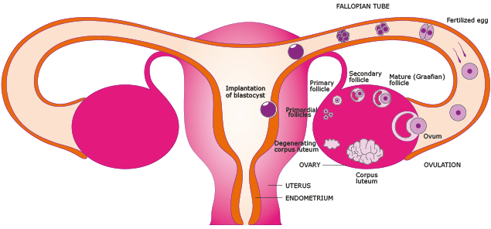
The Menstrual Cycle
Order of events
Follicles develop (with egg inside)
Eggs grow while endometrium is repaired and starts to thicken
Most developed follicle breaks open and released an egg
Remaining follicles degenerate
Follicle that released the egg becomes corpus luteum
Further development of endometrium for implantation
If no implantation occurs corpus luteum breaks down
Causes endometrium to break down and shed

Slide 21
The Menstrual Cycle
Four main hormones
FSH: (follicle stimulating hormone) promotes development of follicles which contain eggs. Also stimulates estrogen production by the follicle wall. Peaks towards the end of the cycle.
Estrogen: Promotes repair and thickening of the endometrium. Increases FSH receptors which in turn promotes estrogen production. High levels of estrogen inhibit FSH and promote LH secretions. Peak at the end of the follicular phase
LH: Promotes the completion of meiosis and digestion of follicle wall to allow ovulation. Stimulates the development of the follicle wall into the corpus luteum after ovulation. Corpus luteum secretes estrogen and progesterone. Sharp peak at the end of the follicular phase
Progesterone: Thickening and maintenance of the endometrium. Inhibits FSH and LH. Rises, peaks, and drops during luteal phase

Slide 22
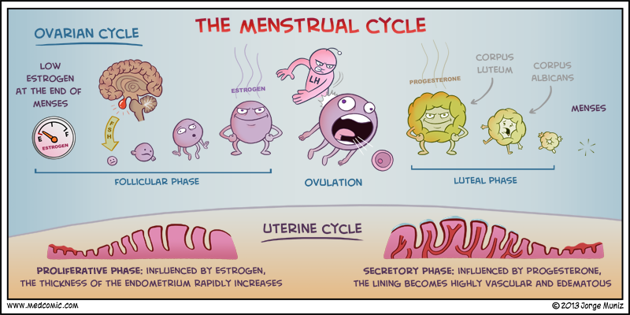
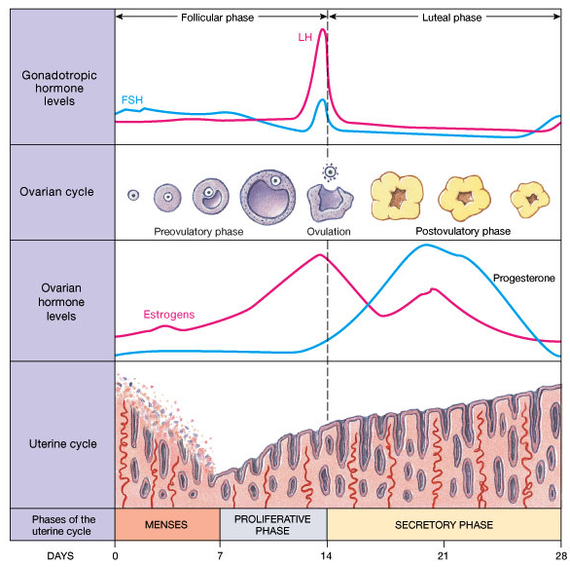
Life lesson: This is when females are the most fertile. (5 days before ovulation up to ovulation)
Life span of sperm = 5 days
Life span of ovum = 24 hrs

Slide 23
Skills
Annotate Diagrams of the male and female reproductive systems (structure and function)

Slide 24
Applications
Causes and treatment of type I and II diabetes
Testing of leptin on patients with clinical obesity and reason for the failure to control the disease
Causes of jet lag and the use of melatonin to alleviate it
The use in IVF of drugs to suspend the normal secretion of hormones, followed by the use of artificial doses of hormones to induce superovulation and establish a pregnancy
William Harvey’s investigation of sexual reproduction in deer

Slide 25
IVF
In vitro means that fertilization occurs outside the body
Women fist take a drug each day to stop FSH and LH secretion
What happens to estrogen and progesterone?
Suspension of menstrual cycle
Doctors can control timing and amount of egg production in the ovaries

Slide 26
IVF
Injections of FSH and LH are given for 10 days
Higher concentration of FSH leads to more follicles being developed
HCG is injected to mature follicles
All eggs are harvested and mixed with sperm cells
Embryos are implanted in the women
Progesterone tablets are usually provided to maintain the uterus lining since the normal menstrual cycle was suspended

Slide 27
William Harvey
Same guy that discovered the circulation of blood
Tested deer according to Aristotle's “seed and soil” theory
Male produces a seed which forms and egg in the menstrual blood
Seasonal breeders
Examined uterus during breeding season
Immediately after mating
Two or more months after mating season

