Slide 1
Topic 2.1-2.7
The Chemistry of Life

Slide 2
Outline
Elements and Water
Carbohydrates
Lipids
Proteins
Nucleic Acids

Slide 3
Elements
Most frequently occurring elements
C,H,O,N
Other important elements
S
Ca
Fe
Na
P

Slide 4
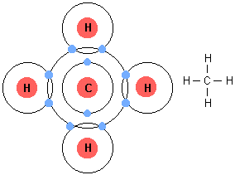
Elements
Carbon can form 4 covalent bonds

Slide 5
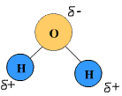
Water

Slide 6
Water
Because of the polarity of water molecules the negative charge on each oxygen atoms is attracted the positive charge on hydrogen atoms of other water molecules
Hydrogen bonds
Gives water its physical properties
Cohesion
Solvent
Thermal

Slide 7
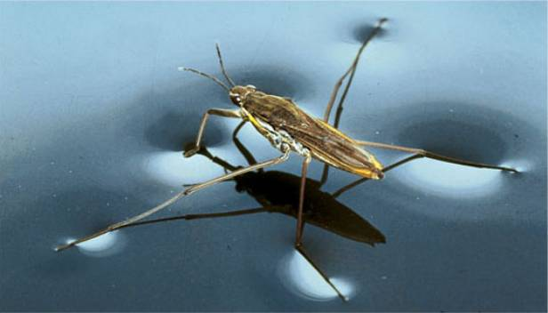
Water
Cohesion

Slide 8
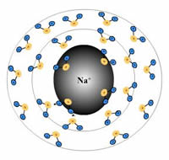
Water
Solvent properties

Slide 9
Water
Thermal properties
Water has a high specific heat capacity

Slide 10
Water
Most biochemical reactions take place in solution where water is the solvent
Condensation/dehydration
hydrolysis
The cytoplasm is largely water and all cells exist in a medium which is water based e.g. tissue fluid, blood, pond.

Slide 11
Organic v inorganic compounds
Organic molecules are found in living things
Inorganic molecules are not found in living things

Slide 12
Organic Molecules
Polymers and Monomers
Carbohydrates
Lipids
Proteins
Nucleic Acids

Slide 13
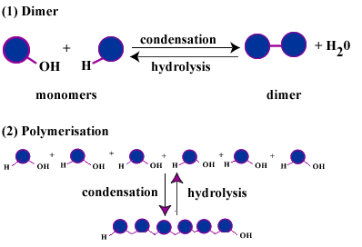
Condensation and Hydrolysis
Catabolism
Anabolism (Add)

Slide 14
Carbohydrates
Short term energy
Monosaccharides
Glucose
Fructose
Galactose

Slide 15
Carbohydrates
Important disaccharides
Maltose
Lactose
Sucrose
Important polysaccharides
Starch
Cellulose
Glycogen

Slide 16
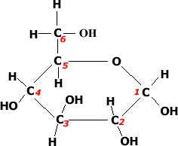
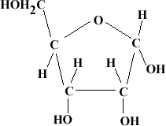
Carbohydrates
Carbohydrates you need to be able to identify
Both monosaccharides

Slide 17
Lipids
Insulation
Energy storage
Buoyancy
Steriods

Slide 18
Lipids
Unsaturated
Fatty acids
Poly or monounsaturated?
OR

Slide 19
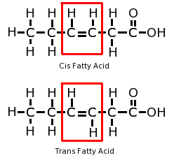
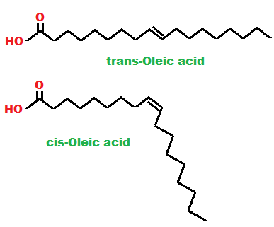
Lipids
Cis and Trans isomers of unsaturated fatty acids

Slide 20
Lipids
Fatty acids are part of triglycerides and phospholipids
Triglyceride has a glycerol back bone and three fatty acids

Slide 21
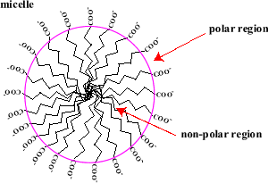
Lipids
In water fatty acids orient themselves in to a sphere shape called a micelle
Hydrophilic
Hydrophobic

Slide 22
Carbs v Lipids
Carbs and lipids both store energy but there are some differences
Ease of digestion
Speed of energy release
Solubility in water
Amount of energy

Slide 23
Proteins
Proteins play many roles in our bodies
Enzymes
Movement
Transportation
They are made up of amino acids
There are 20 in living things
Each amino acids has a similar structure except for the R group

Slide 24
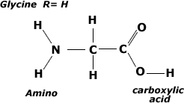
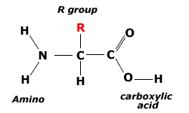
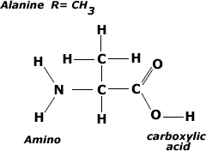
Proteins

Slide 25
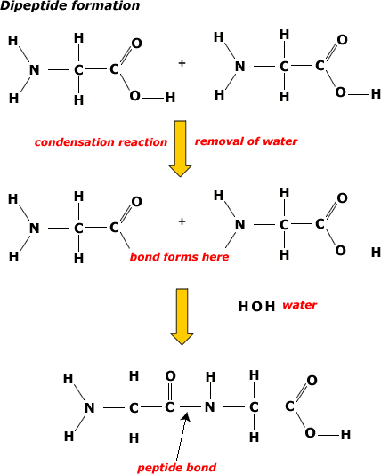
Peptide Bonds

Slide 26
Proteins
Amino acids can be linked together in any sequence giving a huge range of possible polypeptides.
A protein may consist of a single polypeptide or more than one polypeptide linked together
The amino acid sequence determines the three-dimensional conformation of a protein.

Slide 27
Proteins
Rubisco
Insulin
Immunoglobulins
Rhodopsin
Collagen
Spider silk

Slide 28
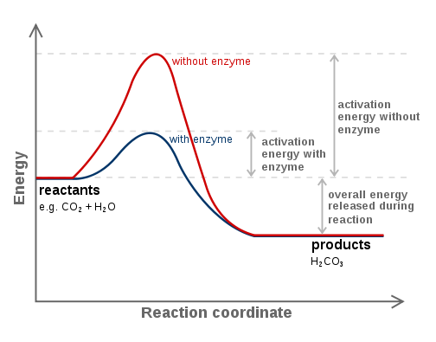
Proteins
Enzymes area protein that lowers the activation energy of a reaction
Speeds up reactions
Called a catalyst

Slide 29
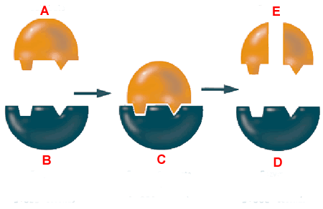
Proteins (Enzymes)

Slide 30
Proteins (Enzymes)
Factors that effect enzyme activity
Temp
Ph
Substrate concentration

Slide 34
Nucleic Acids
Carry genetic information
Nucleotides
Sugar
Nitrogen base
Phosphate

