Slide 1
Topic 2.6 - 7
DNA

Slide 2
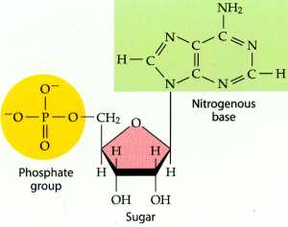
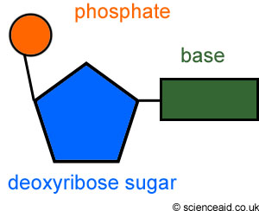
Nucleotides

Slide 3
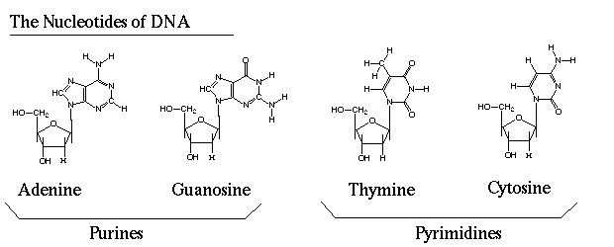
Nucleotides

Slide 4
DNA vs. RNA
DNA | RNA
Deoxyribose | Ribose
Thymine | Uracil
Double stranded | Single stranded

Slide 5
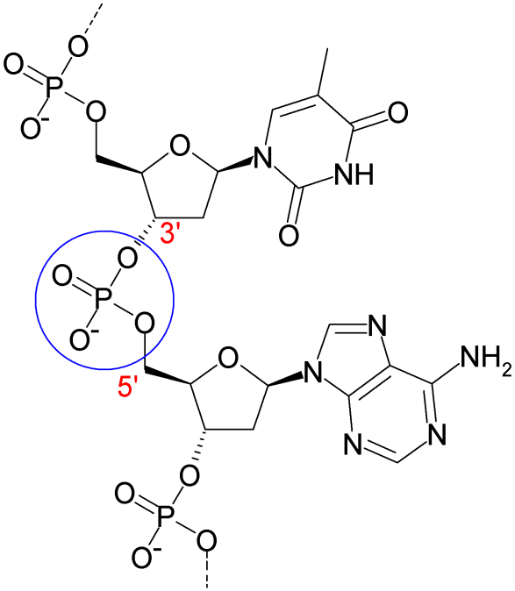
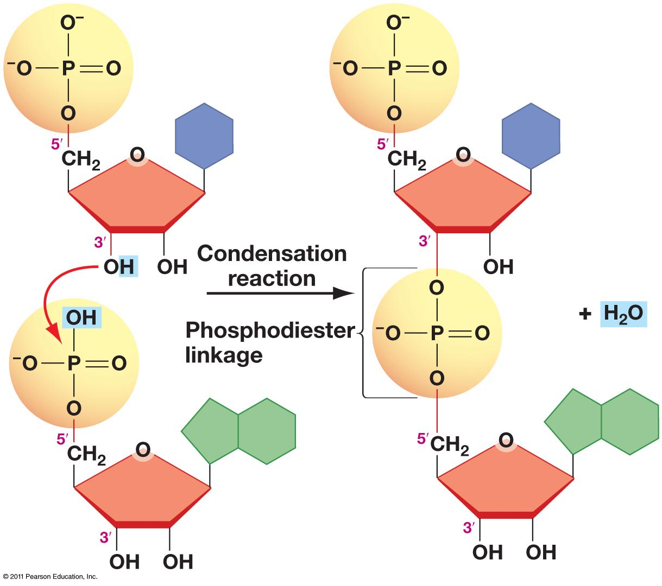
DNA Structure

Slide 6
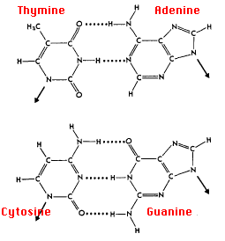
DNA Structure
Purine and pyrimidine

Slide 7
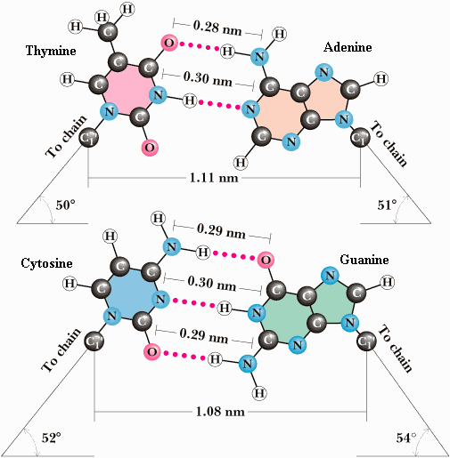
DNA Structure
If it has to be a purine and pyrimidine bond why can’t A go with C and T go with G?

Slide 8
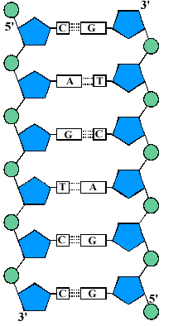
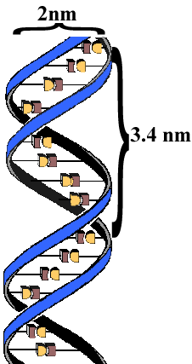
DNA structure
The whole thing…
Anti-parallel
Double stranded
Double helix

Slide 9
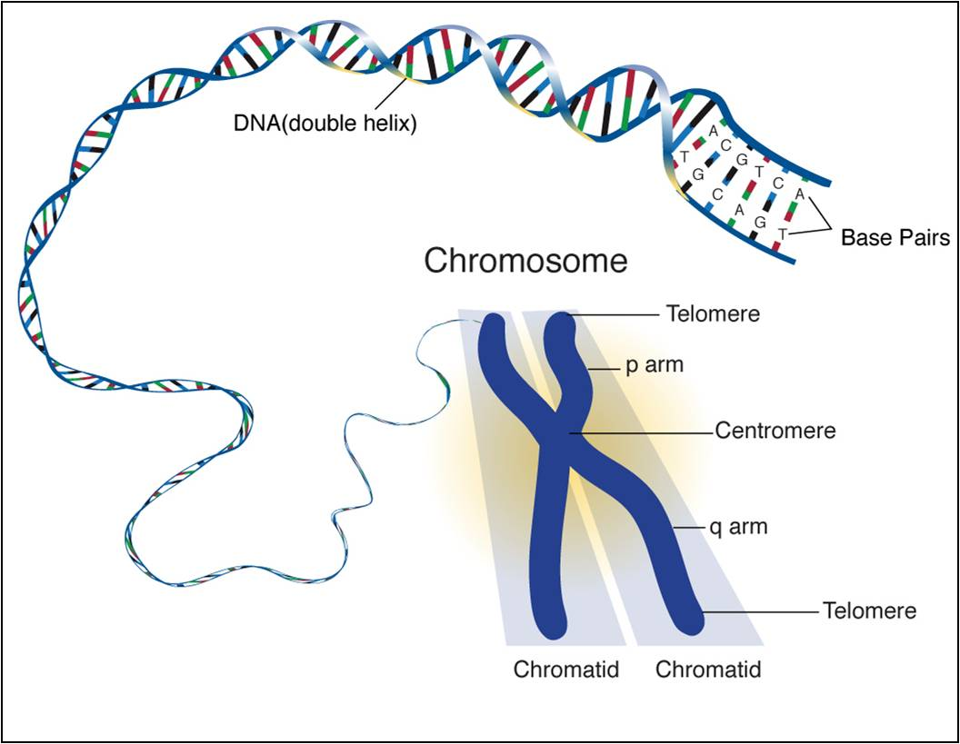
DNA Structure

Slide 10
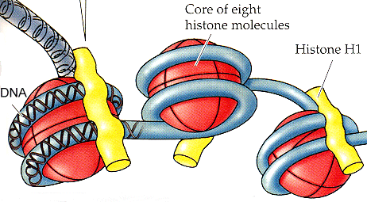
Nucleosome
A nucleosome is the basic unit of eukaryotic chromosome structure

Slide 11
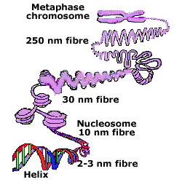
Nucleosomes
Supercoiling

Slide 12
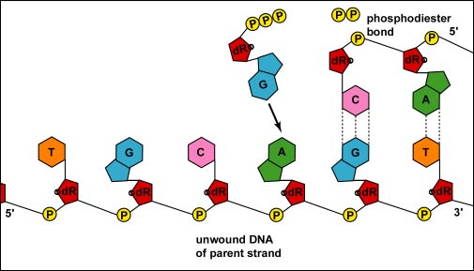
DNA replication
DNA replication occurs in the 5’ to 3’ direction
The 5' (prime) end of the free nucleotide is added to the 3' (prime) end of the nucleotide chain that is already formed.

Slide 13
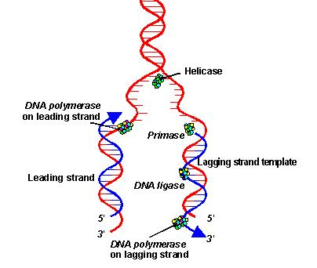
DNA replication
Helicase “unzips” the DNA molecule by breaking the hydrogen bonds
replication fork
Leading strand
Lagging strand (Okazaki fragments)

Slide 14
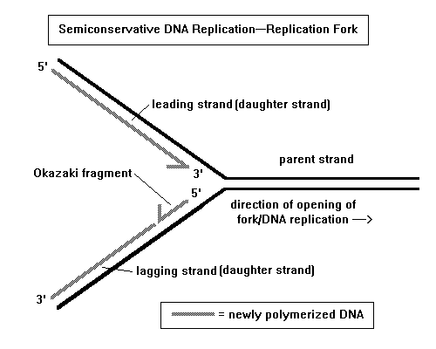
DNA Replication

Slide 15
DNA replication
RNA primase adds short sequences of RNA to both strands
Why?
DNA polymerase III adds nucleotides to each template strand in a 5'→3' direction’

Slide 16
DNA Replication
DNA polymerase I removes the RNA primers replaces them with DNA nucleotides
DNA ligase then joins the Okazaki fragments together to form a continuous strand

Slide 17
DNA Replication

Slide 19
Replication starts at many points in eukaryotic organism

Slide 20
Semi-conservative

Slide 21
DNA to Protein

Slide 22
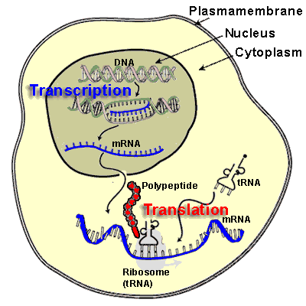
Overview
Genes are expressed by the process of protein synthesis. This starts with DNA, then through the process of transcription mRNA is made, and then through the process of translation protein is made

Slide 23
There are three types of RNA
mRNA
tRNA
rRNA

Slide 24
Transcription
Goal is to turn DNA into mRNA
Why?
Only one of the two strands is copied
Antisense strand
Sense strand
mRNA is a complementary copy of one gene – not the entire strand

Slide 25
Transcription
Three basic steps
Initiation
Elongation
Termination

Slide 26
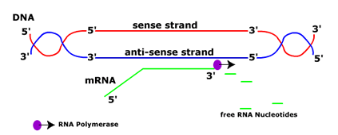
Transcription (Initiation)
Promoter region for the gene determines which strand is the antisense strand
5’ to 3’ direction
RNA polymerase attaches the promoter region and unwinds helix

Slide 27
Transcription (Elongation)
RNA polymerase

Slide 28
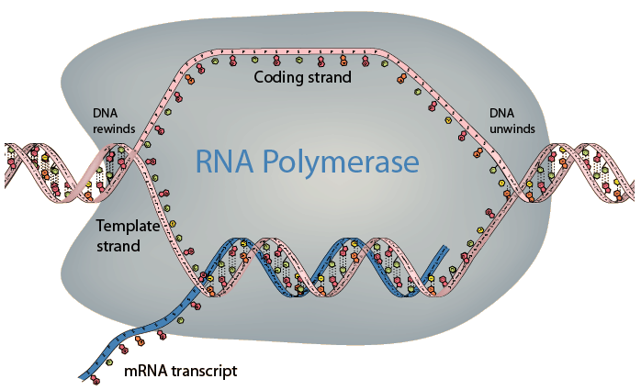
Transcription (Termination)
Transcription goes until it reaches a terminator

Slide 29
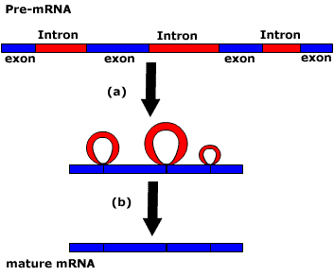
mRNA modification in eukaryotes
Introns are removed
Now it is mature mRNA
The DNA helix reforms.

Slide 30
Translation
Translation also has three stages
Initiation
Elongation
Termination.
5’ to 3’ direction

Slide 31
Translation
Ribosome
Free ribosomes form proteins for internal cell use.
Ribosomes on the ER make proteins for secretion.
Codons are read
tRNA molecules attach to specific amino acid sequences
How is the correct tRNA molecule chosen?

Slide 32
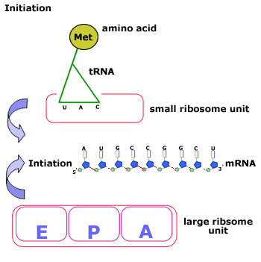
Translation (initiation)
Start codon (AUG) initiates translation
The large unit of the ribosome moves over the mRNA.

Slide 33
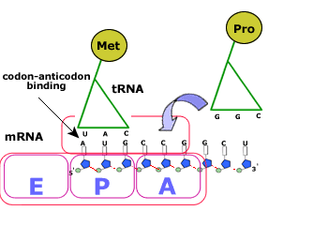
Translation (Elongation)
A- (Amino acid)
P- (Polypeptide)
E- ( Exit)

Slide 34
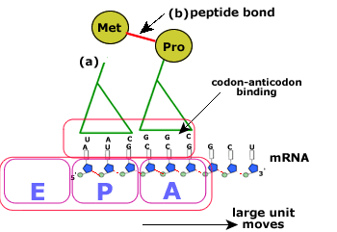
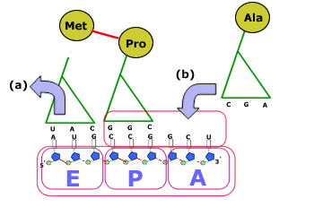
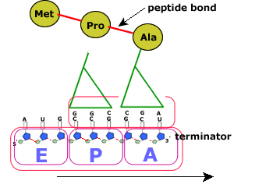

Slide 35
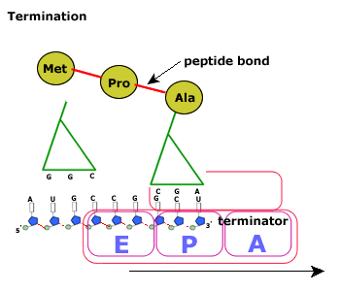
Translation - Termination
Stop codon
The polypeptide is released from the translation process.
The two sub units move and separate.

Slide 36
Peptide Bonds

Slide 37
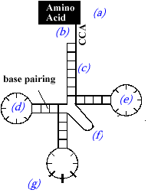
tRNA
Amino acid is attached to this sequence by the activation enzyme. This binds a specific amino acid
Anti-codon

Slide 38
rRNA
Ribosomes are mode of proteins and rRNA
There is a large sub-unit and a small sub-unit
Large sub-unit has three binding sites for tRNA molecules ( E, P and A site).
Small sub-unit has a binding site for mRNA

Slide 39
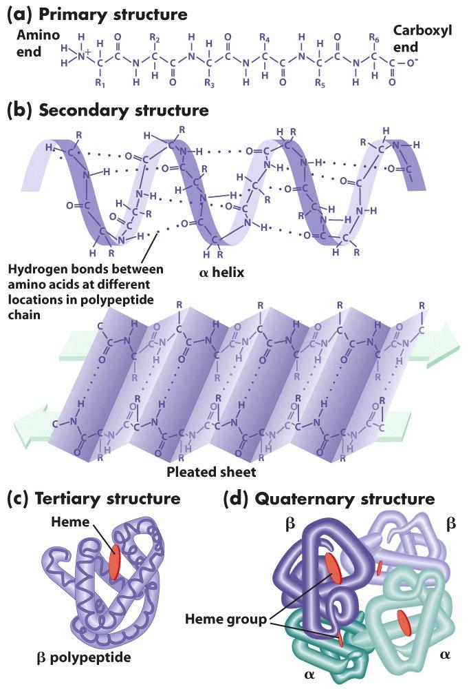
Protein Structure
1°- sequence of amino acids
2° - α helix and β pleated sheets held together by hydrogen bonds
3° - further folding of the polypeptide stabilized by interactions between R groups
4° - multiple polypeptides bonded together

