Slide 1
Topic 6 Human Physiology
6.1 Digestion and Absorption

Slide 2
Overview
Diagram the digestive system
Know the functions of the following: villi, mouth, esophagus, stomach, small intestine, pancreas, liver, gall bladder, large intestine
How is food mixed and moved along the in the gut
Identify tissue layers in transverse sections of the small intestine
The role of enzymes on specific molecules in digestion
How villi increases surface area and why that is important
Various ways that nutrients are absorbed
Outline the process occurring in the small intestine to digest starch and transport products to the liver (see Edmodo)

Slide 3
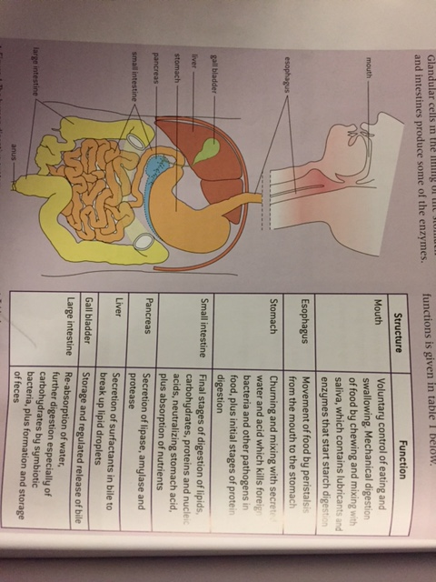

Slide 4
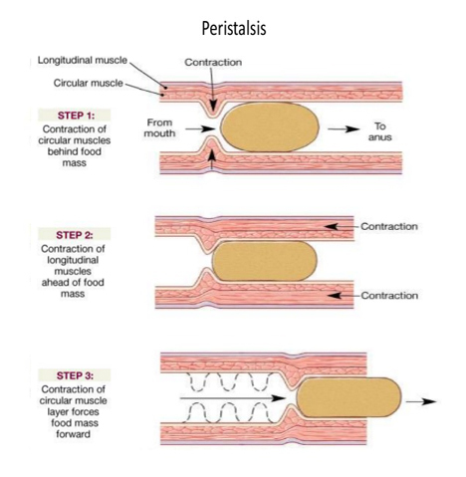
Peristalsis
The contraction of circular and longitudinal muscle layers of the small intestine mixes the food with enzymes and moves it along the gut
One direction
Abdominal for vomiting
Quick to stomach
Slow in intestine
Churns to mix with enzymes

Slide 5
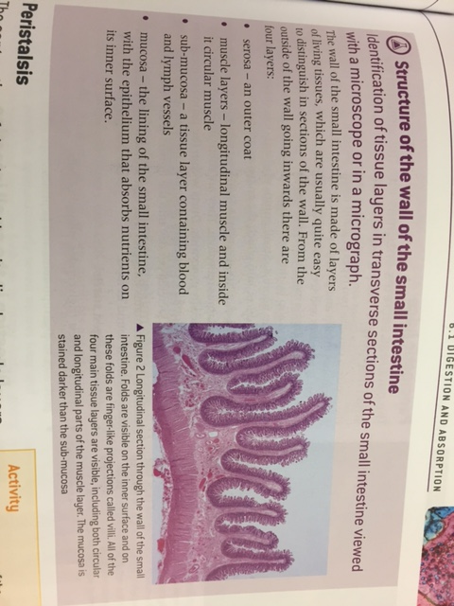
Small Intestine

Slide 6
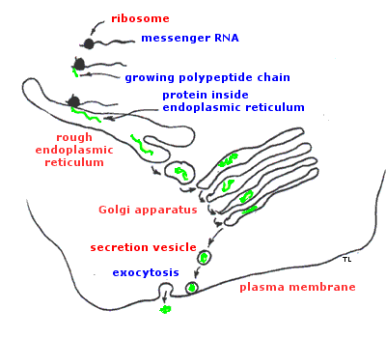
Small Intestine
Pancreas secretes enzymes into the lumen of the small intestine
Insulin and glucagon
Digestive enzymes
Ribosome → RER → Exocytosis → Ducts → lumen
Amylase
Lipase
Protease

Slide 7
Small intestine
Enzymes digest most macromolecules in food into monomers in the small intestine
Starch → maltose
Triglycerides →
Phospholipids →
Proteins and polypeptides → smaller peptides

Slide 8
Small intestine
Wall of the SI produces enzymes
Nucleases
Maltase
Lactase
Sucrase
Exopeptidase
Dipeptidase
Some things may not be digested due to the inability to digest them

Slide 9
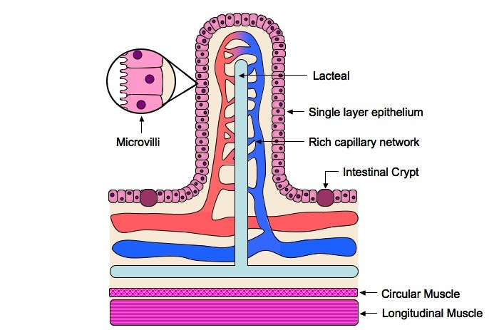
Villi
Villi increase the surface area of epithelium over which absorption is carried out
The process of taking substances into cells and the blood is called absorption
Surface area
microvilli

Slide 10
Villi
Villi absorb monomers formed by digestion as well as mineral ions and vitamins
Glucose, fructose, galactose and other monosaccharides
Amino acids
Fatty acids, monoglycerides and glycerol
Nitrogen bases
Mineral ions
Vitamins
Some harmful substances and bacteria
liver
Some useless substances
urine

Slide 11
Villi
Different methods of membrane transport are required to absorb different nutrients
Lumen → plasma membrane of microvilli → through cell → plasma membrane towards lacteal or capillaries
Fatty acids and monoglycerides move by simple diffusion because they can pass between phospholipids or facilitated diffusion by fatty acid transporting proteins
Assimilation into triglycerides that can’t diffuse back
Trigyceride + cholesterol = droplet that becomes coated in protein and phospholipids
Released by excocytosis into the inner side of villus
Into lacteal or capillaries

Slide 12
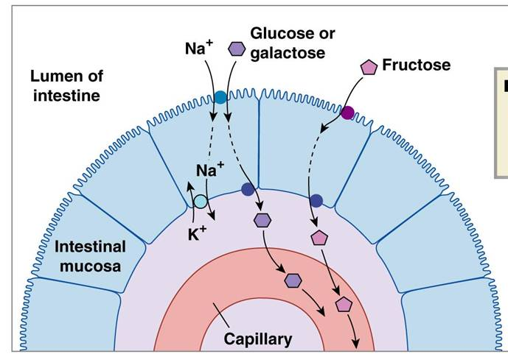
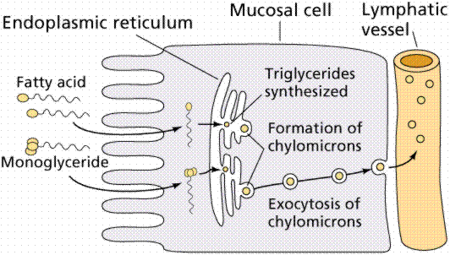
Villi
Glucose (polar) needs to rely on active transport and facilitated diffusion
Sodium potassium pump sets up gradient of sodium ions
Sodium glucose co-transporter moves one glucose and sodium into cytoplasm
Glucose channels (facilitated diffusion) moves glucose into interstitial spaced and then to capillaries

