Slide 1
Option C
Advanced Ecology

Slide 2
Communities and Ecosystems
C.2

Slide 3
Trophic Levels
Most organisms occupy more than one tropic level
It can be difficult to classify some organisms
Feeding relationships are more web like than chain like
Bears eat berries and fish

Slide 4
Food webs
We already did this

Slide 5
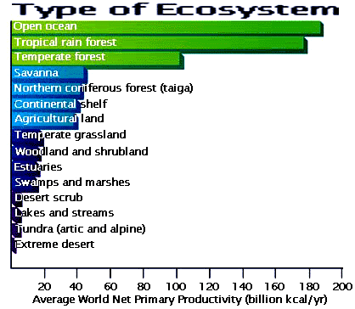
Pyramid of Energy
Remember these are drawn to scale
Does not need to be 10%
Varies by ecosystem
Net primary productivity
Determines length of chain

Slide 6
Gersmehl nutrient cycle diagrams

Slide 7
Gersmehl nutrient cycle diagrams

Slide 8
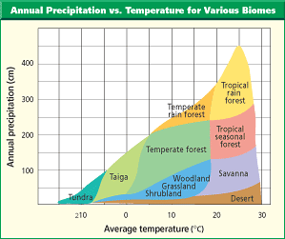
Climate impact on ecosystems
Climate factors influence the distribution of species
Climate will determine the type of ecosystem
Temperature
Precipitation

Slide 9
Succession
Two types: primary and secondary
Primary succession
Starts in ecosystems that have not been colonized
Pioneer species
Start with only organisms that can survive on rock
Development of soil allows more organisms
As deeper soil develops larger plants can develop

Slide 10
Net production
The percentage of ingested energy converted to biomass is dependent on the respiration rate
Net production = gross production – respiration
As succession progresses biomass increases → respiration increases
The gross production declines
Equilibrium happens community production/community respiration =1

Slide 11
Succession
Secondary succession
In areas what have an ecosystem established
Starts with a change in conditions
Fire, construction stops being used, forest cleared

Slide 12
Climax Communities
Through succession over time some communities reach a stable state
Resistant to ecological changes

Slide 13
Closed Ecosystems
Open systems – exchange matter and energy with surroundings
Natural ecosystems
Closed system – don’t exchange matter but does exchange energy (mesocosm)

