Slide 1
Advanced Ecology
Option C

Slide 2
Impacts of Humans on Ecosystems
C.3

Slide 3
Alien and Invasive Species
Result of human activity
Outcompete native species
Why?
Impact dependent on rate of growth and distribution

Slide 4
Alien and Invasive Species
Endemic species = native species
Competitive exclusion
Absence of predators
Be able to provide an example of an invasive species and the impact they had on the ecosystem
You must know the cane toad example

Slide 5
Biological Control
Introducing native predators to control the population
Can be used when an invasive species population is growing rapidly

Slide 6
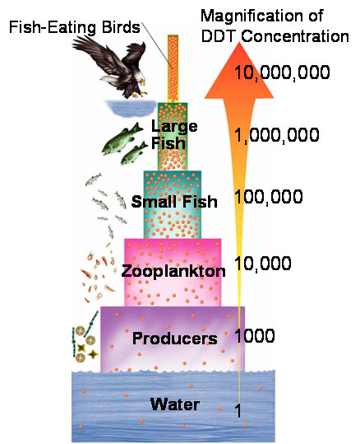
Biomagnification
Some toxins are capable of building up in the body of organisms
Often fat soluble
As trophic levels above the organism consume them the concentration increases
Why?

Slide 7
Biomagnification
Toxin levels in the higher trophic levels could become lethal
Example: DDT caused weakened shells in falcons and osprey

Slide 8
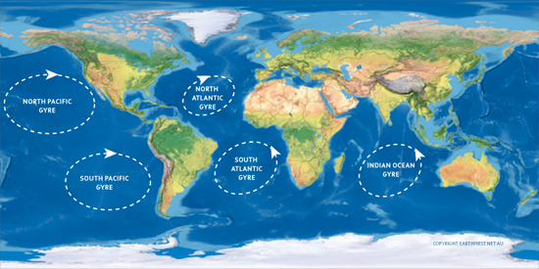
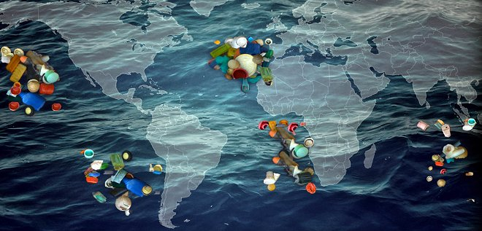
Plastics in the Ocean
Macroplastic and microplastic debris has accumulated in marine environments
Macro = large visible debris
Degradation lead to smaller micro pieces

Slide 9
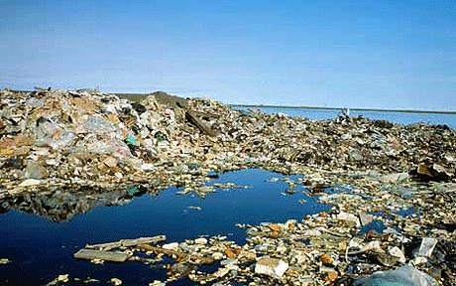
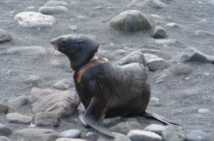
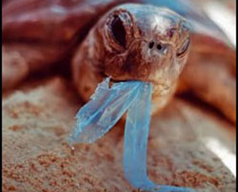
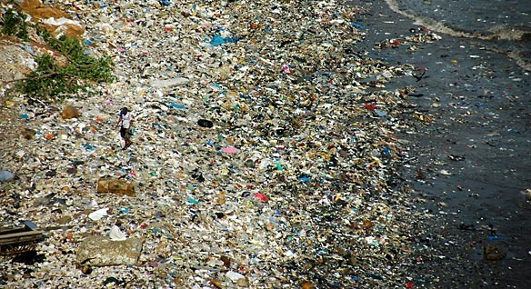

Slide 10
Plastics in the Ocean
Consequences
Animals can eat or become tangled
Plastics can absorb other organic chemicals which can increase toxicity
Degradation releases organic chemicals that can bioaccumulate

