Slide 1
Advanced Ecology
Option C

Slide 2
Population Ecology
C.5

Slide 3
Population size
How would you find the population in a given area?
What if it is a large area?
Population sampling assumes the sample is representative of the whole area
Several samples are usually taken
Why?

Slide 4
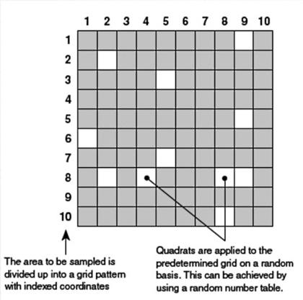
Quadrat Sampling

Slide 5
Population Growth
(natality + immigration) – (mortality + emigration)

Slide 6
Population Growth
A limiting factor is an environmental selection pressure that limits population growth
Top down – predation, keystone species
Bottom up – availability of resources

Slide 7
Population Growth
Factors that influence growth
Density dependent – depends on population size
Limiting factors, competition, disease
Density independent – does not depend on population size
Natural disaster

Slide 8
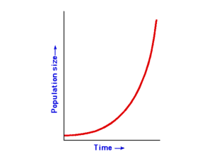
Population Growth
J curve
Ideal conditions
Exponential
Birth rate vs death rate

Slide 9
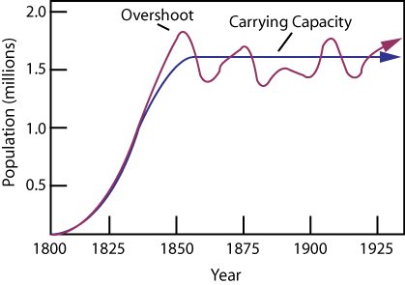
Population Growth
S curve
Colonization of a new habitat
Environmental resistance
Birth rate vs death rate
Exponential phase
Transition phase
Plateau phase

Slide 10
Carrying Capacity
Represented by K
Population stops growing
Natality = mortality
Can overshoot and then crash

