Slide 1
Cellular Respiration

Slide 2
Cellular Respiration

Slide 3
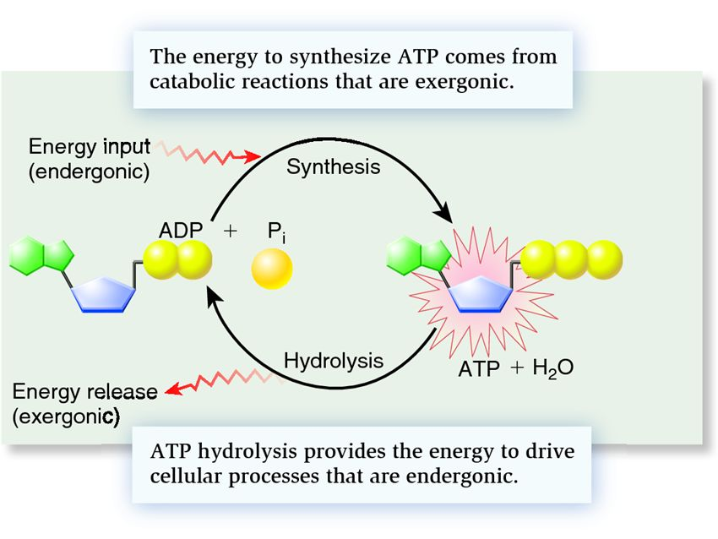

Slide 4
Background
Catabolic reaction – breaks molecules down
Anabolic reaction – adds molecules together
Oxidation – loss of electron, gain of oxygen
Reduction – gain of electron, loss of oxygen

Slide 5
Background
Phosphorylation – addition of a phosphate molecule to an organic molecule

Slide 6
Process
Aerobic
Anaerobic
Glycolysis
In the cytoplasm
Kreb’s Cycle
Lactic acid fermentation
or
Alcohol fermentation
Electron Transport Chain

Slide 7
Glycolysis
C
C
C
C
C
C
6 carbon glucose

Slide 8
Glycolysis
C
C
C
C
C
C
6 carbon glucose
2 ATP
2 ADP
P
P
C
C
C
C
C
C
Fructose-1, 6-biphosphate

Slide 9
Glycolysis
C
C
C
C
C
C
6 carbon glucose
2 ATP
2 ADP
P
P
C
C
C
C
C
C
Fructose-1, 6-biphosphate
Glyceraldehyde-3 phosphate
Glyceraldehyde-3 phosphate
P
P
C
C
C
C
C
C

Slide 10
Glycolysis
C
C
C
C
C
C
6 carbon glucose
2 ATP
2 ADP
P
P
C
C
C
C
C
C
Fructose-1, 6-biphosphate
P
P
C
C
C
C
C
C
2NAD+
2NAD+
2NADH
2NADH
P
P
P
P
Glyceraldehyde-3 phosphate
C
C
C
C
C
C

Slide 11
Glycolysis
C
C
C
C
C
C
6 carbon glucose
2 ATP
2 ADP
P
P
C
C
C
C
C
C
Fructose-1, 6-biphosphate
P
P
C
C
C
C
C
C
pyruvate
2NAD+
2NAD+
pyruvate
C
C
C
2NADH
2NADH
C
C
C
P
P
P
P
2 ATP
2 ATP
C
C
C
C
C
C
2 ADP
2 ADP

Slide 12
Glycolysis Overview
What kind of reaction is glycolysis? Why?
Where is glycolysis taking place in the cell?
What are the products of glycolysis?

Slide 13
The link reaction
Transport protein
NAD+
Coenzyme A
O
CoA
C
C
C
C
C
S
Acetyl CoA
CO2
NADH
Cytosol
Mitochondria

Slide 14
The Kreb’s Cycle
-CoA
Acetyl CoA
Citrate
Oxaloacetate
c
c
c
c
c
c
c
c
c
c

Slide 15
The Kreb’s Cycle
-CoA
Acetyl CoA
Citrate 6C
c
c
c
c
c
c
CO2
NAD+
NADH
c
c
c
c
c

Slide 16
The Kreb’s Cycle
-CoA
Acetyl CoA
Citrate 6C
c
c
c
c
c
c
CO2
NAD+
NADH
c
c
c
c
c
CO2
NAD+
NADH
c
c
c
c

Slide 17
The Kreb’s Cycle
-CoA
Acetyl CoA
Citrate 6C
Oxaloacetate
c
c
c
c
c
c
CO2
c
c
c
c
NAD+
NADH
NADH
NAD+
c
c
c
c
c
FADH2
FAD
CO2
NAD+
ATP
NADH
ADP
c
c
c
c

Slide 18
The Kreb’s Cycle
-CoA
Acetyl CoA
Citrate 6C
c
c
c
c
c
c
CO2
c
c
c
c
NAD+
NADH
NADH
NAD+
c
c
c
c
c
FADH2
FAD
CO2
NAD+
ATP
NADH
ADP
c
c
c
c

Slide 19
The Kreb’s Cycle Answer on page 5 in complete sentences
Why is the kreb’s cycle called a cycle?
How much ATP is formed PER GLUCOSE?
How much NADH is formed PER GLUCOSE?
How much FADH2 is formed PER GLUCOSE?
How much CO2 is released PER GLUCOSE

Slide 20
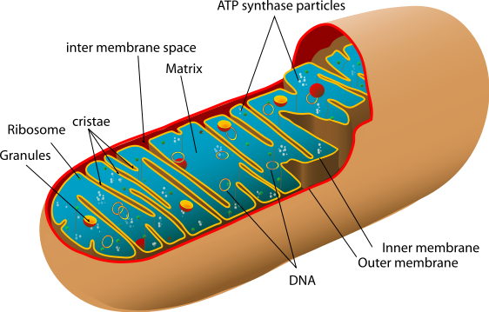
Electron Transport Chain
This is where the majority of the energy is produced.
Inner membrane
Carriers

Slide 21
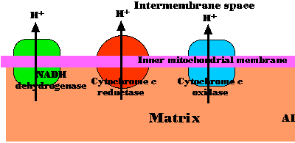
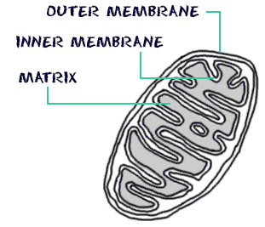
Electron Transport Chain
Carriers
Cytochromes
Coenzyme Q
Oxygen atom

Slide 22
Electron Transport Chain
Carriers
Easily reduced or oxidized
Close together
Pass electrons
NADH and FADH2
Electronegativity

Slide 23
Phosphorylation
The small amounts of energy released are used to carry out phosphorylation
Involves the movement of protons to provide energy for phosphorylation to occur.
Chemiosmosis
This specific phosphorylation is called oxidative phosphorylation

Slide 24
As electrons move down the ETC, protons are added to the intermembrane space
This causes a build up of protons in the inter membrane space
Imbedded in the mitochondria inner membrane are multiple enzymes called ATP synthase
The protons move through ATP synthase to the mitochondrial matrix because of the gradient
As the protons move they phosphorylate ADP

Slide 25
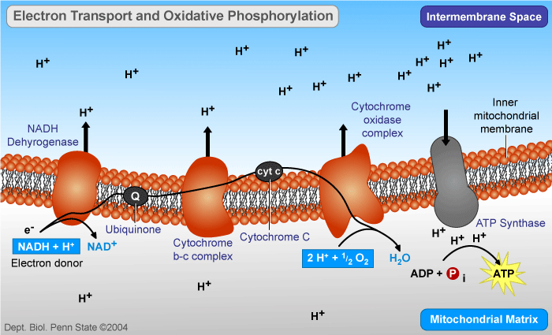

Slide 26
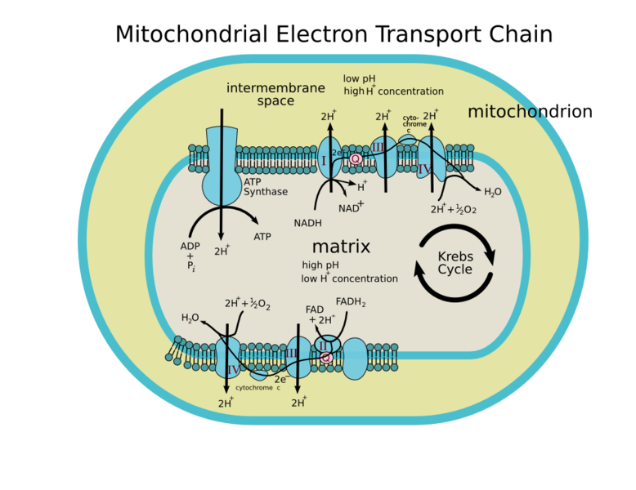
Glycolysis in the cytoplasm

Slide 27
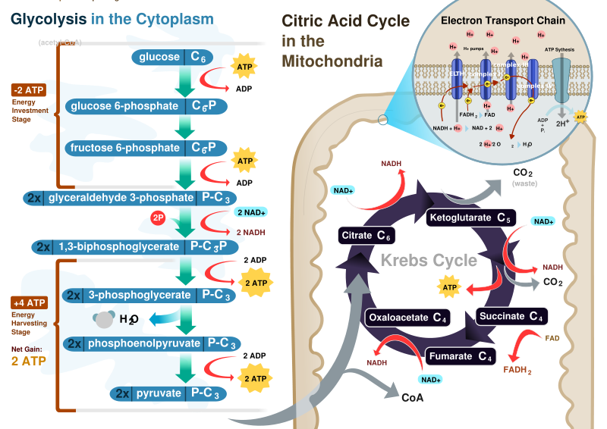

Slide 28
Oxygen
What is the role of oxygen as the final electron acceptor?

Slide 29
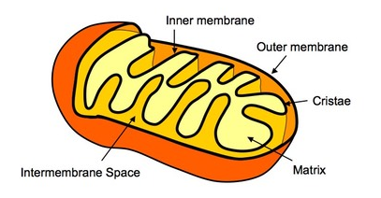
Structure and Function of Mitochondria

