Slide 1
Topic 4
4.4 Climate Change

Slide 2
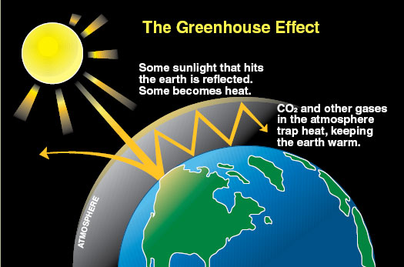
Climate Change
Greenhouse gasses
CO₂ and water vapor

Slide 3
Climate Change
How is CO₂ released into the atmosphere?
Think about the carbon cycle
Water vapor is formed by evaporation from oceans and the transpiration from plants
How is it removed from the atmosphere?
Water absorbs a lot of heat

Slide 4
Climate Change
Other green house gases include:
Methane – released from marshes, landfills, extraction of fossil fuels, and melting ice in polar regions
Nitrous oxide – released by bacteria in some habitats, agriculture, and vehicle exhausts
All the greenhouses together make up less than 1% of the atmosphere

Slide 5
Climate Change
The surface of the earth absorbs short wave energy from the sun
That energy is then re-emited at longer wavelengths
Greenhouse gases absorb long wave radiation

Slide 6
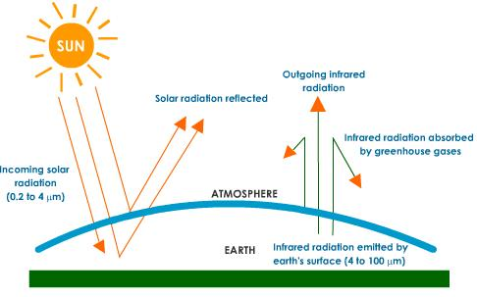
Climate Change
What happens to the radiation from the sun?
25 – 30% is absorbed by ozone (UV)
70-75% reaches the surface of the earth and is converted to heat
Re-emitted as longer wave radiation
70-85% is absorbed by greenhouse gases
The energy is re-emitted to earth causing warming

Slide 7
Climate Change
Two factors determine the warming impact of greenhouse gases
How readily the gas absorbs long wave radiation
The concentration of the gas in the atmosphere
Example – methane causes more warming per molecule but its concentration is lower while carbon dioxide causes less warming per molecule but is higher in concentration

Slide 8
Climate Change
Scientists study carbon dioxide extensively because its amount in the atmosphere has fluctuated.
Why does the fact that it has fluctuated mater?
Ice cores are used to measure past carbon dioxide concentrations and temperatures
Correlations between carbon dioxide concentrations and temperature have been found

Slide 9
Climate Change
Based off of what scientists have found we could expect that an increase in any greenhouse gas concentration would also lead to an increase in temperature
Not directly proportional due to other factors
Cycles in earths orbit
Sunspot activity

Slide 10
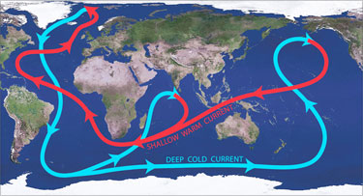
Climate Change
An increase in temperature impacts other aspects of climate
Increase in evaporation → increase in rain and thunderstorms
Increase in ocean temps → increase in storms and hurricanes
Not all areas will become warmer
Circulation of the ocean would cause some areas to be colder such as the west coast of Ireland and Scotland

Slide 11
Climate Change
There is a correlation between rising concentrations of carbon dioxide in the atmosphere and the industrial revolution
Prior to the late 18th century the concentration of CO₂ was 260-280ppm
Late 18th century the industrial revolution was starting
Main impact was late 20th century
Most rise after 1950’s

Slide 12
Climate Change
Recent increases are correlated to increased combustion of fossil fuels after the 1950’s

