Slide 1
Gas Exchange
The Respiratory System

Slide 2
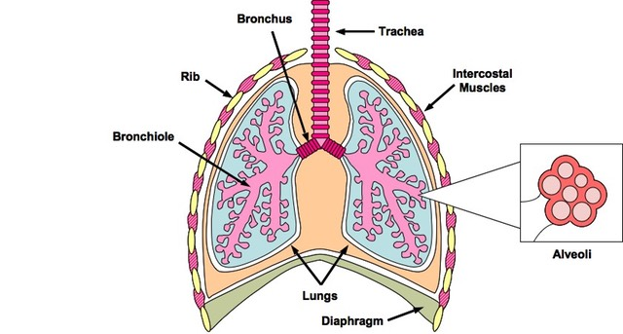
Structure
Trachea → bronchi → bronchiole → alveoli

Slide 3
Overall
Oxygen → blood
Carbon dioxide → lungs
Movement based on concentration gradient

Slide 4
Processes
What is the difference between ventilation, gas exchange, and cell respiration?

Slide 5
Ventilation
Why is a ventilation system important?
Concentration
ATP
Waste removal

Slide 6
Alveoli
Site of gas exchange
Structure and Function
Thin wall
Rich capillary network
Increased SA:Vol ratio
Moist

Slide 7
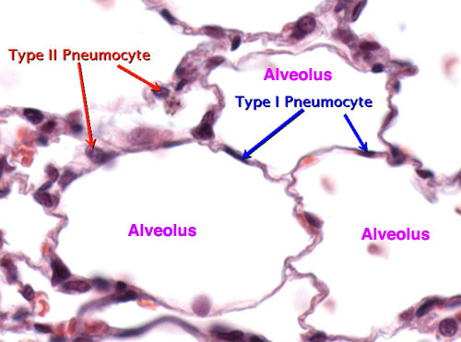
Pneumocytes
The surface epithelial cells of the alveoli
Two types
Type I pneumocytes
Type II pneumocytes

Slide 8
Ventilation Process
Muscle contractions cause pressure changes inside the thoracic cavity that force air in and out of the lungs to ventilate them.
Different muscles are required for inspiration and expiration because muscles only do work when they contract.
Antagonistic muscles

Slide 9
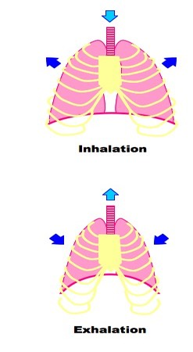
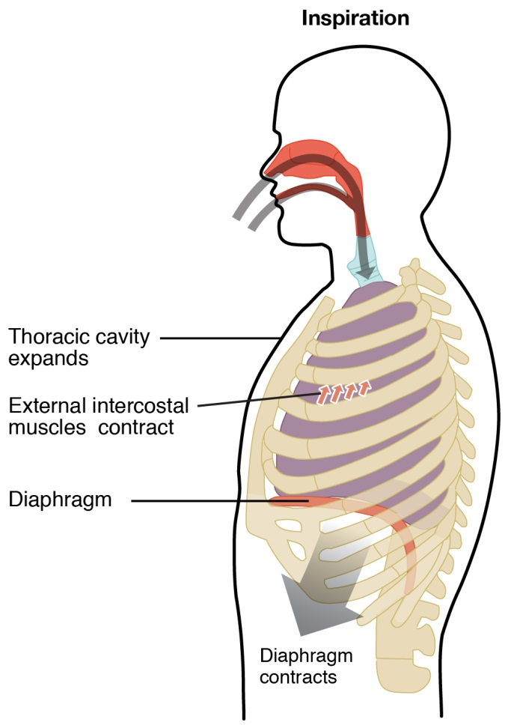
Inspiration
Diaphragm muscles contract and flatten downwards
External intercostal muscles contract, pulling ribs upwards and outwards
Increase in the volume of the thoracic cavity and lung volume
Pressure of air in the lungs is decreased below atmospheric pressure
Air flows into the lungs to equalize the pressure

Slide 10
Expiration
Diaphragm muscles relax and abdominal muscles contract, pushing diaphragm upwards
External intercostal muscles relax, allowing the ribs to fall
Internal intercostal muscles contract, pulling ribs downwards
Volume of the thoracic cavity and lung are decreased
Pressure of air in the lungs is increased above atmospheric pressure
Air flows out of the lungs to equalize the pressure

Slide 11
Lung Cancer
What causes lung cancer?
Smoking
Family history
Exposure to radon
Air pollution

Slide 12
Lung Cancer
Consequences
Shortness of breath
Coughing up blood
Pain
Metastasis

Slide 13
Emphysema
Chronic long-term lung disease
Causes

Slide 14
Emphysema
Consequences

Slide 15
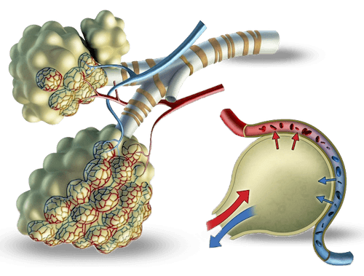
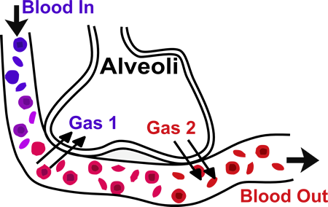
Skill
Students should be able to draw a diagram to show the structure of an alveolus and an adjacent capillary.

