Slide 1
Genetics
Topic 3 and 10

Slide 2
Genes
3.1

Slide 3
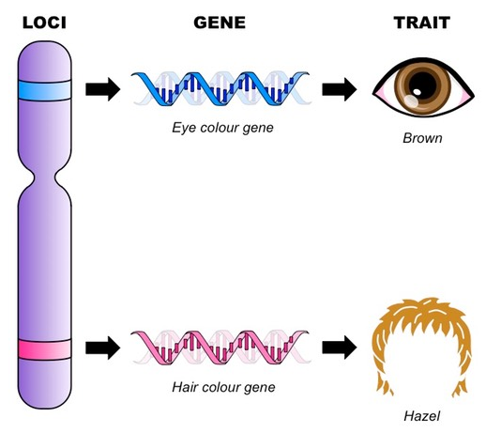
Genes
Genes
Loci

Slide 4
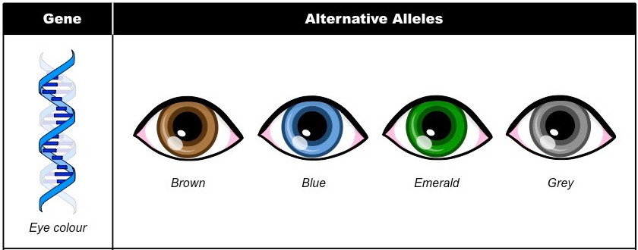
Alleles
Alleles are specific forms of a gene that code for the different variations of a trait
Gene =
Allele =

Slide 5
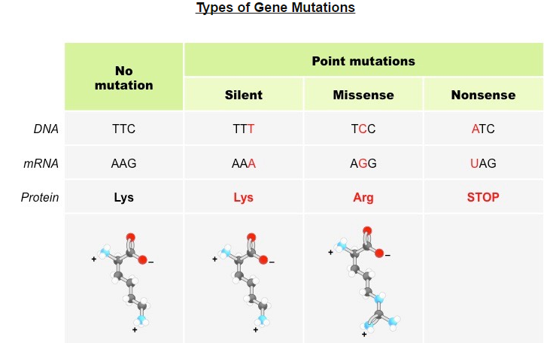
Alleles
New alleles are formed by mutations
Gene mutation

Slide 6
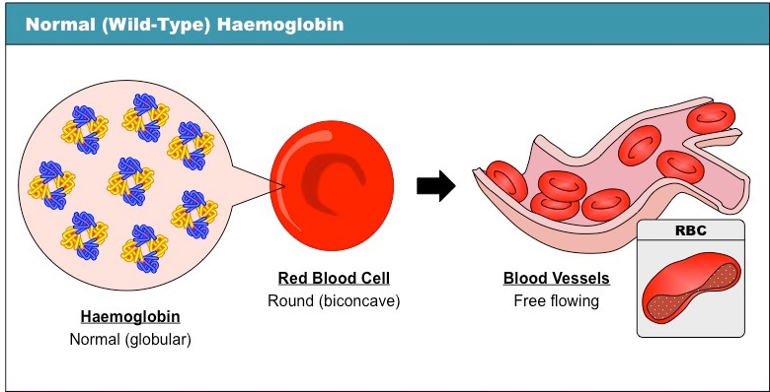
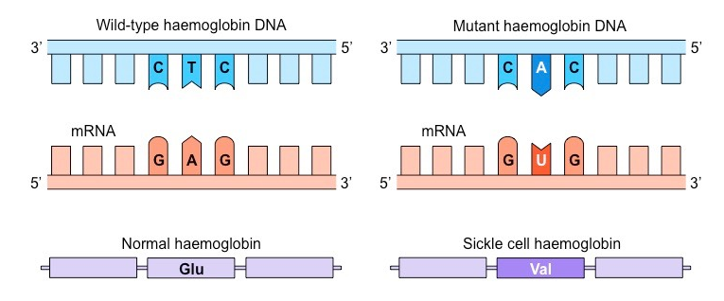
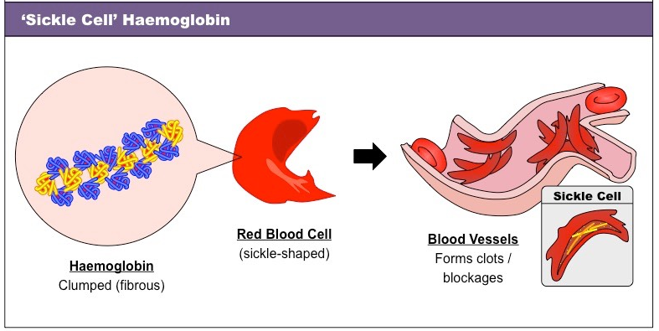
Sickle Cell

Slide 7
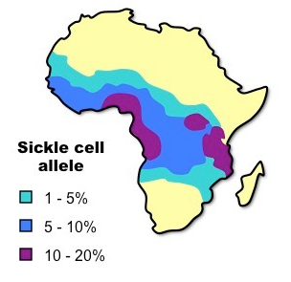
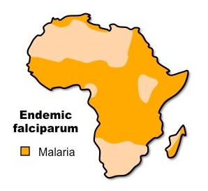
Sickle Cell and Malaria
In areas where malaria is common, there is a higher incidence of people who carry both alleles (heterozygous)
This condition whereby the presence of both alleles is beneficial is known as heterozygous advantage

Slide 8
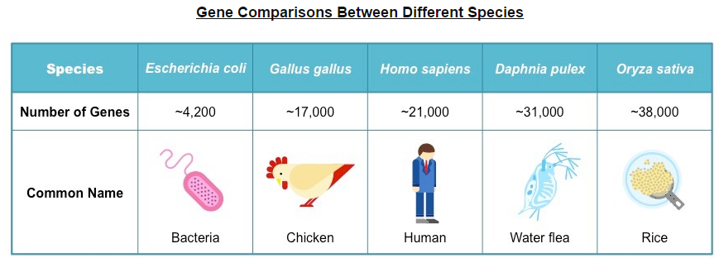
Genome
The genome is the totality of genetic information of a cell, organism, or organelle
The human genome consists of:
46 chromosomes
~3 billion base pairs
~21,000 genes

Slide 9
Chromosomes
3.2

Slide 10
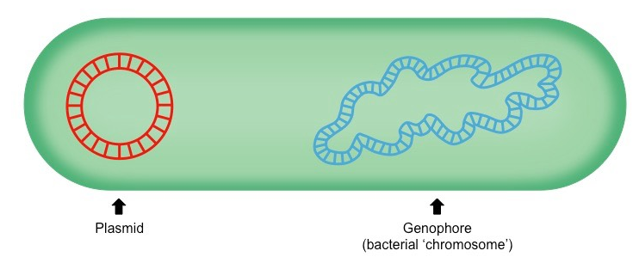
Prokaryotes
Nucleoid
Genophore
The DNA of prokaryotic cells is naked
Plasmids

Slide 11
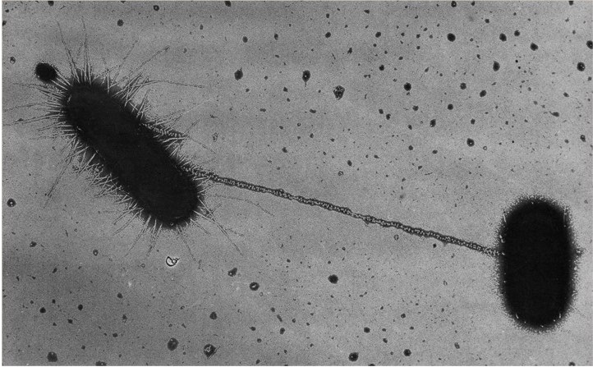
Prokaryotes
Plasmids contain only a few genes and are capable of self-replication
Bacterial conjugation
Horizontal gene transfer
This makes them ideal for gene manipulation

Slide 12
Eukaryotes
Linear molecules of DNA that are associated with histone proteins
The packaging of DNA with histone proteins results in a greatly compacted structure, allowing for more efficient storage

Slide 13
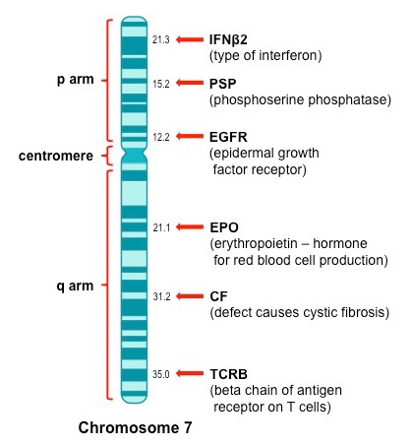
Chromosomes
Centromere
P arm
Q arm
The region in which a locus is positioned can be identified via three points of reference:
First is the number (or letter) of the chromosome(e.g. 7q31 refers to chromosome 7)
Second is the arm letter (p or q) (e.g. 7q31 is on the q arm)
Third is a number corresponding to the G band location (e.g. 7q31 is at the longitudinal position 31)

Slide 14
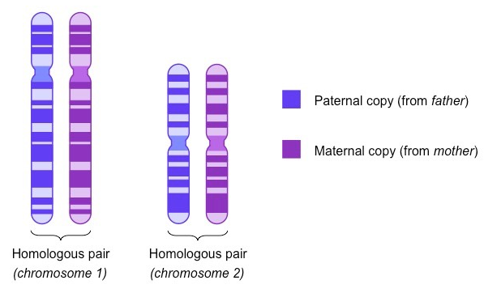
Homologous Chromosomes
Sexually reproducing organisms inherit their genetic sequences from both parents
Homologous chromosomes
Homologous chromosomes must be separated in gametes

Slide 15
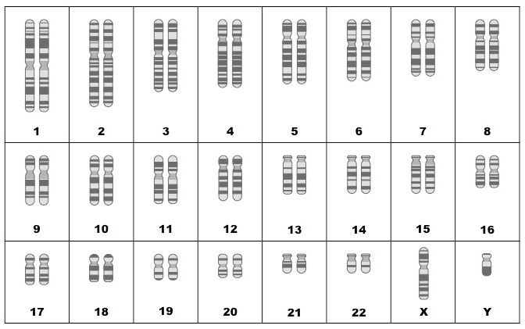
Chromosomes
Autosomes
Sex chromosomes
XY is male
XX is female

Slide 16
Diploid vs Haploid
Nuclei possessing pairs of homologous chromosomes are diploid
2n
These nuclei will possess two gene copies (alleles) for each trait
All somatic (body) cells in the organism will be diploid, with new diploid cells created via mitosis
Most plants and animals
Nuclei possessing only one set of chromosomes are haploid
n
These nuclei will possess a single gene copy (allele) for each trait
All sex cells (gametes) in the organism will be haploid, and are derived from diploid cells via meiosis
Bacteria (asexual) and fungi (except when reproducing)

Slide 17
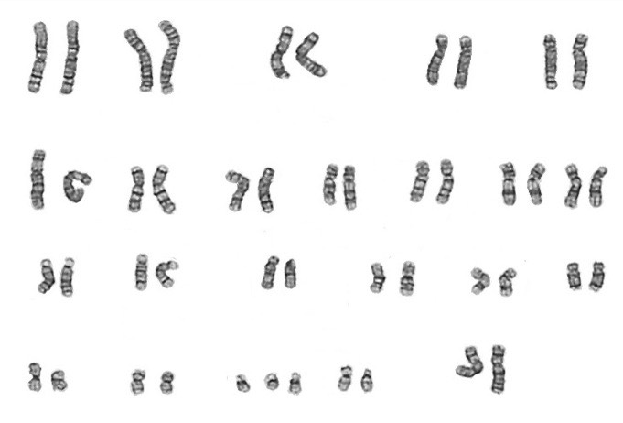
Karyogram
Karyograme
Karyotyping will typically occur prenatally
Down syndrome is a condition whereby the individual has three copies of chromosome 21 (i.e. trisomy 21)

Slide 18
Chromosomes Size
John Cairns pioneered a technique for measuring the length of DNA molecules by autoradiography
Cells are grown in a solution containing radioactive thymidine (tritiated thymidine – ³H-T)
The tritiated thymidine is incorporated into the chromosomal DNA of the cell (³H-T is used as thymidine is not present in RNA)
The chromosomes are isolated by gently lysing the cells and fixing the chromosomes to a photographic surface
The surface is then immersed in a radioactively-sensitive emulsion containing silver bromide (AgBr)

Slide 19
Chromosome Size
The radiation released from the tritiated thymidine converts the Ag⁺ ions in silver bromide into insoluble metal grains

Slide 20
Chromosome Size
Following a period of exposure, excess silver bromide is washed away, leaving the silver grains to appear as small black dots
When the photographic film is developed, the chromosomal DNA can be visualized with an electron microscope

Slide 21
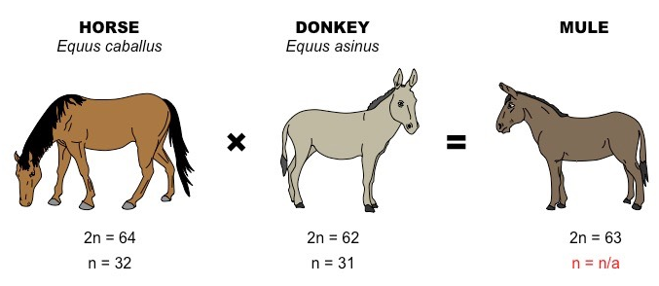
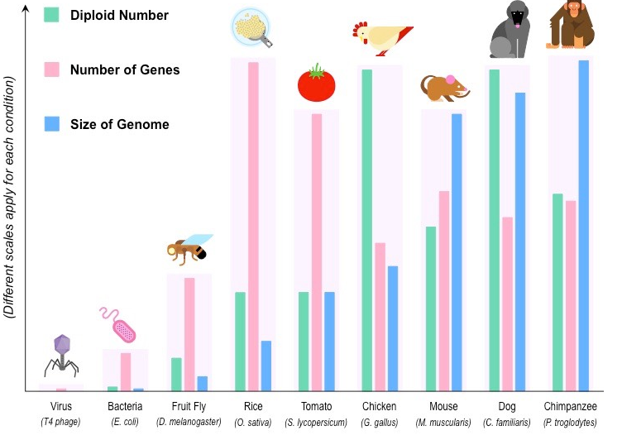
Chromosome number

Slide 22
Meiosis

Slide 23
Meiosis
Meiosis is the process by which sex cells (gametes) are made
It involves the reduction division of a diploid cells into four genetically different haploid nuclei
The process of meiosis consists of two cellular divisions:

Slide 24
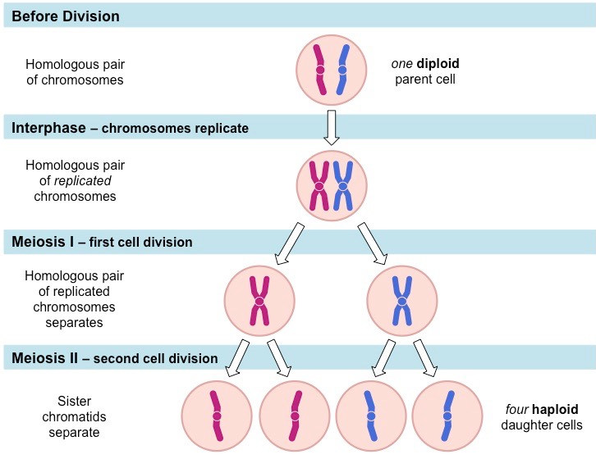
Meiosis

Slide 25
Diploid vs Haploid
Nuclei possessing pairs of homologous chromosomes are diploid
2n
These nuclei will possess two gene copies (alleles) for each trait
All somatic (body) cells in the organism will be diploid, with new diploid cells created via mitosis
Most plants and animals
Nuclei possessing only one set of chromosomes are haploid
n
These nuclei will possess a single gene copy (allele) for each trait
All sex cells (gametes) in the organism will be haploid, and are derived from diploid cells via meiosis
Bacteria (asexual) and fungi (except when reproducing)

Slide 26
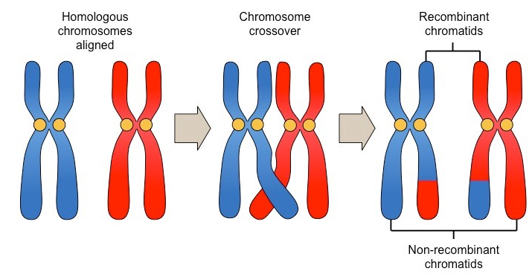
Crossing Over
Prophase I
Synapsis
Bivalent (tetrad)
Chiasmata
As a result of this exchange of genetic material, new gene combinations are formed on chromatids (recombination)

Slide 27
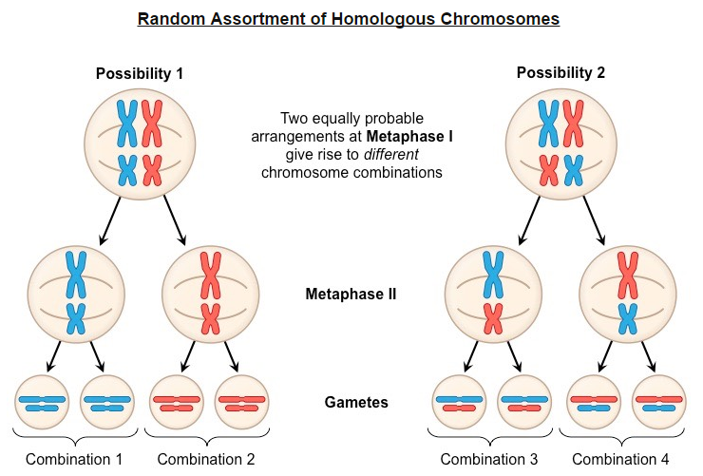
Random Assortment

Slide 28
Genetic Variation
The advantage of meiotic division and sexual reproduction is that it promotes genetic variation in offspring
The three main sources of genetic variation arising from sexual reproduction are:

Slide 29
Nondisjunction
Non-disjunction refers to the chromosomes failing to separate correctly, resulting in gametes with one extra, or one missing, chromosome (aneuploidy)

Slide 30
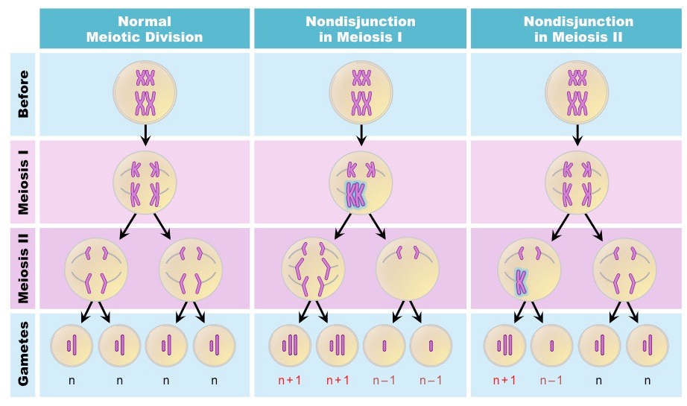
Nondisjunction

Slide 31
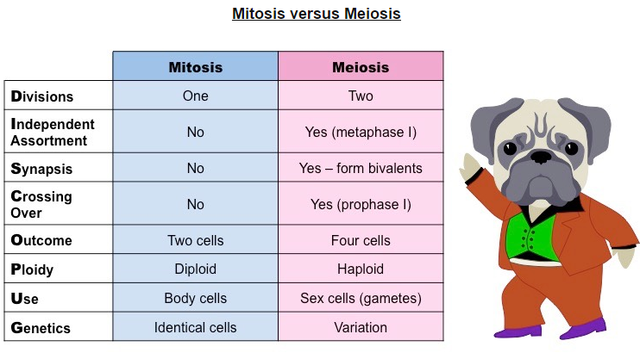
Mitosis Vs Meiosis

Slide 32
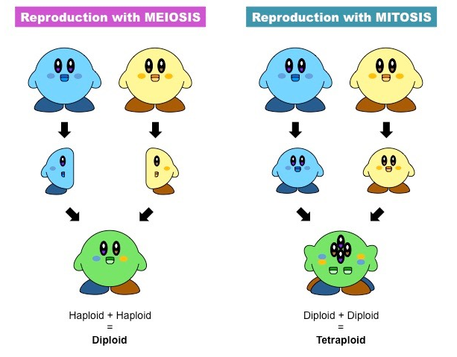
Polypoloidy
Polyploidy is a condition whereby an organism has more than two complete sets of chromosomes in all cells (i.e. > diploid)

Slide 33
Types of Inheritance you need to know
Dominant
Recessive
Co-dominant
Incomplete dominant
Sex-linked
Blood Type
Dihybrid (linked and unlinked)

Slide 34
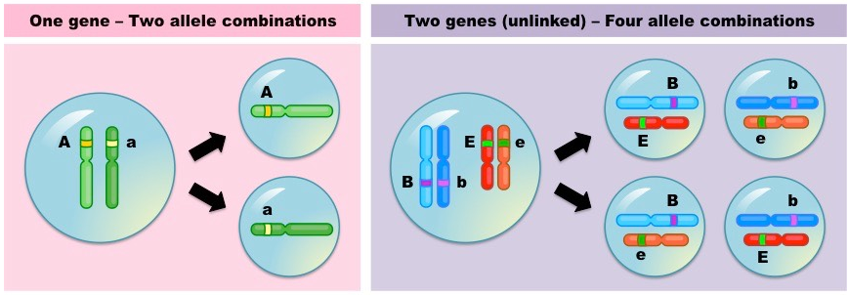
Unlinked Genes
Independent (random) assortment allows pairs of alleles to be inherited independently of one another if their gene loci are on separate chromosomes – these genes are said to be unlinked

Slide 35
Linked Genes
A linkage group is a group of genes whose loci are on the same chromosome and don’t independently assort
Linked genes will tend to be inherited together and don’t follow normal Mendelian inheritance
Linked genes may become separated via recombination

Slide 36
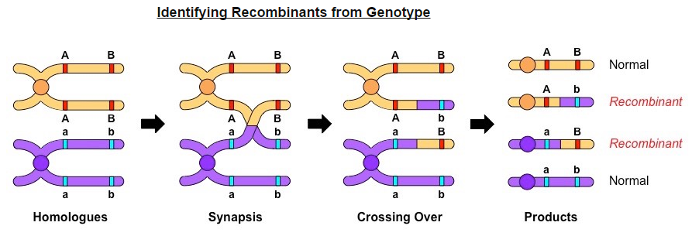
Linked Genes
Recombinants of linked genes are those combinations of genes not found in the parents

Slide 37
Pedigrees
Circle = female
Square = male
Shaded = affected
Half shaded = carrier (is not always represented)

Slide 38
Pedigrees
Autosomal Dominant
Trait should not skip generations
Close to equal distribution between sexes
Autosomal Recessive
Often skips generations
Close to equal distribution between sexes
If both parents are affected all children must be
Sex linked dominant
Should not skip generations
Affected males have affected mothers
All daughters of affected fathers are affected
If a daughter is affected the mother or father must be affected
Sex linked recessive
Most affected individuals are males
If a daughter is affected than the father must be and the mom must at least be a carrier
If mother is affected all sons must be

