Slide 1
Meiosis
Formation of gametes

Slide 2
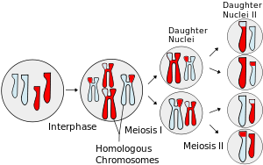
Meiosis
Results
Gametes
Haploid v diploid
Genetic variation

Slide 3
Meiosis
DNA replication and chromosome replication still happen in interphase
Two divisions
Same stage names as mitosis
Meiosis I – reduction
Meiosis II – similar to mitosis

Slide 4
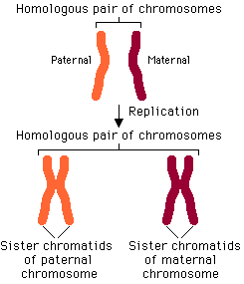
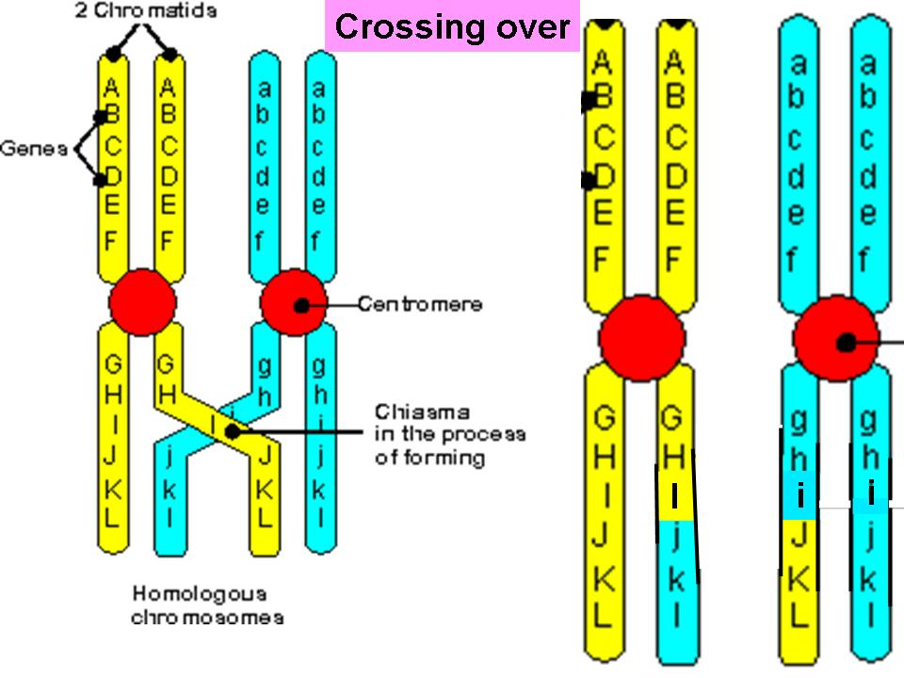
Meiosis I
Homologous chromosomes
Crossing over (prophase I)
Chiasma

Slide 5
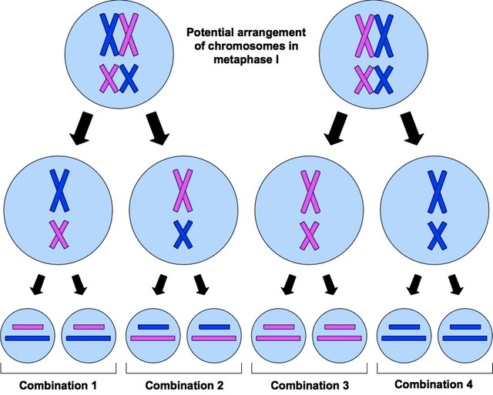
Meiosis I
Independent Assortment

Slide 6
Genetic Variation
Crossing over
Independent assortment
Fusion of gametes
Haploid → diploid

Slide 7
Stages (135-136)
Draw each stage of meiosis explain each
The following terms should be used when appropriate
Homologous chromosomes
Centromere
Spindle fibers
Sister chromatids
Nucleus
Crossing over
Chiasma

Slide 8
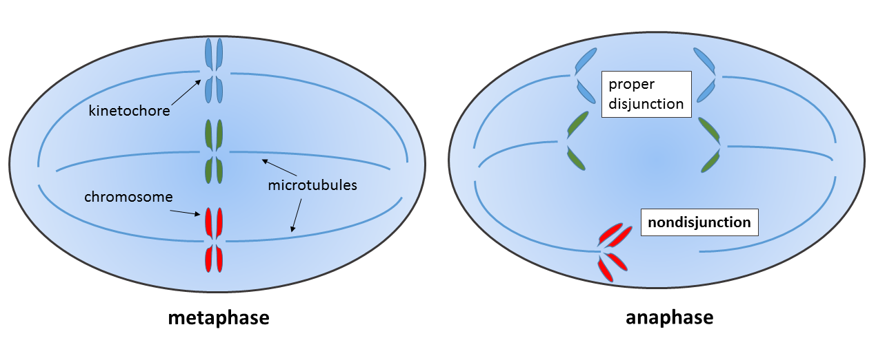
Nondisjunction

Slide 9
Nondisjunction

Slide 10
Karyotype

Slide 11
Karyotypes
Chorionic villus sampling
Small sample of the placenta is taken
11th – 13th week of pregnancy
Amniocentesis
A sample of the amniotic fluid (surrounds fetus) is taken
3 - .5% chance of miscarriage when in the 2nd trimester
Can be done at 12-14 weeks but there is an increased risk of miscarriage

Slide 12
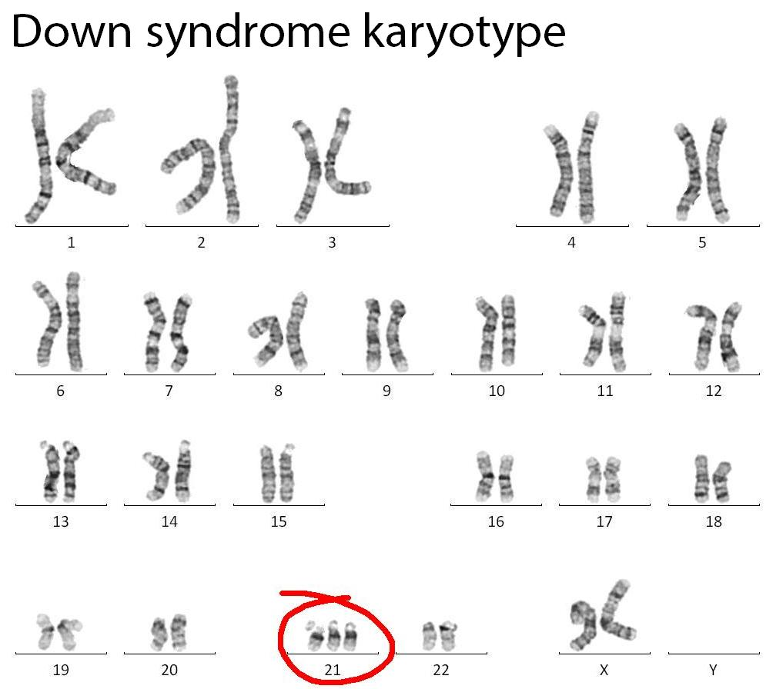
Karyotypes

