Slide 1
Photosynthesis

Slide 2
Formula
6CO₂ + 6H₂O + light energy 6O₂ + C₆H₁₂O₆

Slide 3
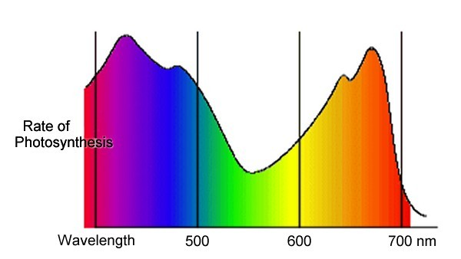
Light

Slide 4
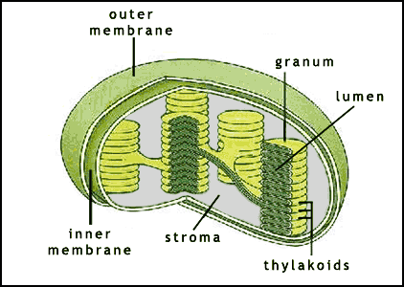
Where is photosynthesis?

Slide 5
The Chloroplast
Structure and function

Slide 6
Chloroplast
Structure and function relationship
Chloroplasts absorb light
Chloroplasts produce ATP by photophosphorylation
Chloroplast carry out chemical reactions of the Calvin cycle

Slide 7
Two parts
Light Dependent
Light Independent
The light dependent reaction takes light energy and turns it into chemical energy that the cell can use
Reactants: Light energy + H2O + ADP + NADP +
Products: ATP + NADPH + O2
The light independent reaction uses the ATP and NADH produced to make glucose
Reactants: ATP + NADPH + CO2
Products: Glucose

Slide 8
Light Dependent Reaction

Slide 9
Photosystem II
Chlorophyll a
Photolysis
PSII
H20 + light energy → H+ + O + e-

Slide 10
Primary electron acceptor
e-
PSII
H20 + light energy → H+ + O + e-

Slide 11
Electron transport chain
Middle Carrier = cytochrome
Chemiosmosis
Phosphorylation
Primary electron acceptor
ADP
2e-
ATP
PSI
PSII
H20 + light energy → H+ + O + e-

Slide 12
Primary electron acceptor
ADP
2e-
ATP
PSI
PSII
H20 + light energy → H+ + O + e-

Slide 13
Primary electron acceptor
Primary electron acceptor
ADP
2e-
2e-
ATP
PSI
PSII
The void left by the electron leaving PS I is filled by the de-energized electron from PSII
H20 + light energy → H+ + O + e-

Slide 14
Primary electron acceptor
Primary electron acceptor
2e-
NADPH
ADP
2e-
NADP+
2e-
ATP
PSI
ETC - ferredoxin
NADP reductase of the electrons from ferredoxin oxidized
NADP+ reduced to NADPH
PSII
H20 + light energy → H+ + O + e-

Slide 15
Primary electron acceptor
Primary electron acceptor
2e-
NADPH
ADP
2e-
NADP+
2e-
ATP
PSI
PSII
H20 + light energy → H+ + O + e-

Slide 16
Chemiosmosis
Respiration chemiosmosis | Photosynthesis chemiosmosis
Involves ETC in cristae | Involves ETC in thylakoids
Energy released by passing of electrons | Energy is released by passing of electrons
Energy is used to pump H+ into intermembrane space | Energy is used to pump H+ into the thylakoid space
H+ come from matrix | H+ come from stoma
H + diffuse back into the matrix through channels of ATP synthase | H + diffuse back into the stroma through channels of ATP synthase
ATP synthase catalyses the oxidative phosphorylation of ADP to ATP | ATP synthase catalyses the oxidative photophosphorylation of ADP to ATP

Slide 17
Light independent
Summary:
Reactants: Light energy + H2O + ADP + NADP +
Products: ATP + NADPH + O2
Photosystem II makes ATP
Photosystem I makes NADPH

Slide 18
Light independent
Takes ATP and NADPH from the light dependent reaction
Main reactant is CO2

Slide 19
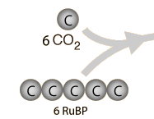
6 C unstable compound

Slide 20
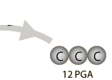
6 C unstable compound
12 G3P

Slide 21
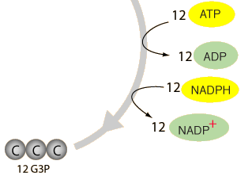
6 C unstable compound
12 G3P
12 Triose phosphate

Slide 22
6 C unstable compound
10 Triose phosphate

Slide 23
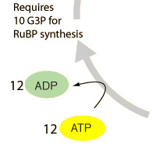
6 C unstable compound
TP
6
6
10 Triose phosphate

Slide 24
6 C unstable compound
TP
6
6
10 Triose phosphate

Slide 25
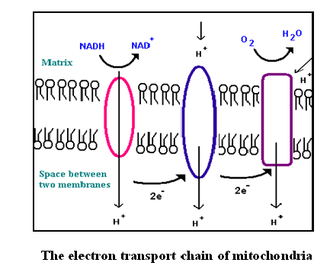
Chemiosmosis

