Slide 1
Photosynthesis and Cellular Respiration Intro

Slide 2
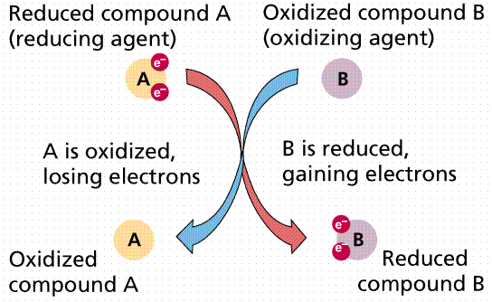
Reactions
Catabolic
Anabolic
Oxidation
Reduction

Slide 3
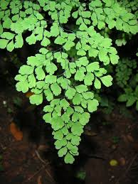
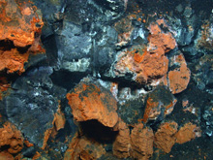
Autotrophs
What do autotrophs do?
Photoautotrophs
Chemoautotrophs
What is the opposite of an autotroph?

Slide 4
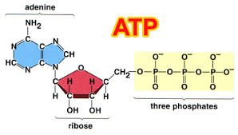
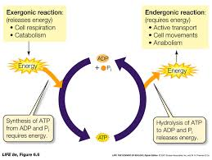
ATP
Cellular energy is stored in ATP

Slide 5
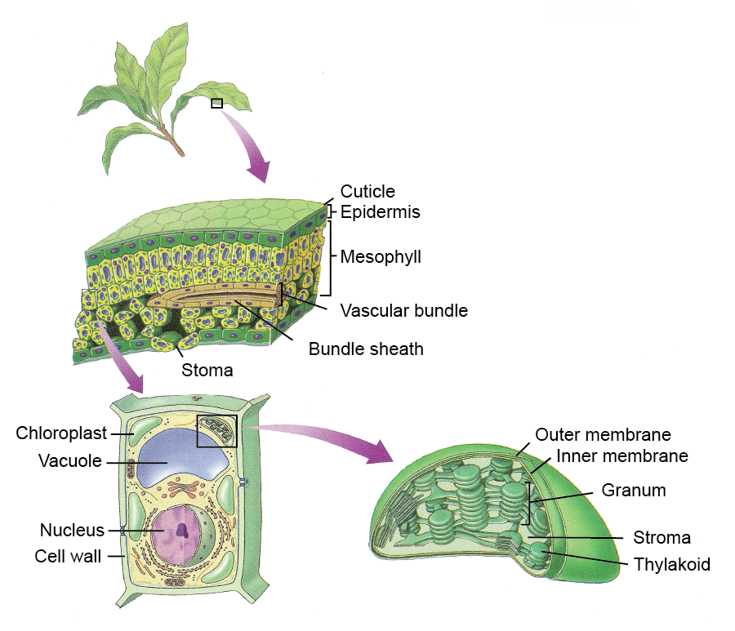
Photosynthesis
Leaf
Palisade mesophyll
Chloroplast

Slide 6
Photosynthesis
CO2 + H2O → C6H12O6 + O2
Is this equation balanced?????

Slide 7
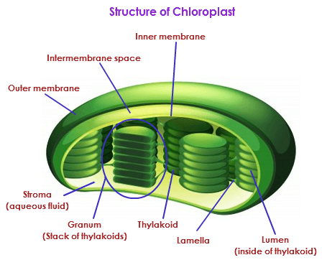
Photosynthesis
Light Dependent
Light + H2O → ATP + O2
Light Independent
ATP + CO2 → C6H12O6

Slide 8
Cellular Respiration
C6H12O6 + O2 + →H2O + CO2 + ATP

Slide 9
Cellular Respiration
Anaerobic
Aerobic

Slide 10
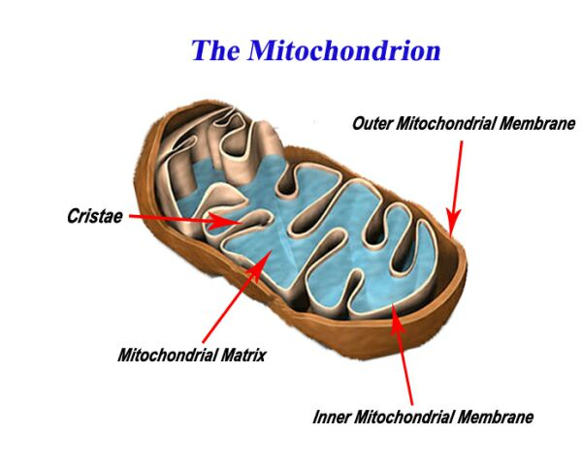
Cellular Respiration
Glycolysis
Anaerobic
Cytoplasm
Kreb’s Cycle
Aerobic
Matrix
Electron Transport Chain
Aerobic
Inner membrane

Slide 11
