Slide 1
Plant Science
9.3 Growth in Plants

Slide 2
Plant Growth
Indeterminate vs determinant growth
Which type of growth do plants show?

Slide 3
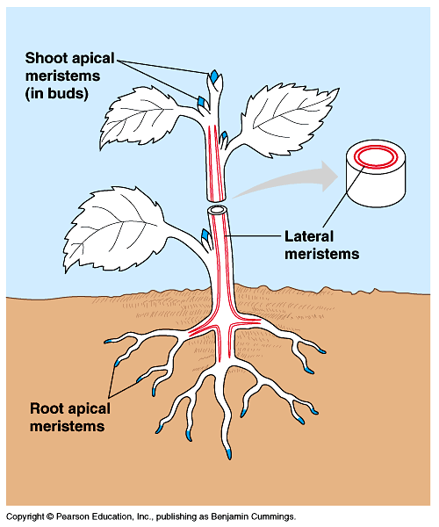
Plant Growth
Meristems
Apical or primary meristems
Leaf, flowers, shoots, roots
Lateral meristems or cambium

Slide 4
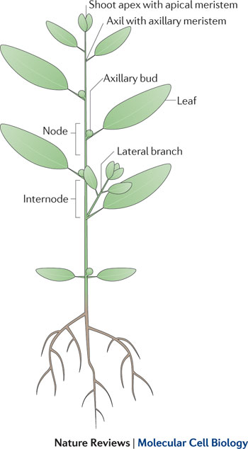
Plant Growth
Mitosis in the shoot apex allows extension of the stem and development of leaves
What is mitosis?
What are the products of mitosis?
What are the steps of mitosis?

Slide 5
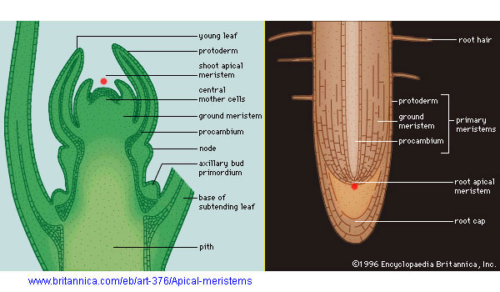
Plant Growth
Apical meristems
Protoderm
epidermis
Procambium
vascular
Ground
pith

Slide 6
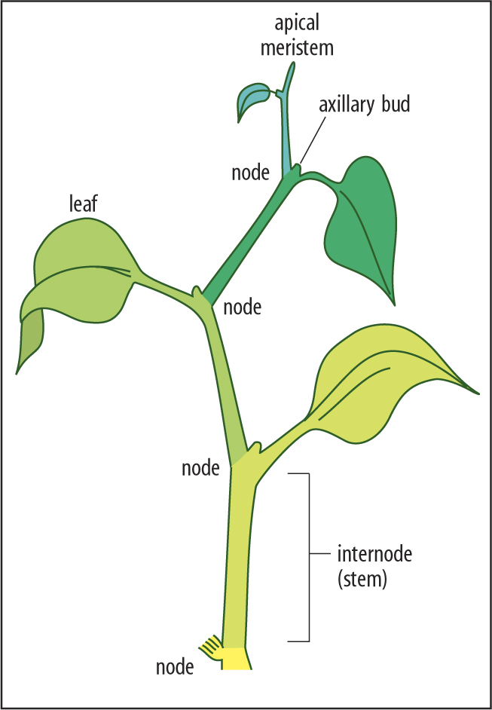
Plant Growth
Auxin initiates the growth of roots and development of fruits and leaves
Indole-3-Acitic acid (IAA)
Stimulate or inhibit
Auxiliary bud growth
Further the node means there is a lower auxin concentration

Slide 7
Plant Growth
Tropisms
Positive
Negative
Photo
Gravi

Slide 8
Plant Growth
Auxin influences cell growth rates by changing the pattern of gene expression
Absorption by phototropins
Specific wavelengths cause conformation change
Allow binding to receptors that control transcription
PIN3 (transport auxin) impacted

Slide 9
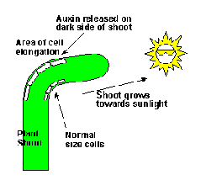
Plant Growth
Phototropins detect light on one side then auxin is transported to the other side (shaded side)

Slide 10
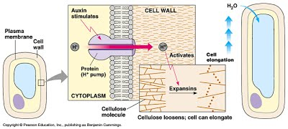
Plant Growth
Auxin efflux pumps can set up concentration gradients of auxin in plant tissue
Auxin causes transport of hydrogen ions from cytoplasm to cell wall;
decrease in pH / H+ pumping breaks bonds between cell wall fibers;
makes cell walls flexible/extensible/plastic

Slide 11
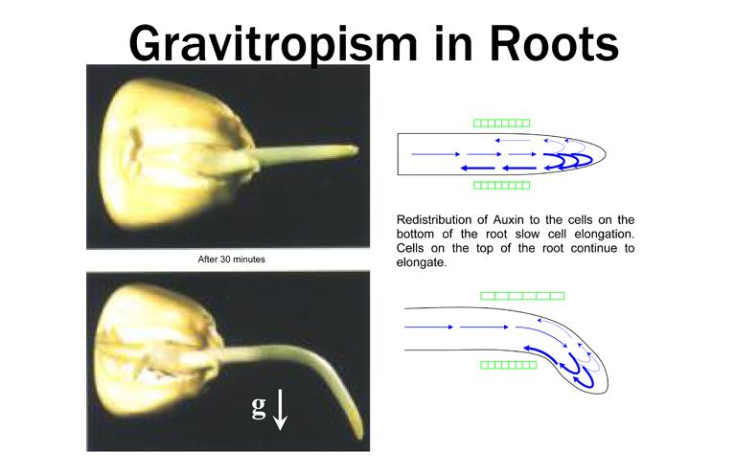
Plant growth
Gravitropism
Auxin dependent
Statoliths
PIN3 and auxin
Auxin effect in root vs shoot

Slide 12
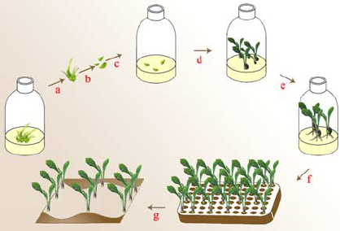
Plant Growth
Micropropagation
produces large number of cloned identical plants
depends on the totipotency of pant tissues
Process:
Tissues from the stock plant are sterilized and cut into pieces called explants
The explant is placed into a sterilized growth medium that contains plant growth hormones (auxin and cytokinin)
If ratio of auxin to cytokinin is 50:50, and undifferentiated cell mass called a callus forms
If ratio of auxin to cytokinin is greater than 10:1, a roots develop (rooting media)
If the ratio is less than 10:1 shoots develop (shooting media)
Once the plant has roots and shoots, it can be transferred to soil

Slide 13
Plant Growth
Why is micropropagation important?
Micropropagation of plants, allows for the production of virus free strains of plants
It can also be used to produce plants with desirable characteristics much faster using less space
You can also store little plantlets for long periods of times in liquid nitrogen, which would be valuable with endangered species

Slide 14
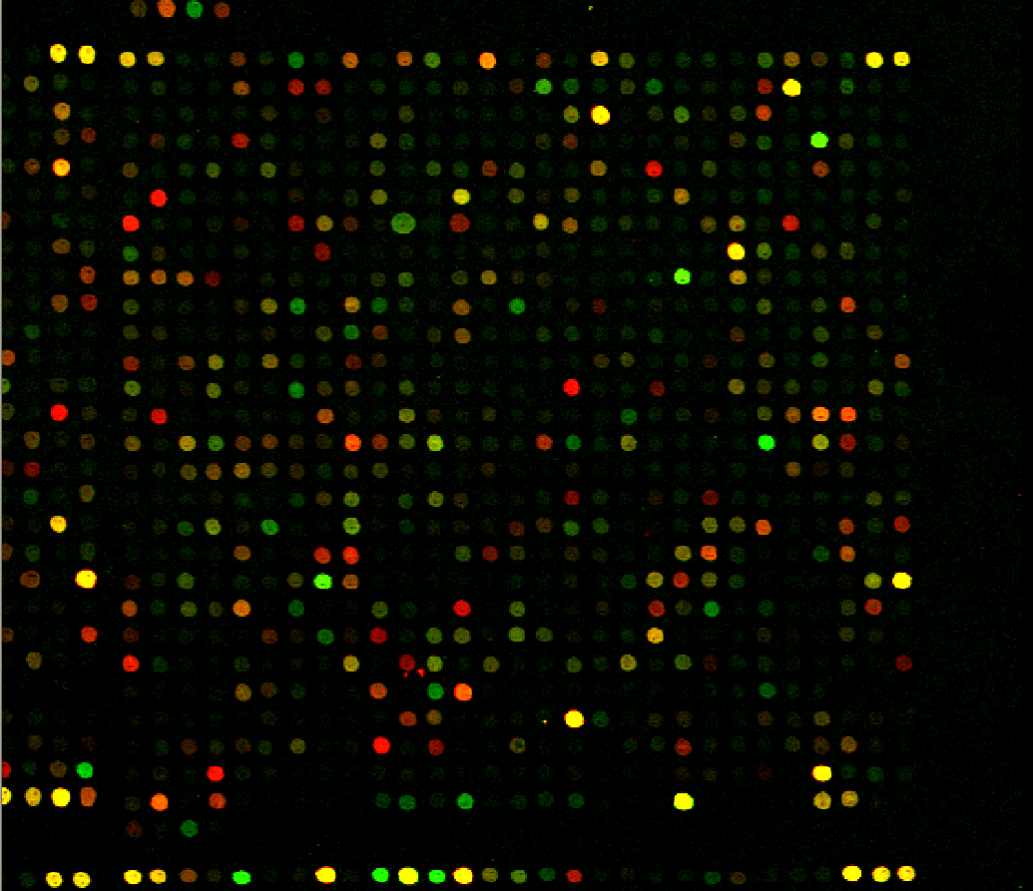
Plant growth
How were the roles of hormones discovered in plants?
Study of trace amounts of substances and gene expression
Microarray

