Slide 1
Plant Science
9.4 Reproduction in Plants

Slide 2
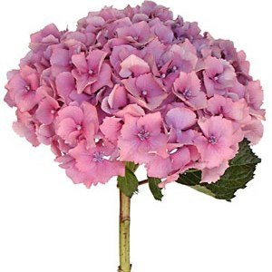
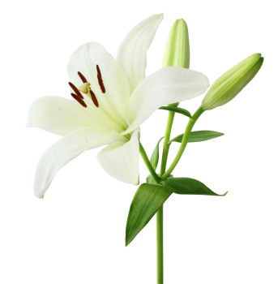
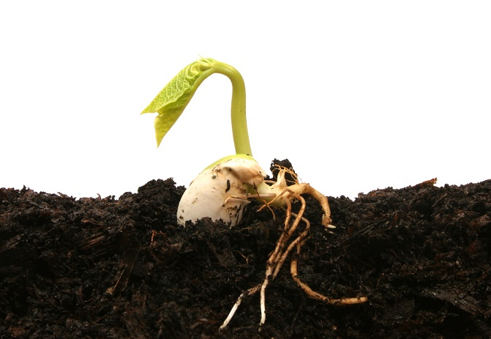
Reproduction in Plants
Vegetative phase
Reproductive phase
Flowers
Sexual reproduction
How does the shoot become flower producing instead of leaf producing?

Slide 3
Reproduction in Plants
Flowering involves a change in gene expression in the shoot apex.
Day length is measured by light-sensitive pigments
FT (flowering time) protein
flowering factors in shoot apical meristem triggered
cells differentiate in flower bud cells

Slide 4
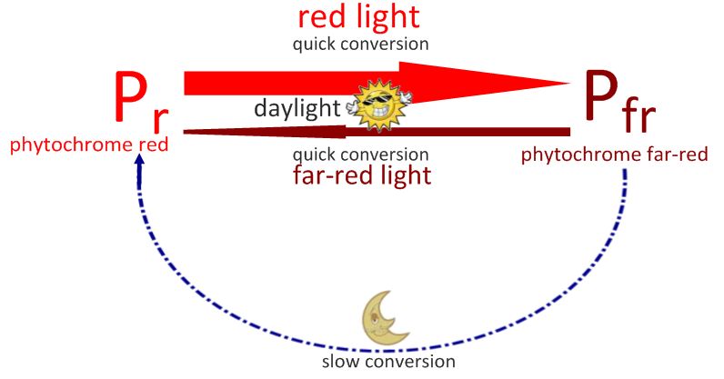
Reproduction in Plants
The switch to flowering is a response to the length of light and dark periods in many plants.
Phytochrome is a pigment that exists in plants in two forms:
P_{R}, absorbs white/red light
P_{FR}, absorbs dark/far-red light
When absorbing light P_{R}→P_{FR}
In absence of light P_{FR} → P_{R}

Slide 5
Reproduction in Plants
Short-day plants flower in the fall
Long night
P_{FR} is an inhibitor of flowering in short-day plants
Long-day plants flower in the summer
Short night
P_{FR} is a promoter of flowering in long-day plants

Slide 6
Reproduction in Plants
Can we grow flowers out of season?
How?

Slide 7
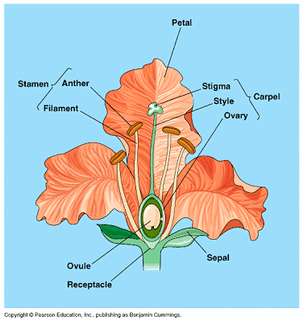
Reproduction in Plants

Slide 8
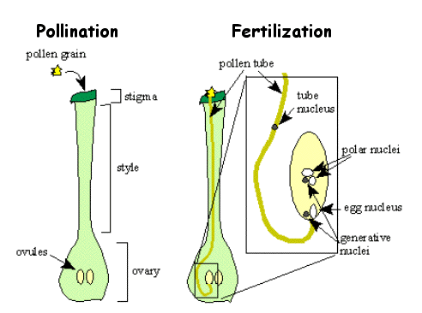
Plant Reproduction
Success in plant reproduction depends on pollination, fertilization and seed dispersal

Slide 9
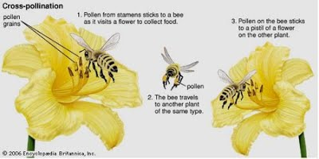
Plant Reproduction
Mutualistic relationships for reproduction

Slide 10
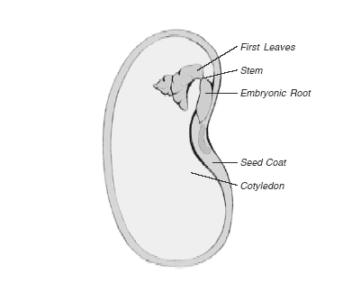
Plant Reproduction
Be able to draw the internal structure of a seed
Cotyledons are the embryo leaves and contain food reserves
Seed coat can be called testa
Embryo root also called radicle
Embryo shoot also called plumule

