Slide 1
Topic 1
Statistical Analysis

Slide 2
Statistics and Data (pg 2)
What is statistics?
Why do we use statistics?

Slide 3
Data
How is data collected in science?
There are two types of data
Quantitative
Qualitative

Slide 4
Qualitative Data
When collecting data you have to take into consideration the limitations of your measuring equipment
How do you know the limitations?

Slide 5
Qualitative Data
What if you don’t know the limitations?

Slide 6
Data
In any experiment there should be an independent variable and a dependent variable

Slide 7
Basics Statistics
Mean - Average of data points
(4+6+8)/3 = 6
Range – measure of the spread of data
4,6,8 to find range 8-4=4

Slide 8
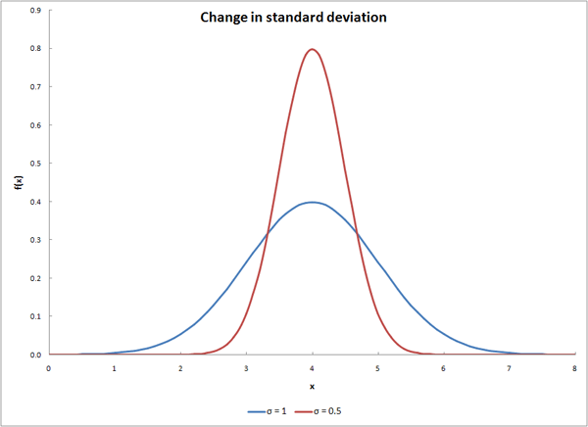
Standard Deviation and Graphing (pg4)
Clustered around the mean
Spread out
X

Slide 9
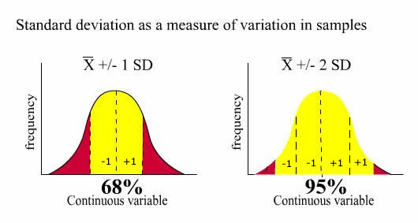
Standard Deviation
2SD
68% of all the data values (measurements) in a sample can be found between the mean +/- 1 standard deviation

Slide 10
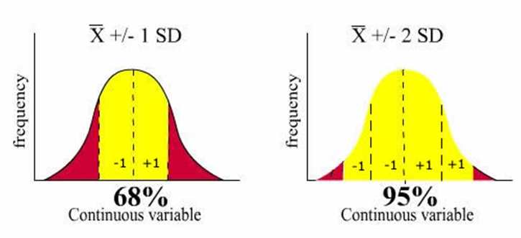
Standard Deviation
So if I said that in my Honors Biology class the average exam grade was an 85 with a standard deviation of 3.4 that means that 68% of students scored between a 81.6 and 88.4.
95% of students would fall in two standard deviations (between 78.2 and 91.8)

Slide 11
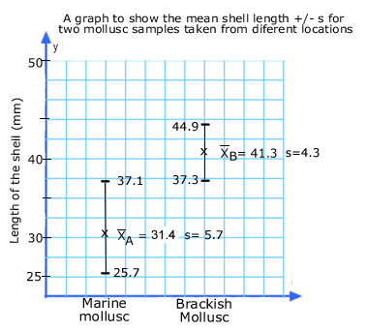
Standard Deviation and Graphing (pg 4)
Error bars – Visual representation of the variability of data. Can show range or standard deviation.

Slide 12
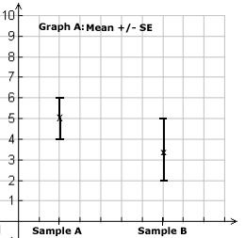
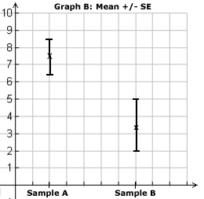
Error bars

Slide 13
Graphing
Title must include the dependent and independent variable
Both axis labeled with units
Always graph the mean
Always include error bars
Make a key when needed

Slide 14
t-test and Correlation (pg 6)
The t-test assesses whether the means of two groups are statistically different from each other.
In biology the critical probability is usually taken as 0.05 (or 5%). This means the difference is due to chance 5% of the time
If P > 5% then the two sets are the same
If P < 5% then the two sets are different

Slide 15
Correlation v. Causation
What is correlation?
What is causation?
Does correlation imply causation?

